Slide 1




Self Driving cars dilemma debate
Global Recruitment Team
@UniRdg_Outreach

Slide 2
Aims and objectives
To understand debating and some key skills needed for it
To take part in a classroom debate concerning an ethical dilemma
Notes:
Go through aims and objectives
*OPTIONAL*: If you would like to expand this activity you can ask students to write their own definition of debating before going on to slide 3 where we give a definition.

Slide 3
Debating: what is it?
Debating is something you all will have some understanding and experience of, so what is it?
Debating is when people discuss matters (usually in a formal manner), looking at arguments both for and against the matter in discussion. Through debating different sides of an argument we are able to see others points of view and weigh up the positives and negatives of each option. Therefore, debating is often used as the starting point of decision making.
STARTER MINI TASK
Spend a few minutes to write down some of the key skills and qualities needed for debating
Notes:
Go through the definition and introduce the mini task. You can get students to do this independently or in pairs/small groups and feed back after a few minuets depending on your timings for the session.

Slide 4
Debating: skills
Through debating we use many ‘Transferable Skills’, which are skills that can be used and valuable in many different subjects and career pathways.
Due to the variety of topics and issues that can be debated it is very beneficial skill to practice and develop.
Some skills we use and develop through debating:
  Clear expression and communication
  Ability to challenge and defend ideas
  Independent research
  Critical thinking
  Public speaking
  Constructive criticism
Qualities needed for debating:
Respect
Patience
Confidence
An open mind
A good listener
Teamwork

Slide 5
DEBATE TIME
Notes:
Note – do make sure in advance that an activity like this is not triggering for anyone in the audience. Whilst the activity is in no way graphic or meant to focus on murder / death, it might not be appropriate for someone with has a family member who has suffered a car crash etc. (But in theory this activity should be totally fine and appropriate for KS3 and up).

Slide 6

Source: Ted Ed
Notes:
Video
https://www.youtube.com/watch?v=ixIoDYVfKA0 YouTube link

Slide 7
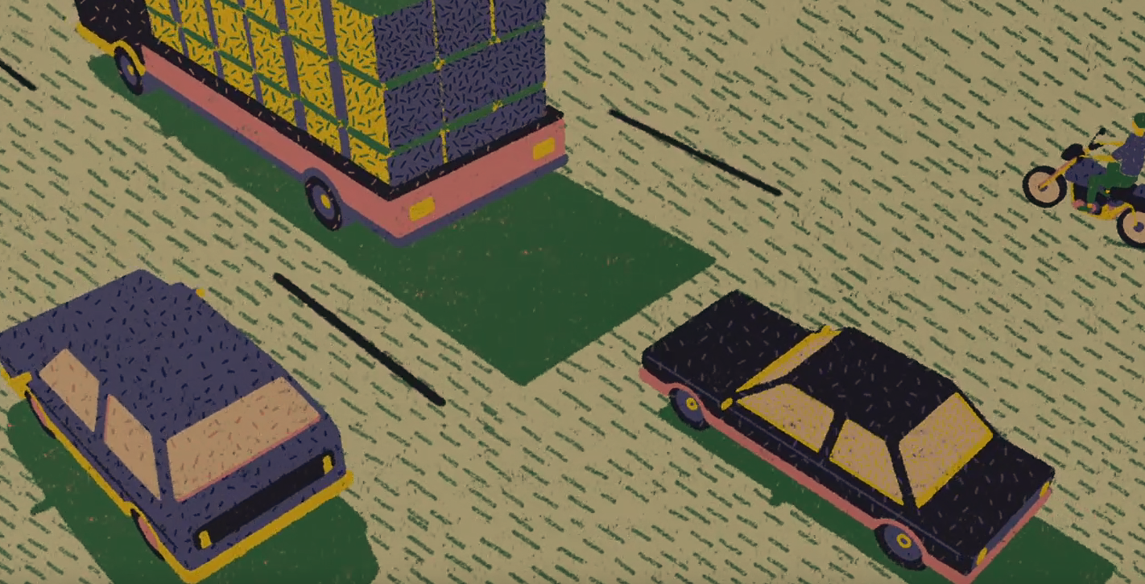
What should the car do?
Notes:
Start by giving the students a few minutes to think alone – What are the pros and cons for each option ( 1. hitting the truck with your car head on with 2 passengers, 2. going into the SUV with 2 passengers, 3. going into the motorcycle with 1 person)
Prompts:
Who has the right to decide?
Does all life have the same value?
What is one vehicle has more safety measures/protection?
Caveats:
What if one of the vehicles contained a loved one?
What if one of the vehicles contained an object of value?
What if one of the vehicles contained a child?
Students are split into teams discuss what they think about their assigned argument and report back to the floor.

Slide 8
Debating the issues
Discuss the issues in your groups
Think about your argument
What are your key points?
Decide who in your groups will say each point
  Are there any weaknesses?
?

Slide 9
Debating Manners:
If you want to make a point, put your hand up when the team is finished
Each team will have the chance to put across their argument
Listen to each team, make notes about their arguments, and come up with points that will challenge their arguments.
Be constructive! No personal remarks
You can talk with your team, but be quiet!
You can speak only when the moderator allows

Slide 10
Debating the issues
Think about the arguments put forward from other groups and come up with a response/counter argument.
You should end your counter argument with a final statement that sums up your points.
Keep this fairly short and persuasive.
This is where you will conclude why your argument is the best option!

Slide 11
QUESTIONS?
AIMS AND OBJECTIVES
To understand debating and some key skills needed for it
To take part in a classroom debate concerning an ethical dilemma
Notes:
Take any questions from students.
Ask students to write a few sentences about how confident they are with todays aims/objectives..

Slide 12
HOMEWORK TASK
Should we lower the voting age to 16?
Include arguments for and against (counter argument)
Sum up with a final statement and conclusion
Next lesson we will go through some of the points you came up with

