Slide 1
Accommodation At University
www.reading.ac.uk

Slide 2
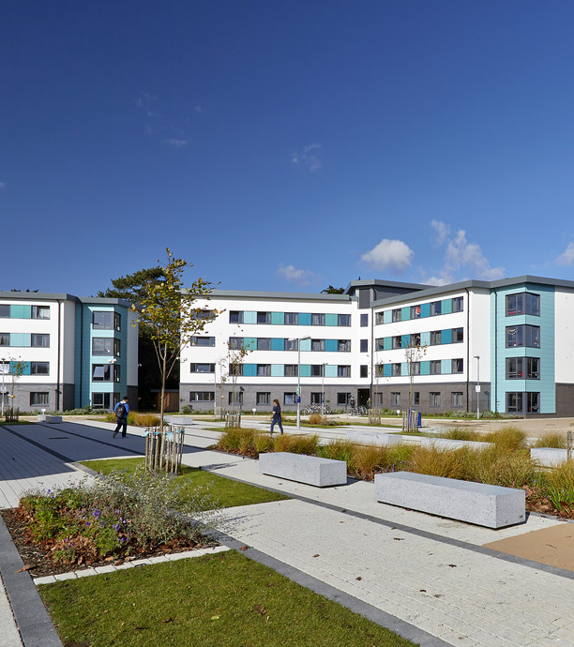
WHAT WE WILL COVER
What are my options for living at university?
When/how do I apply for halls?

Slide 3

Why is it called living in ‘Halls’..?

Slide 4

Why is it called living in ‘Halls’..?
When you live away as a student at university, you’re likely to apply for a place in halls, and move into shared accommodation designed for students.
They’re called ‘halls’ because historically they were large buildings with lots of ‘hallways’ and room coming off that led to bedrooms. So essentially a building with lots of halls in it…

Slide 5
True or false:
Student rooms are always dark and grotty.

Slide 6
Student rooms are always dark and grotty.
False!
Accommodation has come a long way in recent years, and most student rooms in the UK are now modern and comfortable. This includes, good heating, double glazing, hot showers and speedy Wi-Fi. You can often look around student bedrooms on Open Days.

Slide 7
True or false:
It’s easy to make friends in halls

Slide 8
It’s easy to make friends in halls
True!
Living in halls in your first year as it really is a great way to make friends. You’ll probably all have you first dinner together after you move in, or chat over a cup of tea while you move your belongings in. They’ll be your first friends, and people that you see everyday, at your best and at your worst, so it’s like a ready made set of friends!

Slide 9
True or false:
As a student you might have a ‘roomie’ (share a room with someone)

Slide 10
As a student you might have a ‘roomie’.
False!
You won’t be sharing a room with anyone
– having a ‘roomie’ is an American college thing, and next to no bedrooms at universities in the UK have shared bedrooms.

Slide 11
True or false:
Halls are often a short walk away from lectures

Slide 12
Halls are often a short walk away from lectures
True
If it’s a campus university you’re looking at, it’s likely that halls with be on campus, or a very short walk away from where the main action happens.
Be aware that your lectures could take place anywhere on campus, not just in your ‘department building’ so you don’t need to only look at halls that are closest to your department area. You might like to think about the walk to the gym, library, or shop!

Slide 13
True or false:
Doing your own washing at uni is scary

Slide 14
Doing your own washing at uni is scary
For lots of students, living in halls offers all sorts of new learning experiences.
Generally, shared laundry facilities exist next to the main student living areas. You pay per use for the washing machine, and you need to make sure you’re around to take it our when it finished, otherwise someone else might..!
It’s another £1 or so to use the dryer as well.

Slide 15
True or false:
If I move into halls I won’t have to think about paying bills

Slide 16
If I move into halls I won’t have to think about paying bills
True
Everything is included in the rent for halls. That’s heating, internet, water, electrics… you get to explore the fun with paying your own bills in your second and third year if you chose to move out and rent a private house with some uni friends!

Slide 17
True or false:
You have to cook your own meals at uni

Slide 18
You have to cook your own meals at uni
False
Learning to cook at university can be fun, and you’ll always have people around to ask for help and advice. It’s also a nice social activity, and you can get to know people really well by sharing meals and catching up in the kitchen.
If you’re nervous about cooking or worried you won’t be able to keep up with making every breakfast, lunch and tea, you can chose a ‘catered’ option for halls, where you will get some or all of your meals provided.

Slide 19
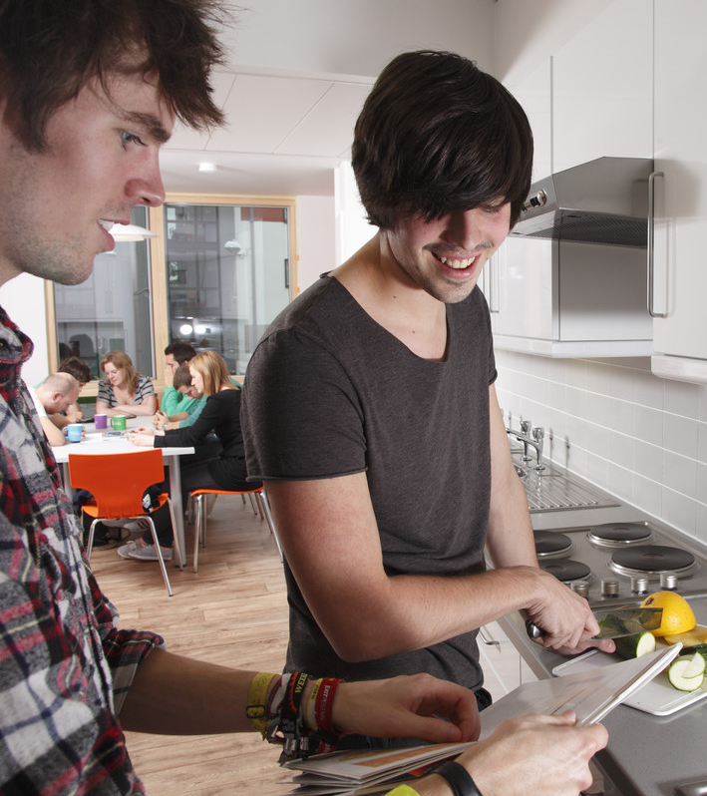
A shared kitchen
Whether you chose to be ‘catered’ or ‘self catered’ You will most likely find that you share a kitchen with around 6 or 7 other people, and you’ll live in the same shared ‘flat’ as these other students.

Slide 20

Things to think about:
Can be catered or self-catered
Can be en-suite or shared bathroom
Different contract lengths (e.g. 40 or 51 weeks)
24/7 security

Slide 21

How and when to apply:
Usually after you have accepted an offer
Do some research when you chose your no. 1 choice
- Online tours can be useful
- View rooms on an open day and ask questions
Be aware the deadline will be before your course starts – usually around 1st August
On the application you may be asked to choose a few different options, as well as state your interests and hobbies.
Deposit required
Notes:
There will be different deadlines for different universities, and generally you’ll be directed to what you need to fill in once you’ve confirmed which university is going to be your firm choice.
There will be an online application form, and often you get to choose your top-5 accommodation choices, based on how much you want to pay and what facilities you’d like. It’s worth doing a little bit of research, and not just ‘guess’ which accommodation will be right for you.

Slide 22
Let’s hear from a student!
At the University of Reading, you can find a student to chat with about anything! They have written and video blogs all about student life to give you a taste of what university is really like!
Explore our ‘Chat with a student’ function here
Hear from one of our students about what to bring to university here: https://youtu.be/WJWOSkvX4wA

Slide 23
Still have questions?
We have lots of online content for students and teachers to help with the decision of going to university.
Check out our webpages for live online events, visits to the university and recordings to help you stay informed about your choices.
www.reading.ac.uk/outreach

