Slide 1
What are the Climate Stripes?
Show Your Stripes Day 2026
Show Your Stripes Day
20th June 2026

Slide 2
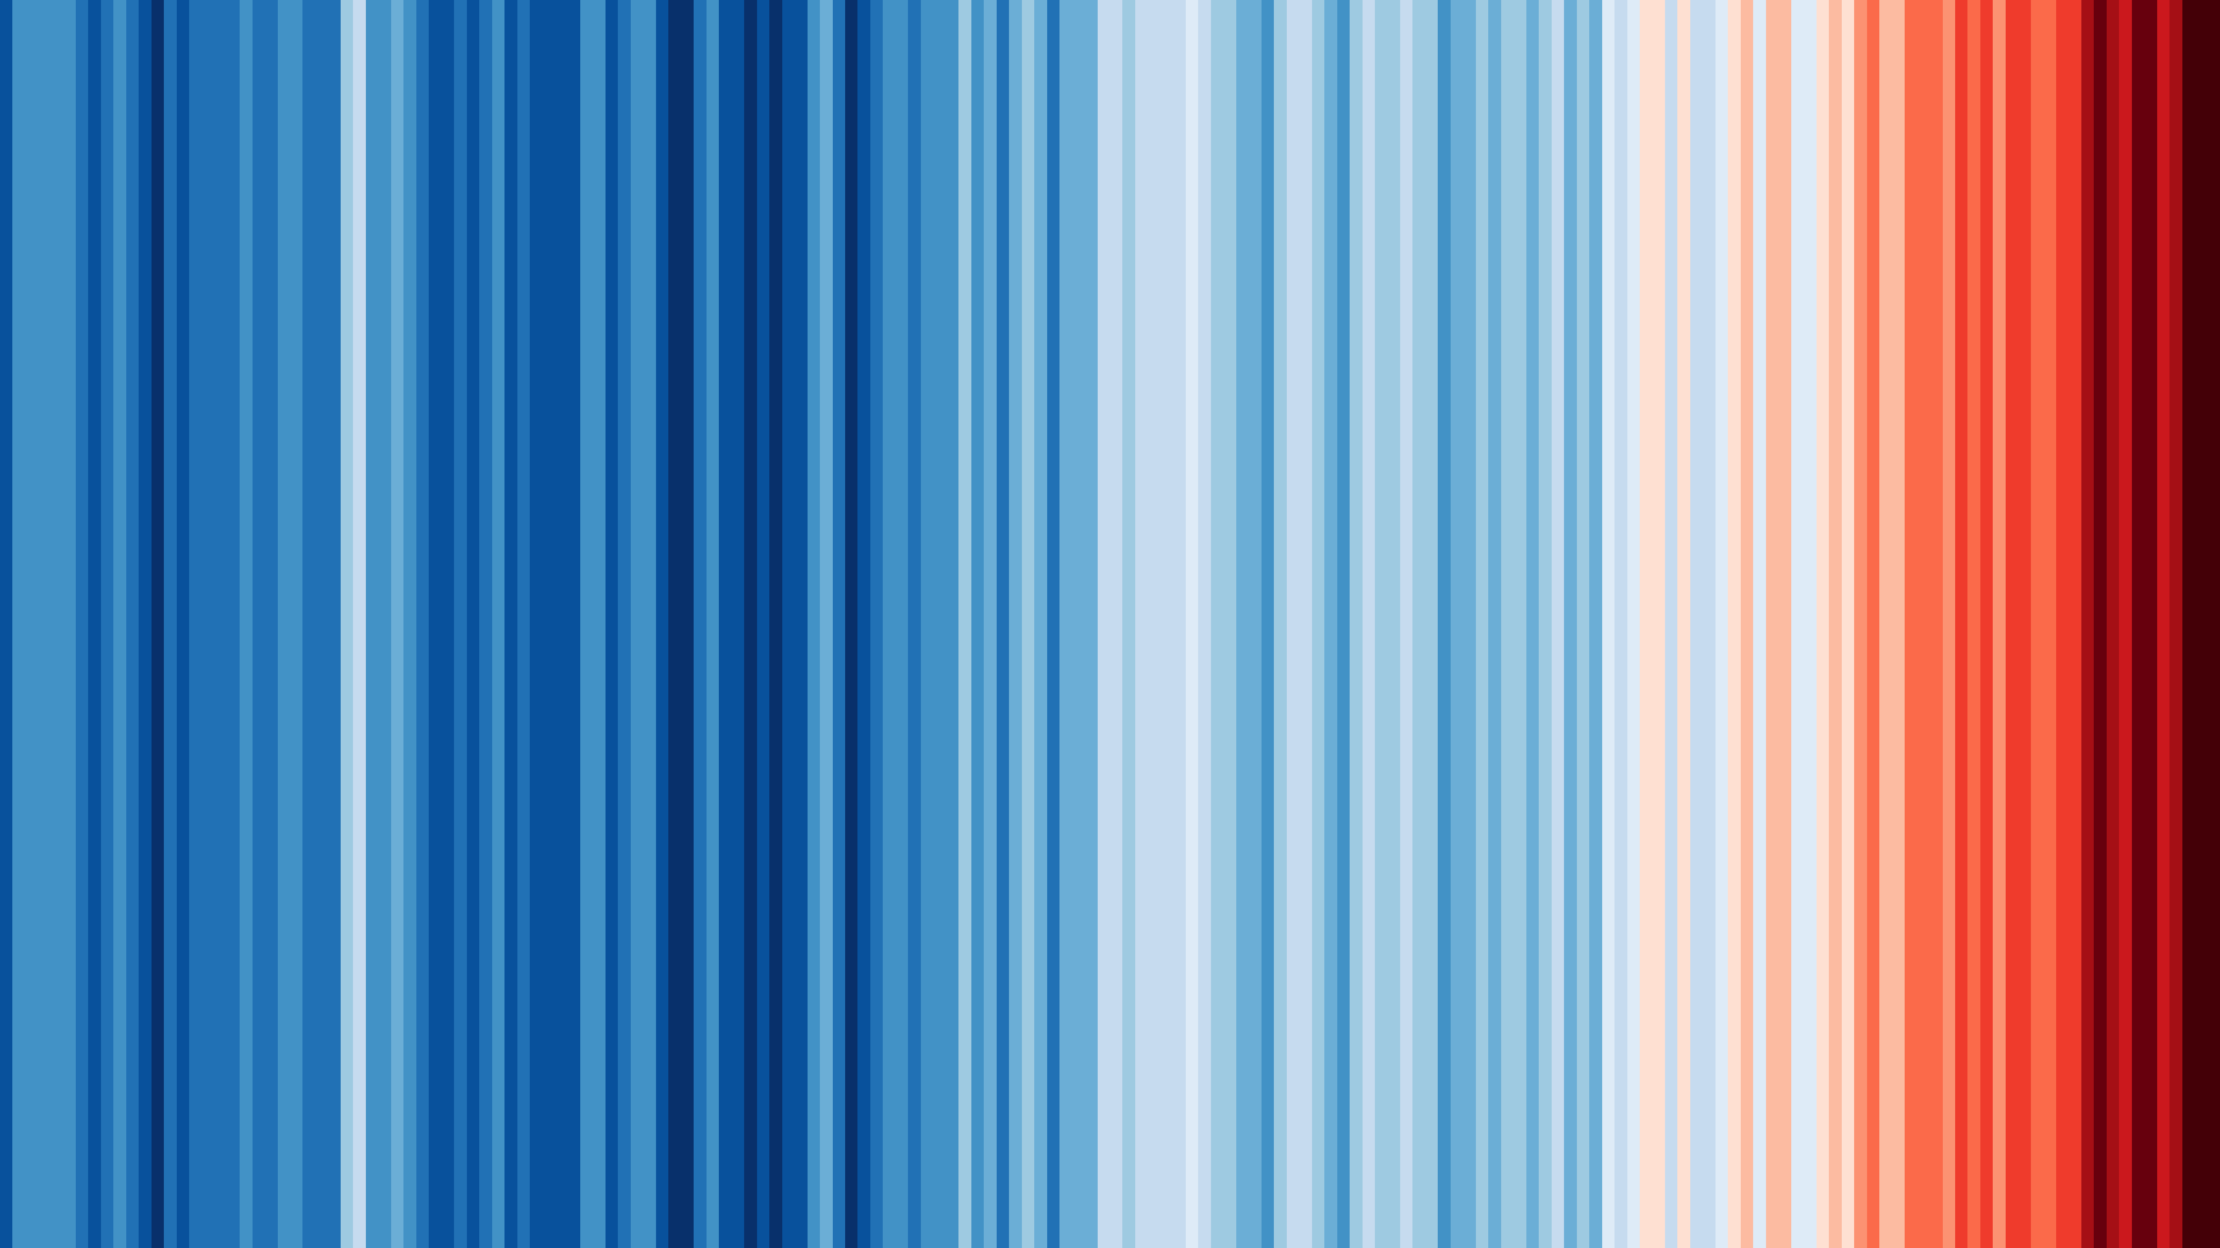
What are the Climate Stripes?
The Climate Stripes are a series of vertical coloured bars, showing the progressive heating of our planet over the last 175 years in a single image.
Global stripes 1850-2025

Slide 3
What do the Climate Stripes show?
Each stripe represents the average temperature for a single year, relative to the average temperature over the period from 1961 to 2024.
Shades of blue indicate cooler-than-average years, while red shows years that were hotter than average.

Slide 4
What do the Climate Stripes show?
The bands of deep red stripes on the right-hand side of the graphic shows the rapid heating of our planet in recent decades.

Slide 5
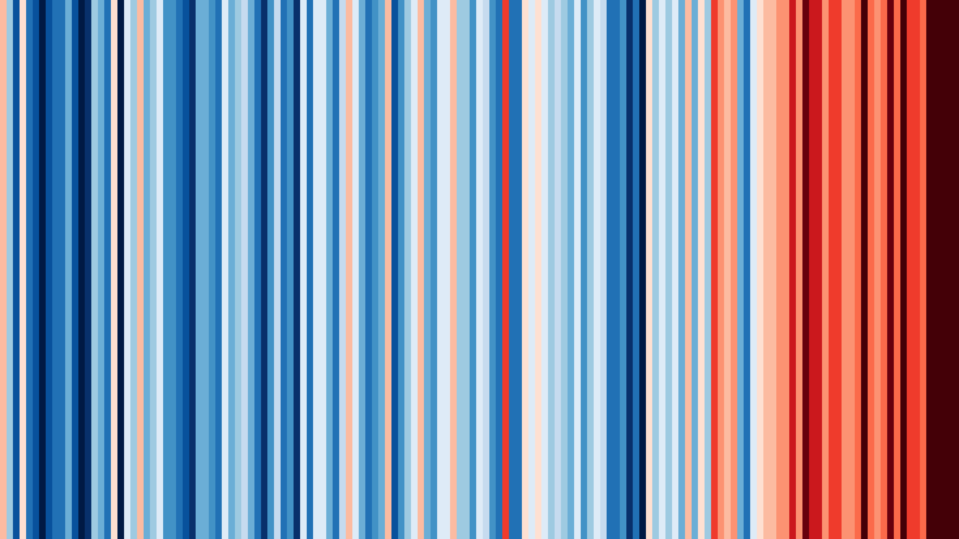
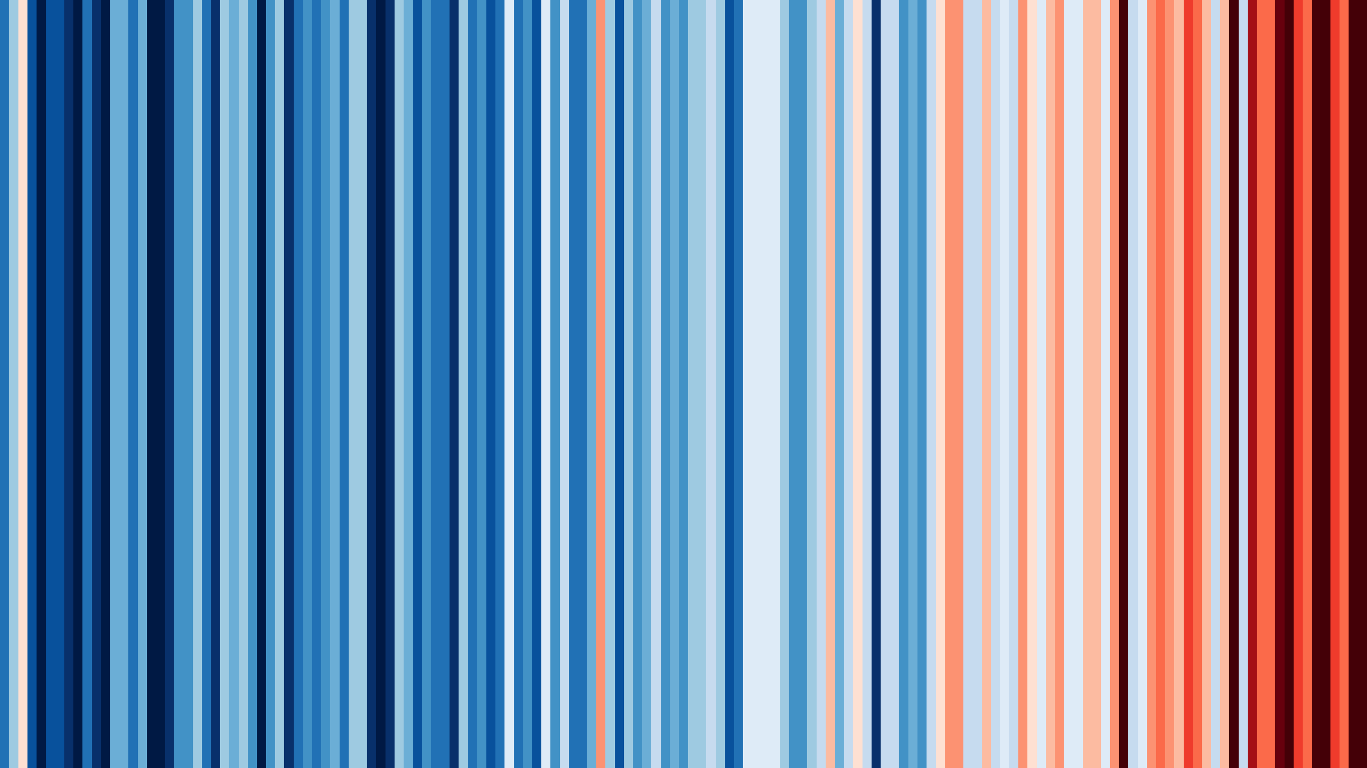

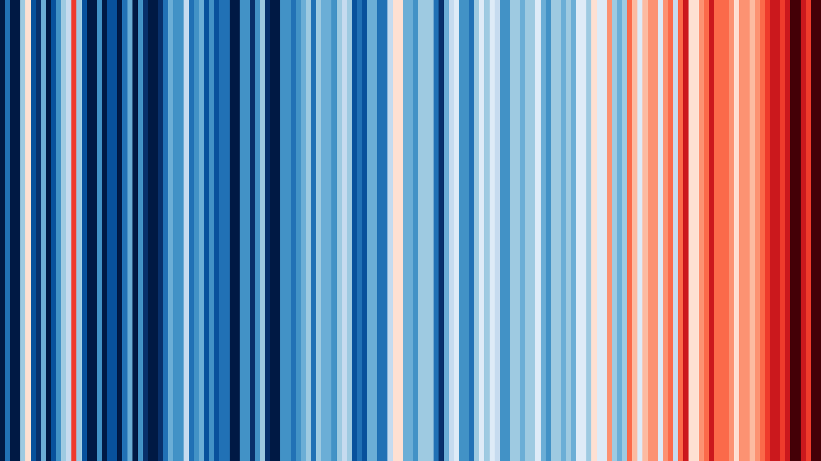
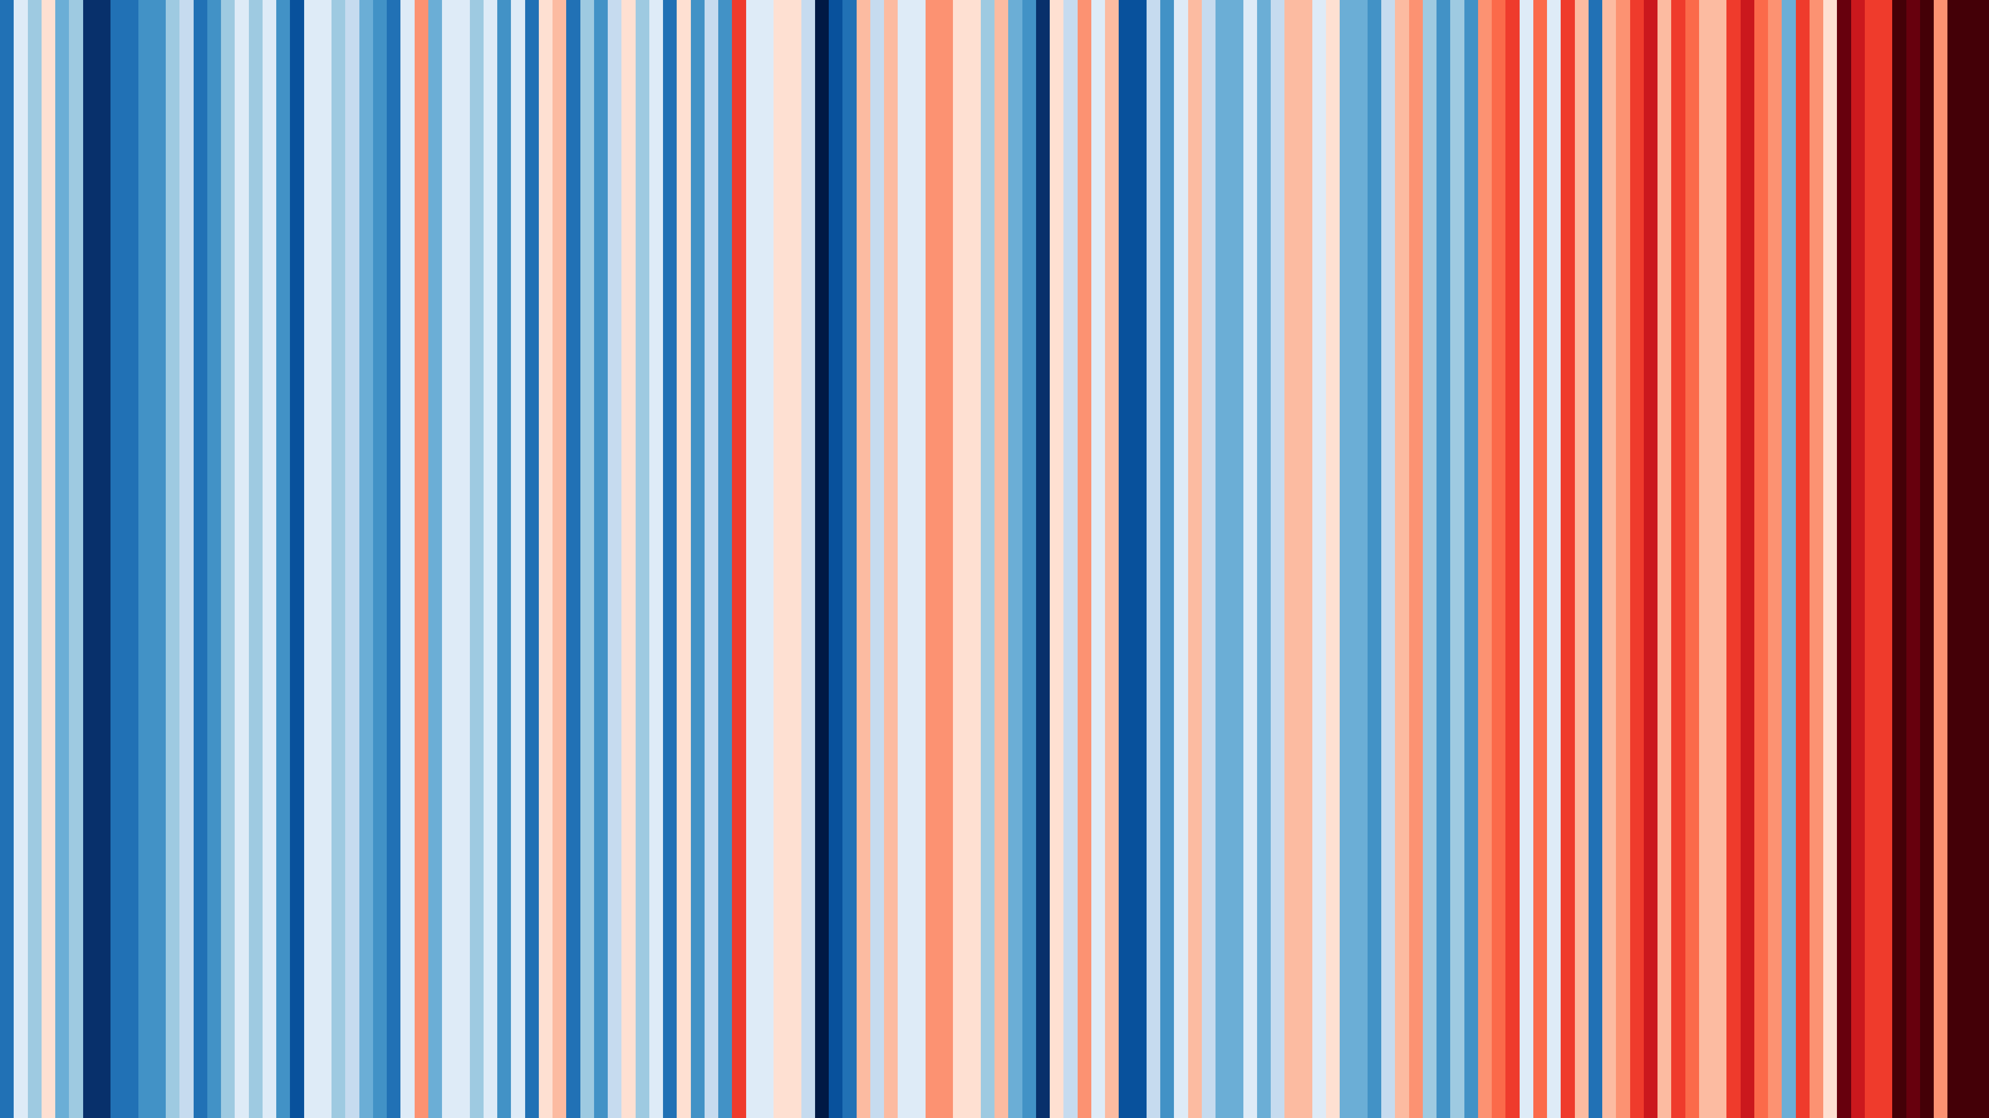



They aren’t the same everywhere…
Africa- Algeria
Asia- Thailand
Australasia - Australia
Caribbean- Jamaica
Europe- Germany
Middle East- Bahrain
North America - USA
South America- Brazil

Slide 6
But they show the same pattern: a warming climate
Africa- Algeria
Asia- Thailand
Australasia - Australia
Caribbean- Jamaica
Europe- Germany
Middle East- Bahrain
North America - USA
South America- Brazil

Slide 7
What about my Climate Stripes?
Insert the image of your local climate stripes available to download from the #ShowYourStripes website and insert into slide.
Notes:
Once you have downloaded your local climate stripes image, you can either complete our related activities and have students think about the questions below, or if you want to go more into what climate change is, and what schools can do, continue with the PowerPoint, otherwise we suggest trying some of our new activity resources.
What patterns can you see?
What has happened in your region/ how do you think your region has changed over that period of time?
How do my stripes compare to other parts of the world?
How do we talk about climate and our feelings around it?
How can we educate others using the climate stripes?

Slide 8
What is Climate Change?
What is global warming? - KS3 - The Regenerators - BBC Bitesize
Notes:
To find out more about what climate change is, watch this short video from BBC Bitesize for a child friendly explanation. You can move on to the next slides if you want to consider with students what can be done in schools and how they can contribute to your school Climate Action Plans.

Slide 9
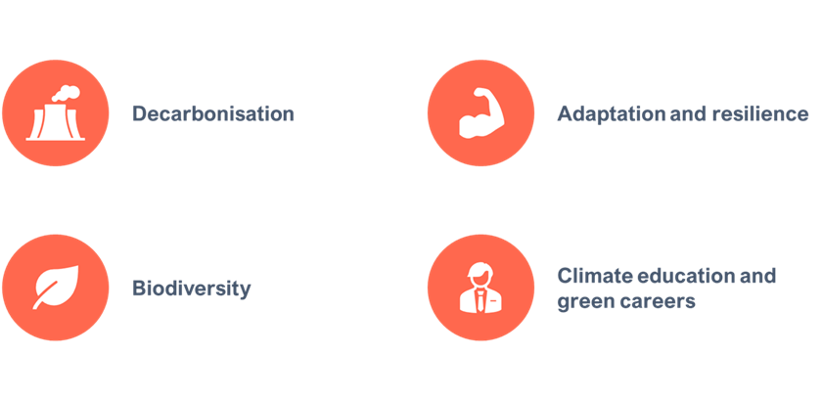
What Can We Do at School?
Help Your School Create a Climate Action Plan!
A Climate Action Plan (CAP) is a detailed plan to enable your school to become more environmentally friendly
It focuses on 4 different areas:

Slide 10
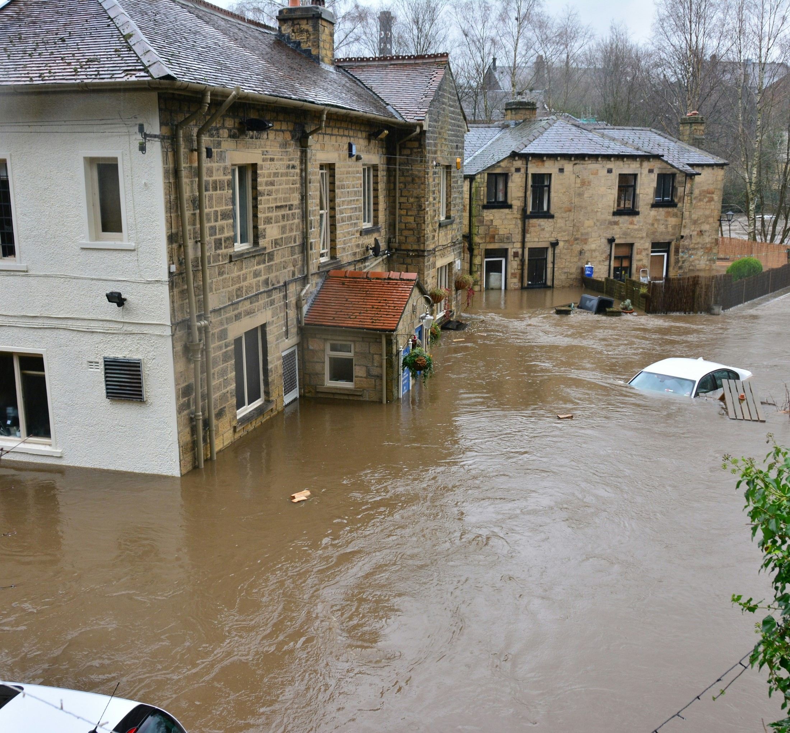
Adaptation and Resilience
Working to adapt school buildings and systems to help us prepare for the effects of climate change, such as:
Hotter drier summers
Wetter winters

Slide 11
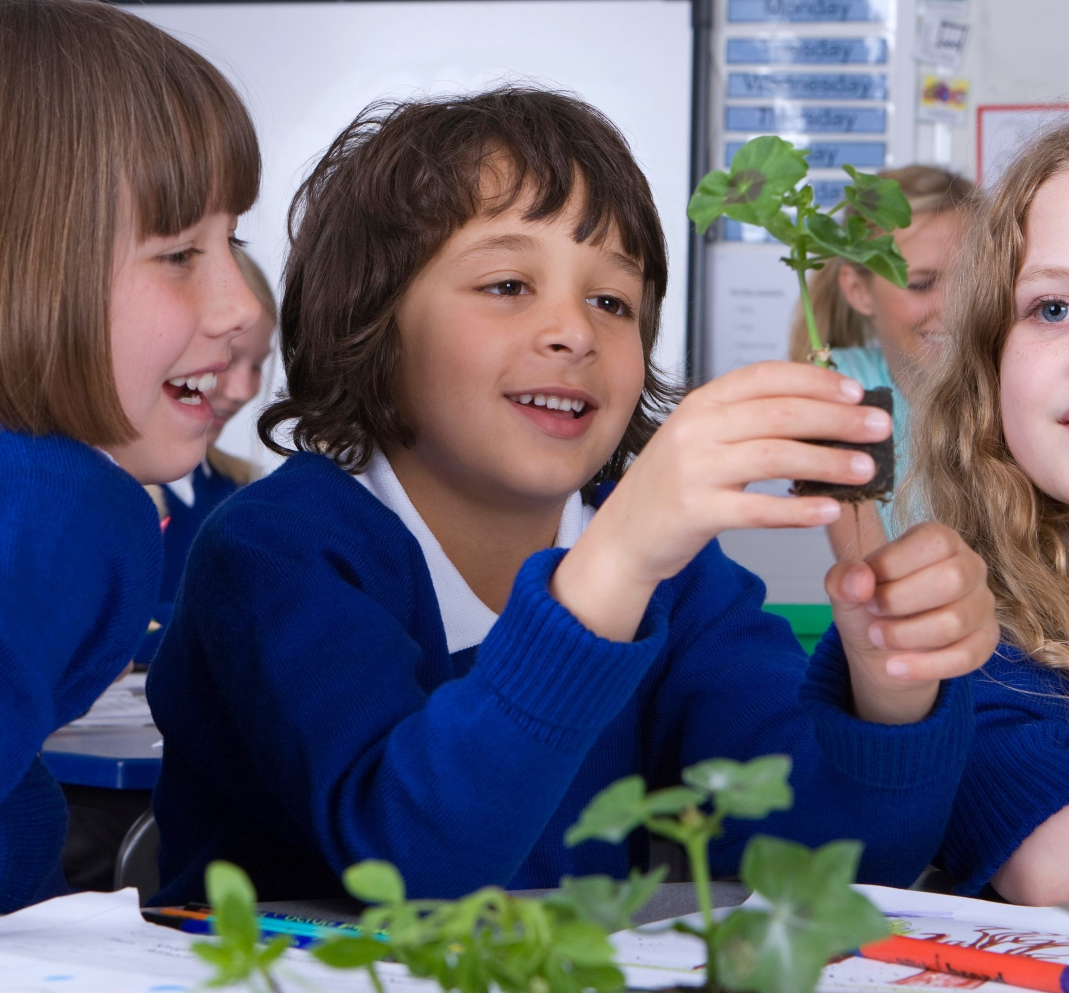
Biodiversity
Protecting and increasing the biodiversity (plants and animals) found in your school grounds and
increasing your access to, and connection with, nature.

Slide 12
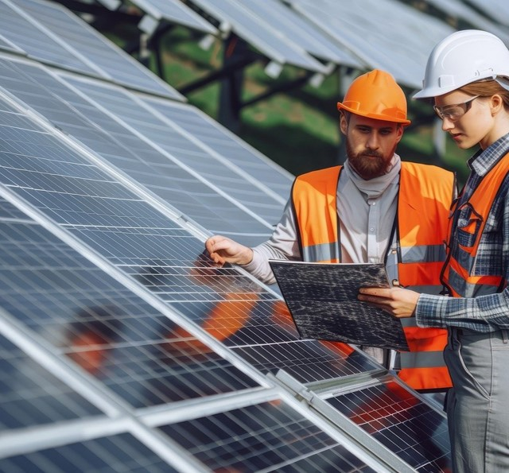
Climate Education and Green Careers
Preparing you with knowledge and skills for living and working in a world impacted by climate change, through improved education & practical opportunities.​

Slide 13
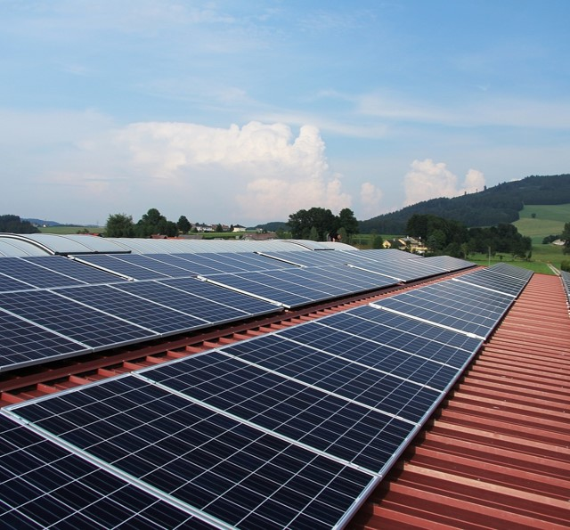
Decarbonisation
Working to reduce carbon dioxide emissions from school through changes to:
Energy
Transport
Food
Waste
Buying supplies & School equipment
Water use

Slide 14
Next Steps for Schools:
For more help reach out to your local Climate Ambassadors to support you with your climate action plans:
Contact us & get involved | Climate Ambassadors
Get your students involved in developing your Climate Action Plan:
Try using this Imagination Workshop Guide from the Climate Ambassadors activity to get them generating ideas which could be included in your CAP.

