Slide 1
Not a problem to be fixed
Dr Vikki Burns
University of Birmingham
@drvikkiburns

Slide 2
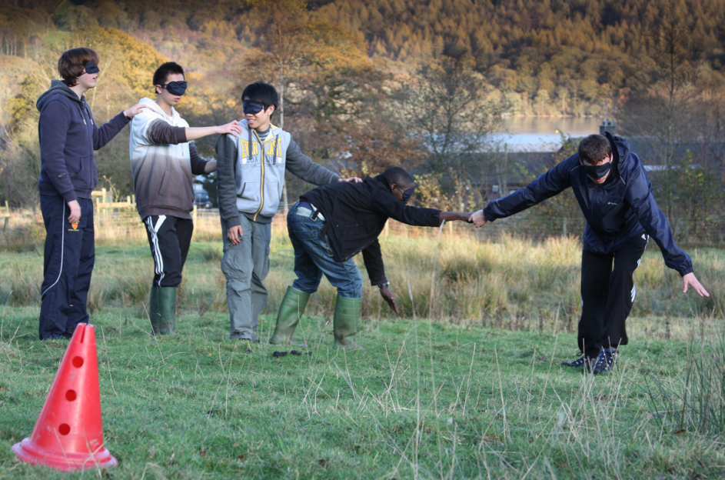
The Raymond Priestley Centre
Notes:
Many options for developing groupwork skills, but one that is often utilised is outdoor pursuits
Lots of anecdotal success over many years, but generally as a field it lacks systematic evaluation -

Slide 3
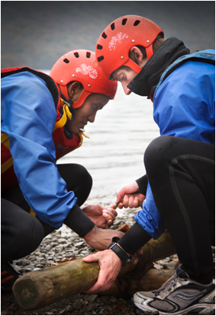
Asked how culture affects groupwork?
H: “I don’t feel it will really affect my experience, um, I’m an open minded person as long as everyone speaks English and I can communicate with them, then, you know that’s all that matters, in my opinion. ”
I: “Most of the Asian people, especially for us who come from China because of the cultural thing, we are quite shy, so sometimes the European people may think that we are not work hard but, but, but... the fact is we are just too shy and we, we don’t want to be, sometimes we just want to listen to first listen, firstly listen to others, others opinions, so we keep quiet, but it doesn’t mean that we are not contributing, but sometimes because we are quiet, and sometimes the other group member of mine misunderstand us, so sometimes, it’s kind of pressure for me
Burns 2012

Slide 4
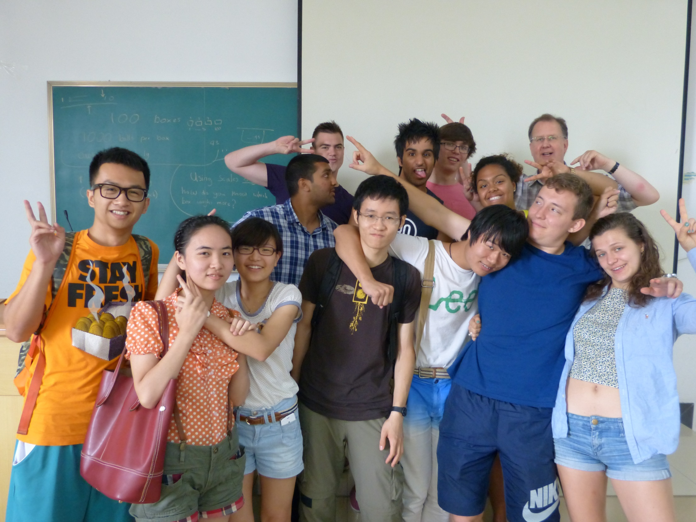
Cultural integration in engineering

Slide 5
H: My hall is majority international students and so one of my friends lives in a flat with five of them. She’s the only English student, there’s, I can’t remember, I think, a girl from Russia, a girl from Africa and two girls from China, and they literally just stay in their rooms, just don’t integrate at all. She’s made an effort to, do stuff, but they don’t have any of it, don’t go into the kitchen, or whatever, just cook their food and go back into their room, just don’t talk at all
H: Ithink if [international students] were more comfortable, because they know we’re the same, then they might be more outgoing
Burns 2015

Slide 6
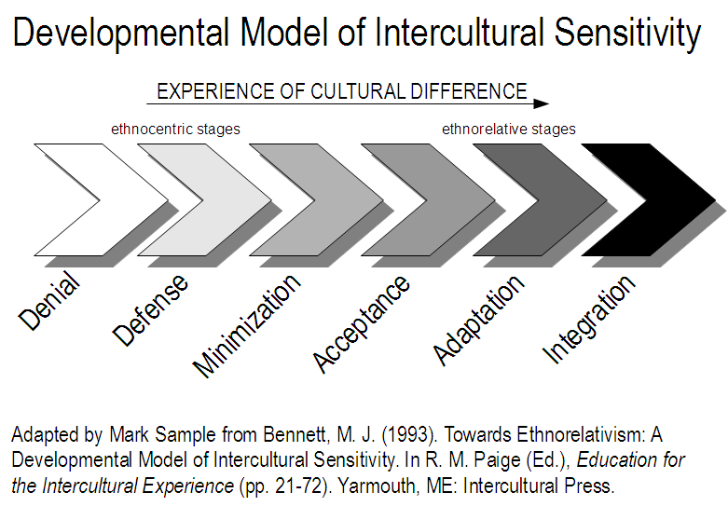

Slide 7
Notes:
Denial - unable to experience differences in other than extremely simple ways
Defense – feel under siege (can sometimes be reversed too)
Minimization - recognition of the common humanity of all people regardless of culture
Acceptance - They accept that all behaviors and values, including their own, exist in distinctive cultural contexts and that patterns of behaviors and values can be discerned within each context.
Adaptation - consciously shifting perspective and intentionally altering behavior.
Integration - being a person who is not defined in terms of any one culture

Slide 8
Ethnocentric ask:
How can we help international students to fit in to our university?
Ethnorelative ask:
How can we all listen, learn and create structures that support an effective multicultural learning and living environment for all?

Slide 9
Allport’s (1956) Contact Hypothesis
Adapted by Dovidio, Gaertner & Kawakami, 2003

Slide 10
Current approaches
“We'll help you build a network of new friends from all over the world, improve your understanding of cultural differences and learn how to communicate effectively with people from diverse backgrounds.”

Slide 11
The potential of sport and student activities

Slide 12
IS and extracurricular activities
Associated with improved life satisfaction and academic involvement (Toyokawa & Toyokawa, 2002)
More than half of Asian students rarely participate (Wu and Hammond 2011)
Studies usually focus on undergraduate students on three year programmes
Participants : 30 Northeast Asian master students (10 Chinese, 10 Japanese, 10 Korean)
: undergraduate level in their home countries
: no overseas learning experience in Western countries

Slide 13
Our findings
Motivators to participation | Barriers to participation
Ease of access | Difficulty of access
Encouraged | Discouraged
Emotional benefits | Lack of interest
Broadening perspective | Cultural constraint
Developing abilities | Other commitments (including family)
Social benefits | Age
Need to understand specific needs – training for student groups?
Emphasise benefits to Asian (international?) students
Research conducted by Inhyang Choi (2016)
Notes:
In spite of the potential benefits,
more than half of Asian students rarely participate in extracurricular activities
(Wu and Hammond 2011)
Five cardinal relationships of Confucianism
: 長幼有序
: old and young have an order or sequence
: the concept of friends is only with same age person
son and daughter must always listen their parents

Slide 14
Potential influence of Foundation programmes
Shape the narrative
With your students
With any “interventions”
Across the university and the sector
Advise on practice
Use models to guide
Both home and international students
Academics and professional services
In and out of the classroom

Slide 15
Conclusion
Foundation programmes
Rest of the university
Let’s fix the RIGHT problem

