Slide 1


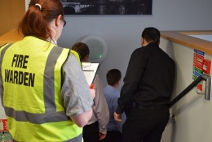
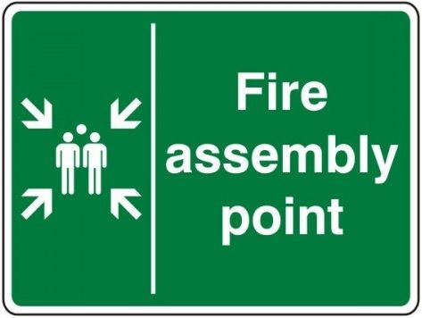
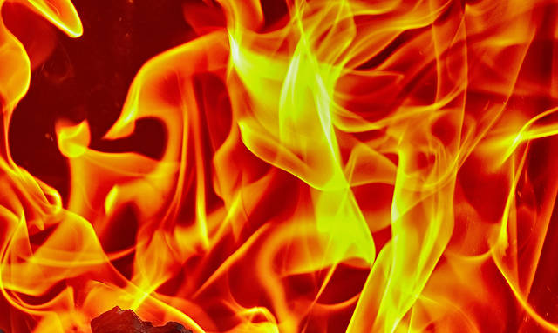
Acting Fire Warden

Slide 2
Lecturers
Lecturers are responsible for ensuring all students within their teaching space safely evacuate during any fire alarm activation . It is therefore important upon hearing the building fire alarm lecturers immediately ask their students to evacuate to the Fire Assembly Point whilst also directing them to the nearest fire exit.
It is recommended lecturers familiarise themselves with this presentation which will provide a good understanding of the Fire Warden role, this in turn will assist in evacuating the building safely.

Slide 3

Introduction
A Fire Warden is an essential role in any fire evacuation plan.
This presentation is designed to give you the basic knowledge to understand and carry out the role of the Acting Fire Warden when members of the normal evacuation team may be reduced during Covid-19 phased return.
Please go through the following slides and complete the quiz at the end, once you have successfully answered all the questions you can form part of the evacuation team as an Acting Fire Warden.
Thank you for your help☺

Slide 4
The Fire Alarm
All buildings are fitted with fire alarm systems incorporating automatic fire detectors designed to identify a fire at the very early stages and sound the fire alarm.
People still remain the best form of detection and will normally identify a fire in an occupied building before the automatic detection, therefore should you identify a fire, red break glass call points are positioned adjacent to all exits to sound the fire alarm.
Evacuation can be carried out in under 2 ½ minutes within your building and with automatic detection you should never stumble across a large fire inside your building. Therefore as an acting Fire Warden and being one of the last to leave the building you will still remain safe.

Slide 5



What can set the fire alarm off
Faulty equipment
Fire alarm break
glass call point
Smoke & heat
from a fire
All of the above can set off the fire alarm therefore if you have not been notified of a test, regardless of what you believe has happened, please follow these procedures.

Slide 6
The Evacuation Procedure
In the event of an unplanned fire alarm activation an Acting Fire Warden will be expected to:-
Ask people to evacuate the building by the nearest fire exit.
Make your way to your Fire Warden Sweep Pack, open the pack put on the yellow Hi-Viz jacket and take out the plan.
Sweep your area identified on the plan being the last to leave this area.
Report to the Evacuation Officer outside the building who will be wearing an Orange Hi-Viz jacket.
Each task is covered in more detail in the following slides.

Slide 7

Asking people to evacuate
As soon as the fire alarm sounds, politely but firmly ask people to evacuate the building to the Assembly Point by the nearest fire exit regardless of any one way systems introduced due to Covid-19.
The location of the Assembly Point is displayed on the Fire Action Notices around your building.
The longest part of an evacuation is often the time taken to decide to evacuate, this is known as the Reaction Time. The sooner we can get people moving towards a fire exit the quicker the evacuation, remember we should be aiming to evacuate the building in under 2 ½ minutes.

Slide 8
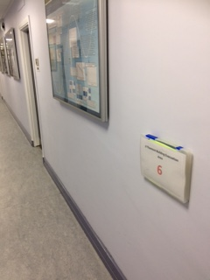
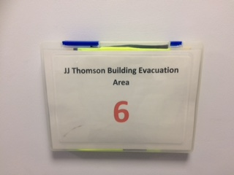
Fire Warden Sweep Pack
All buildings will have similar evacuation procedures incorporating Sweep Packs strategically located in your building. These packs similar to the one pictured below contain plans of your sweep area and a yellow Hi-Viz Fire Warden jacket.
Fire Warden Sweep Pack

Slide 9
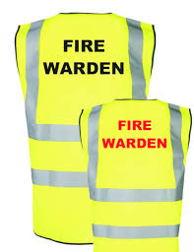
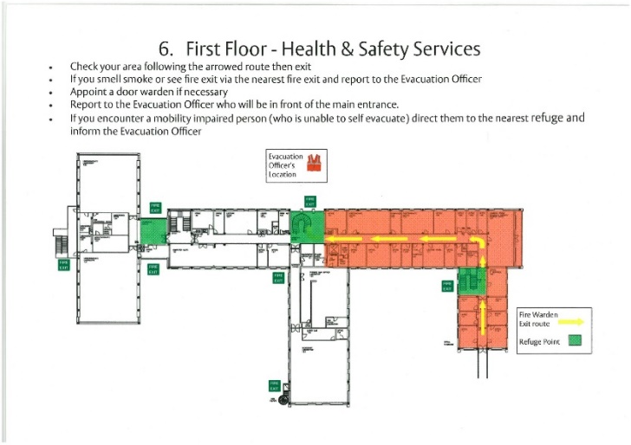
Fire Warden Sweep Pack
After initially asking people to evacuate make your way to the Fire Warden Sweep Pack, put on the yellow Hi-Viz jacket and take out the sweep plan.
Sweep Plan
Yellow Hi-Viz Jackets

Slide 10

Fire Warden Sweep Plan
The Sweep Plan will identify an area which you should walk to ensure everyone has evacuated safely (the sweep) and is given a unique reference for the Evacuation Officer to record against when you report to them. Each area should take you no longer than 2 minutes to sweep.
Sweep the entire area identified on the plan including any toilets and Refuge areas, start at one end ensuring people evacuate as you go and be the last person to leave your area.

Slide 11
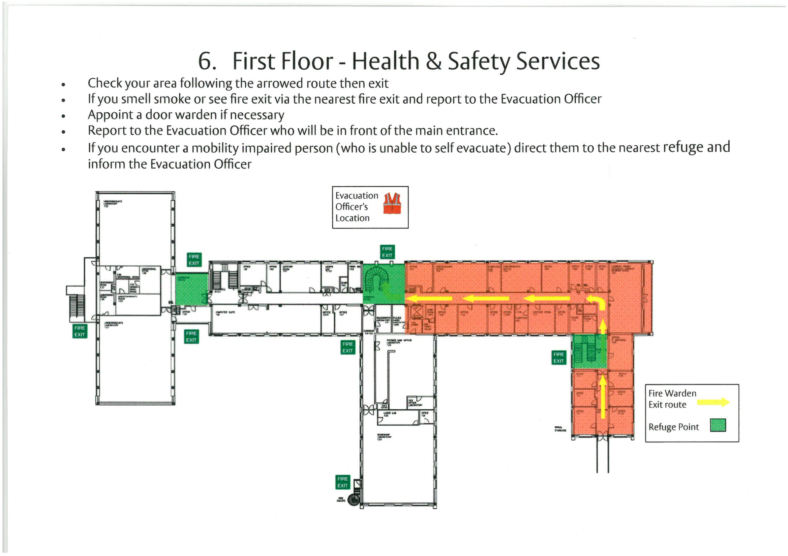
Example Fire Warden Sweep Plan

Slide 12
The Sweep
Whilst you carry out the Sweep:-
Look, listen and smell for signs of a fire, leave immediately if you discover a fire and call the fire service, don’t forget to report your findings to the Evacuation Officer.
If you come across any occupants unwilling to leave, note their location and report this to the Evacuation Officer when you exit the building.
If you find rooms with locked doors, treat the room as empty and continue with the sweep.

Slide 13

The Sweep
Note anybody in a Refuge area and report this to the Evacuation Officer as a priority when you exit the building. The individual in the Refuge area should already have a Personal Emergency Evacuation Plan (PEEP) and be aware of the correct procedures they should follow.
A Refuge is a signed safe area someone unable to use the stairs may wait for up to 30 minutes and is normally located within or adjacent to a staircase.

Slide 14
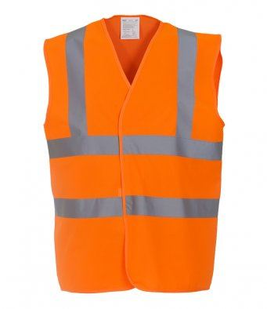
Reporting to the Evacuation Officer
Once you have finished your sweep leave the building with your plan by the nearest fire exit and immediately report your findings to the Evacuation Officer.
The Evacuation Officer will be outside the building by the entrance nearest to the fire alarm panel and wearing an Orange Hi-Viz jacket.
Evacuation Officer

Slide 15
Reporting to the Evacuation Officer
Once you have reported to the Evacuation Officer you may be asked to take up the role of a Door Warden and position yourself outside of a door to stop individuals re-entering the building.
Should you find upon exiting the building there is no Evacuation Officer you may need to take on this role yourself. Please familiarise yourself with the Acting Fire Evacuation Officer presentation.

Slide 16
Evacuation Procedure
If your building does not have a Fire Warden Sweep Pack it is likely to be deemed a small building and have very few people, these buildings are very quick and easy to sweep by one person familiar with the building. If this is your building please follow the same procedure albeit without the Fire Warden Sweep Pack and Evacuation Officer. Once you have carried out the sweep liaise with Security on their arrival.
Should you have any questions or believe you should have a Sweep Pack please contact the University Fire Safety Advisor.

Slide 17
Evacuation Procedure
Upon return to your building familiarise yourself with:-
The contents and location of Sweep Packs within your building.
All the fire exits in your area.
The location of your building Fire Assembly Point.

Slide 18
Emergency telephone numbers
Campus Security emergency Tel:- 0118 378 6300
Fire Tel:- 999 or 112
If you discover a fire, call 999, the Fire Service will not attend unless someone calls them to confirm there is a fire. Do not assume someone else has called, the more calls made to the fire service the better the information which can be passed to the on coming fire engines.
Security are alerted automatically when the fire alarm sounds and will immediately attend to investigate the cause however still please contact Security on the emergency number to inform them if there is a confirmed fire.
It is good practice to store the Security emergency number in your mobile phone.

Slide 19
Quiz

Slide 20
Quiz
What should you do upon hearing the fire alarm?
Politely but firmly ask people to evacuate the building to the Assembly Point by the nearest fire exit regardless of any one way systems introduced due to Covid-19. Then proceed to the Fire Warden Sweep Pack put on the yellow Hi-Viz jacket and sweep your area.
How long should it take you to sweep your area?
Each area should take you no longer than 2 minutes to sweep.
During your sweep what would you do if you came across a room with a locked door ?
If you find rooms with locked doors, treat the room as empty and continue with the sweep.
During your sweep what would you do if you came across someone in a Refuge Area?
Note anybody in a Refuge area and report this to the Evacuation Officer as a priority when you exit the building. The individual in the Refuge area should already have a Personal Emergency Evacuation Plan (PEEP) and be aware of the correct procedures they should follow.

Slide 21
Quiz
What should you do when you finish your sweep?
Once you have finished your sweep leave the building with your plan by the nearest fire exit and immediately report your findings to the Evacuation Officer.
Where will you find the Evacuation Officer?
The Evacuation Officer will be outside the building by the entrance nearest to the fire alarm panel and wearing an Orange Hi-Viz jacket.
What should you do if you find there is no Fire Evacuation Officer?
Should you find upon exiting the building there is no Evacuation Officer you may need to take on this role yourself. Please familiarise yourself with the Acting Fire Evacuation Officer presentation.
What should you do if you discover a fire?
If you discover a fire, call 999, the Fire Service will not attend unless someone calls them to confirm there is a fire, do not assume someone else has called.

Slide 22
Contact details
If you have any questions regarding Fire Safety or the Acting Fire Warden procedure please contact:-
David Sharp - Fire Safety Adviser
Tel:- 07719 356158
d.w.sharp@reading.ac.uk
Kevin McGovern - Deputy Fire Safety Adviser
Tel:- 07725 217289
k.b.mcgovern@reading.ac.uk

Slide 23
Thank you for your help☺

