Slide 1
Microsoft Teams Awareness
Information Technology
IT004 Unified Communications
Introduction to using Microsoft Teams for communications

Slide 2
Agenda
Welcome and introductions
Scope of this training session
Overview demonstration of Microsoft Teams for Calls, Chat and Meetings
Further project information and next steps
Use the Meetings icon to open the meetings view

Slide 3
Welcome & Introduction
Stuart Brown, Director of Digital Technology
Ian Woolner, Microsoft Modern Workplace Specialist
Jocelyn Robinson, Project Manager
Judith Macfadyen, Change Analyst
Use the Meetings icon to open the meetings view

Slide 4
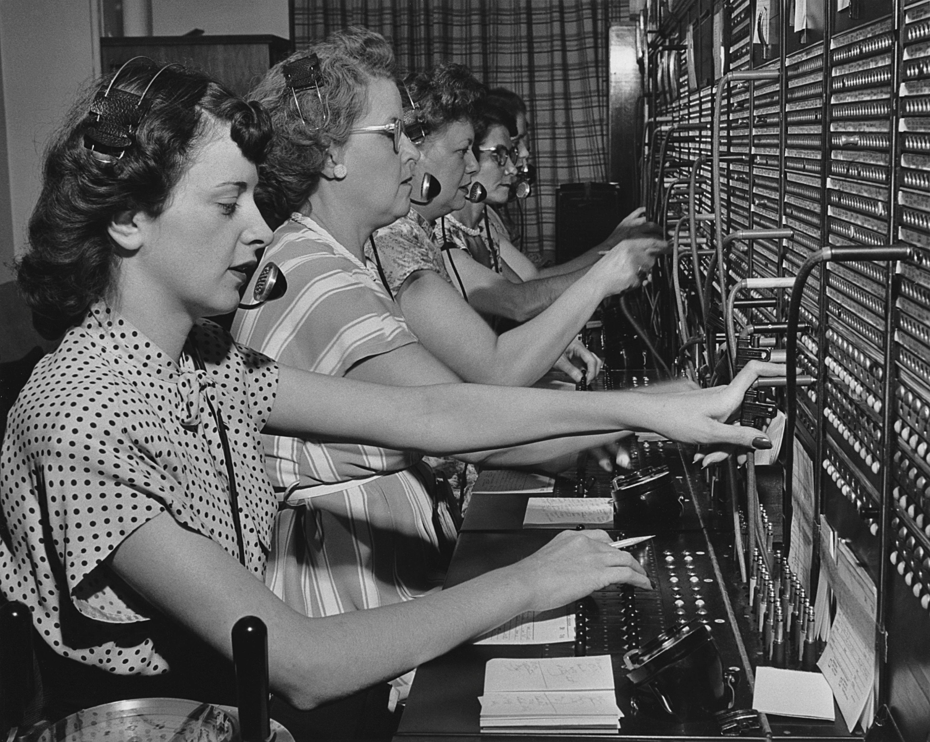
Why do we need the change?
Use the Meetings icon to open the meetings view

Slide 5
What is Teams?
Teams is a collaboration tool that provides staff with the ability to work, communicate and share information together via a common space from whatever their location.
Over 1000 of you already use it earnest but not as a replacement phone system – yet!
Main features include:
Communication through chat, conferencing and standard telephone features (voicemail, hunt groups, call forward etc)
File Storage and Sharing Files (both internally and externally)
Many other plugins and features!
Use the Meetings icon to open the meetings view

Slide 6
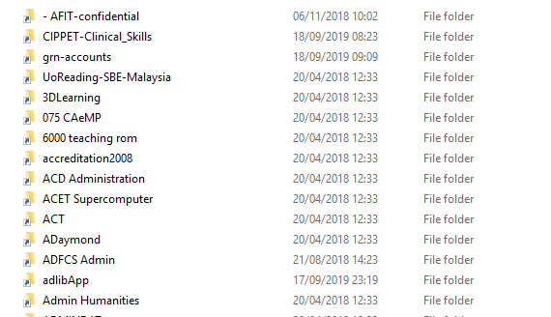
Scope of Today’s Session?
Today we need to focus on “Communications with Teams” only.
But what about file storage and file sharing training?
We need to define a strategy for this challenge first:
Training for this will come soon!
Use the Meetings icon to open the meetings view

Slide 7
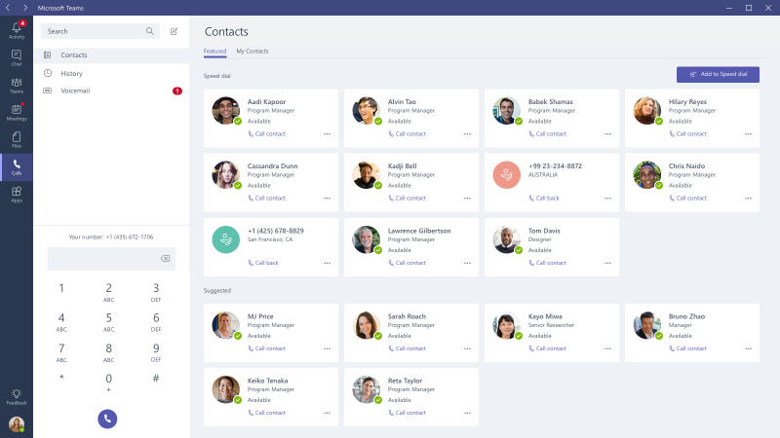
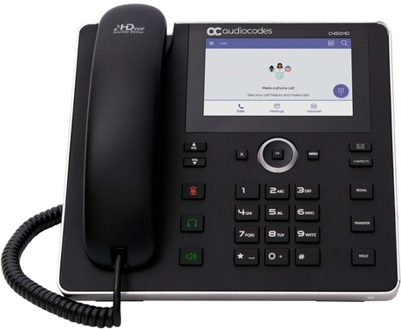
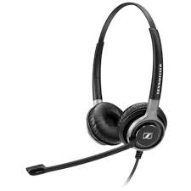
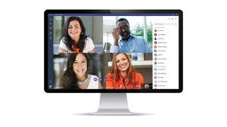
Demonstration
Use the Meetings icon to open the meetings view

Slide 8
The Project
When?
Who?
How?

Slide 9
Who does this affect?
All staff in Functions and Schools who use the current telephone system on four campuses:
Whiteknights
London Road
Greenlands
Malaysia

Slide 10
What will be the result?
Most users will use headsets and the Teams application on laptop / PC.
Users who cannot use a headset will have a Teams phone.
Everyone will be able to:
Access Teams for Calls, Chat or Meetings from any Teams phone or Reading University PC / laptop across any Campus or a work Smart phone.
Access Teams from home equipment or a personal Smart phone that uses Android or iOS.
See caller id where it is available.
Control your own Voicemail, call pick up and forwarding rules without waiting for IT help.
Set up and hold your own meetings or conference calls with or without video and screen sharing.

Slide 11
When is it happening?
Nov 2019
Dec 2019
Jan to March 2020
April 2020
May 2020
Familiarisation
Preparation
Delivery
Migration
Disposal
Teams pushed out to all users (Win10)
Awareness sessions for all staff
Website published
Requirements gathering
Anyone on Skype for Business put on Teams for calls
Headsets and IP phones given out
Training sessions
Call centre software
Analogue phones
All users on to Teams Calls
Old phones no longer work
Can now dial external numbers
Training sessions
Collect old equipment and dispose of it

Slide 12
What do I need to do?
We shall be asking Admin and ESCOP staff to act as a single point of contact within the Departments.
All staff will need to fill in a Form to tell us what they need.
Start now to use Teams for Chat.
Once you have your headset or phone, start to use it for internal calls and for Teams meetings.
Make sure you are familiar with the software and equipment before we migrate everyone onto Teams for all calls next year.

Slide 13
What help will be provided?
In house web page with videos, how-to sheets and FAQs.
Drop in sessions for communicating with Teams UI.
Individual introductory training for use of phones.
From requirements gathered we can identify who else needs help with specific matters such as Accessibility or Delegated users.
Microsoft website and / or further training on other parts of Teams.

Slide 14
Further Information
Team email / Raise a call through the IT Self Service portal.
Web Page from Staff Portal.
‘Working with Teams’ Team – regular Blogs on project progress.
Set up a conversation – give your name to Judith on the way out.
Also see the chosen headset and handset.
Unified-communications@reading.ac.uk

