Slide 1
Developing ‘soft’ transferable skills to achieve ‘hard’ targets through cultural and community engagement
Felicia Heard & Dr Rebecca Hooker, INTO, University of Exeter
InForm Conference, Birmingham, Saturday 30th June, 2018

Slide 2
Overview
What are soft skills?
Ways of developing them?
Engagement and Communicative Language Skills (ECLS)
Unexpected outcomes
Issues for consideration

Slide 3
What are ‘soft skills’?

Slide 4
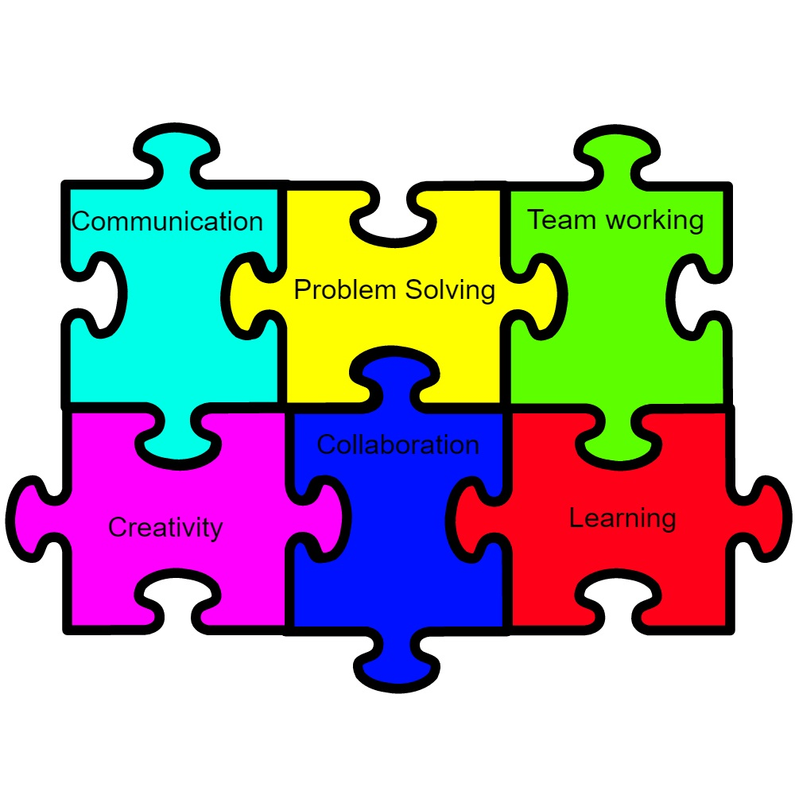
Conflict management Self-awareness Self-management Cultural awareness Teamwork abilities Project Management
Another list of ‘soft skills’.................

Slide 5
Definition of ‘Soft Skills’
“Character traits, attitudes and behaviors – rather than technical aptitudes”
(Robles, 2017)

Slide 6
Soft Skills College Students Need Now and in the Future
Motivation /Commitment
Thinking/ Reflective skills
Enthusiasm
Ambition
Preparation
Goals
Talents
Attendance
Interpersonal Skills
(Appleby, 2017)

Slide 7
How do Students Demonstrate ‘Soft Skills’
Ask questions
Make thoughtful comments
Pursue extra information for understanding
Make good decisions about classes/
what to study/ time management
Attend class conscientiously
Are prepared
Complete assignments carefully accurately
Use talents wisely
Positive attitude and hard work
Go beyond the basic requirements of the task, e.g. seeking out extra readings
Motivated about future careers
Excited and realistic about the future
Perceive education as an investment for the future
Think- connect past experiences to
present and future/ problem solve
Reflect on past experiences

Slide 8
Engagement and Communicative Language Skills (ECLS)
Aims
Provide opportunities for students’ interaction with native speakers of English
Help students with their communicative language skills in English
Increase students’ awareness of British culture
Use apps and some computer software to support learning

Slide 9
Engagement and communicative language skills (ECLS)
Implementation
Weekly Community Engagement Task: visits to Exeter Central library, charity shops, the Guildhall
Follow up: short reflective writing piece (50 words) + short presentation (3 minutes) in small groups
Community Engagement Project: a visit to the RAMM museum, Exeter to research an artefact/ section in the museum
Follow up: reflective writing piece (300 words) + short presentation (5 minutes) to the whole class

Slide 10
Assessment
No formal assessment with a grade
Formative seminar: Weekly Community Engagement tasks
Summative seminar: Community Engagement project

Slide 11
Engagement and communicative language skills (ECLS)
Example completed tasks: Weekly Community Engagement Tasks via Padlet
I went to the cinema museum with my classmates, and teacher Janey. we asked some questions, and we saw artists photos and how to make movies, and I asked one question about children. If children want to visit this museum how can they enjoy it
Last Friday we went to city centre at Queen Street to visit resturant or café . We were exiting and had a good experience to do some practice speaking with naitve people. We learned to do conversation ,and do graph about that -speaking lesson.
I visited Tourist Information Centre on friday last week. I asked some questions about Cathedral Church.In addition,I know some history of this church with help.I think it was a precious experience for me.It help me have a chance to connect with local person.

Slide 12
Engagement and communicative language skills (ecls)
Example completed tasks: Community Engagement Project
On 26th July 2017, I visited the Royal Albert Memorial Museum in Exeter. … I decided to talk about the air raid shelter also known as the Anderson shelter in social and industrial history. …The purpose of the shelter is to protect people from German’s bomb threats from September 1940 to May 1941. …
I found it unbelievable to stand in front of an Anderson shelter which was created 78 years ago to protect civilians. I felt exhilarated because I was unaware of an invention created to protect civilians from bombs….
Although it was difficult and unpleasant for British citizens to stay up the whole night in a narrow Anderson shelter, it was a great idea to protect individuals. ...This invention was clever because the shelters were made out of steel to protect people.

Slide 13
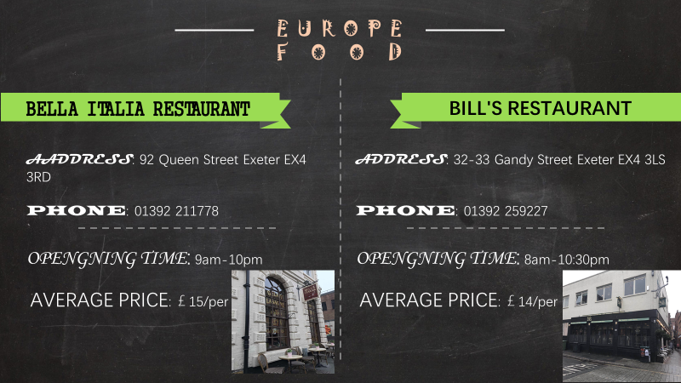
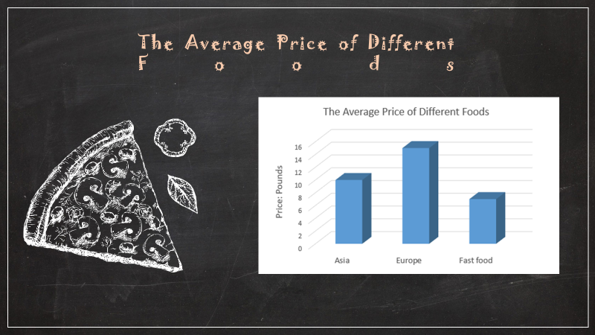
Engagement and communicative language skills (ECLS)
Example completed tasks: Presentation

Slide 14
Engagement and Communicative Language Skills (ECLS)
Student feedback: Helen
The new thing I learnt this week
is we need to say
"Sorry, I am not certain about this, maybe I can recommend you to
search it..."
It's my presentation I felt very excited during make our presentation. I shared my precious memory to our class. It was fantastic. I would like do it again

Slide 15
Engagement and communicative language skills (ECLS)
Unexpected outcomes - soft skills:
Courtesy
Confidence
Curiosity
Enthusiasm
Working in a team
Communication skills
Comfortable feeling

Slide 16
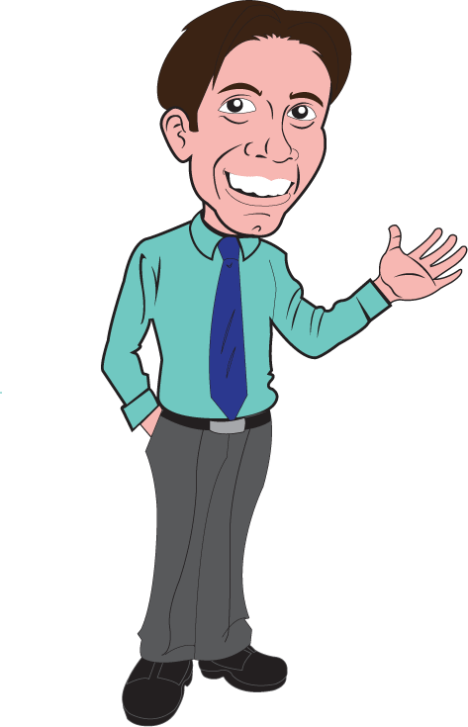
What the teacher said............
“The students from Duryard definitely showed a level of professionalism in their presentations”
“ Mon (Thailand) had a tremendous advantage with her presentations”
“ James (China) was quiet but his advanced presentation skills were the one area of strength which we could work on. We used it as a ‘crowbar’ to get him to do some work”

Slide 17
Engagement and communicative language skills (ECLS)
Issues (+) and (-)
Not formally assessed - some students do not consider the module to be important and of value
Practising and rehearsal build confidence and comfort
Time more constructively spent on developing hard skills?
Evaluating personality and behaviour realistic?
Exposure to authentic communicative situations beneficial but
difficult to resource

Slide 18
References
Robles, M. M. (2012). Executive perceptions of the top 10 soft skills needed in today's workplace. Business Communication Quarterly, 75 (4) 453–465.
Appleby, D (2017). ‘The soft skills college students need to succeed now and in the future. Transferable skills for success in college and the workplace.’ American Psychological Association. Psychology Student Network. http://www.apa.org/ed/precollege/psn/2017/09/soft-skills.aspx
Accessed 28th June, 2018.

