Slide 1
Using Legitimation Code Theory to Enhance Students’ Academic Writing
Paula Villegas Verdu
Associate Member, LCT Centre for
Knowledge-Building.

Slide 2
Overview
What do we expect in a good academic paragraph?
How can LCT help us identify what we want students to produce?
How do we use LCT to explain what we want students to produce? - Practical Activities.
Recap
What is next?

Slide 3
What do you expect in a good academic paragraph?
Durkheim (1933) suggests that deviance exists because actions from those outside the norm “shock the collective conscience” (p. 38). In the case of female bodybuilders, pursuing their sport is seen as challenging the social distinction between masculinity and femininity. It is taken as a blatant attempt to defy the traditional notion of the female body (Aitchison, 2006). Unfortunately, female bodybuilders are often met with disapproval. From stares from fellow gym users to insensitive comments, female bodybuilders suffer from forms of opposition. Linda agreed wholeheartedly when I brought this up. “People talk about female athletes and they expect track stars and netballers,” she said. Chare (2004) labels the resistance of female bodybuilders against this cultural norm as the “radical politics of muscle”. The female bodybuilder’s physique strongly opposes the traditional female body and representation of femininity.
Student A (revised)
Brooke, (2017p.55-56 )

Slide 4
What do you expect in a good academic paragraph?
Durkheim (1933) suggests that deviance exists because actions from those outside the norm “shock the collective conscience” (p. 38). In the case of female bodybuilders, pursuing their sport is seen as challenging the social distinction between masculinity and femininity. It is taken as a blatant attempt to defy the traditional notion of the female body (Aitchison, 2006). Unfortunately, female bodybuilders are often met with disapproval. From stares from fellow gym users to insensitive comments, female bodybuilders suffer from forms of opposition. Linda agreed wholeheartedly when I brought this up. “People talk about female athletes and they expect track stars and netballers,” she said. Chare (2004) labels the resistance of female bodybuilders against this cultural norm as the “radical politics of muscle”. The female bodybuilder’s physique strongly opposes the traditional female body and representation of femininity.
Student A (revised)
Brooke, (2017p.55-56 )

Slide 5
What do you expect in a good academic paragraph?
Durkheim (1933) suggests that deviance exists because actions from those outside the norm “shock the collective conscience” (p. 38). In the case of female bodybuilders, pursuing their sport is seen as challenging the social distinction between masculinity and femininity. It is taken as a blatant attempt to defy the traditional notion of the female body (Aitchison, 2006). Unfortunately, female bodybuilders are often met with disapproval. From stares from fellow gym users to insensitive comments, female bodybuilders suffer from forms of opposition. Linda agreed wholeheartedly when I brought this up. “People talk about female athletes and they expect track stars and netballers,” she said. Chare (2004) labels the resistance of female bodybuilders against this cultural norm as the “radical politics of muscle”. The female bodybuilder’s physique strongly opposes the traditional female body and representation of femininity.
Student A (revised)
Brooke, (2017p.55-56 )

Slide 6
What do we expect in a good academic paragraph?
This paragraph uses both the literature and specific examples from context to create a cohesive academic paragraph.
As opposed to
Paragraphs which engage with academic literature but fail to relate the quotes to the relevant context. (What is the point of all these quotes?)
Paragraphs which explains the relevant context but fail to engage with the literature. The examples are too specific and anecdotal. (Can you back this up with evidence?)

Slide 7
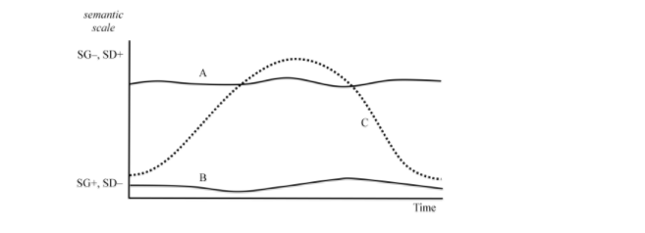
Semantic Profiles
Figure 1. Semantic Profiles (Maton, 2014 p.38).
Line A-> Academic Literature
Line B -> Specific Context
Line C -> Specific Context + Academic Literature

Slide 8
How can LCT help us identify what we want students to produce?
Semantic Gravity
Degree of context-dependence of meaning, it can be stronger (+)
or weaker (-) along a range of strengths
weaker = less context-dependent
stronger = more context-dependent
Example one Revolution (SG-) / Industrial revolution (SG+)
Example two Solution (SG-) / homogenous mixture of two or more substances

Slide 9
How can LCT help us identify what we want students to produce?
Semantic Gravity
strengthening semantic gravity – e.g. moving down from
abstract concept to concrete examples
• weakening semantic gravity – e.g. moving up from
concrete examples to more abstract ideas

Slide 10
How can LCT help us identify what we want students to produce?
Semantic Gravity
Degree of complexity in meaning , it can be stronger (+) along a range of strengths
weaker = less meaning is condensed
stronger = more meaning is condensed
Example Gold as the shiny metal used in jewellery / Au
SD-
SD+

Slide 11
How can LCT help us identify what we want students to produce?
Semantic Density
Degree of complexity in meaning
weakening semantic density
e.g. ‘unpacking’ a dense concept by
putting it into everyday language
• strengthening semantic density
e.g. taking a lengthy description and
‘packing it up’ into a symbol or
technical term

Slide 12
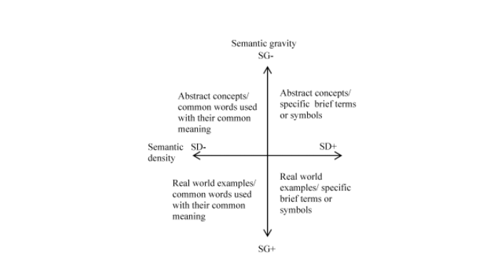
How can LCT help us identify what we want students to produce?
The Semantic Dimension
Figure 4. The relationship between SG & SD (Maton, 2011 as cited in Blackie, 2014 p. 464)

Slide 13
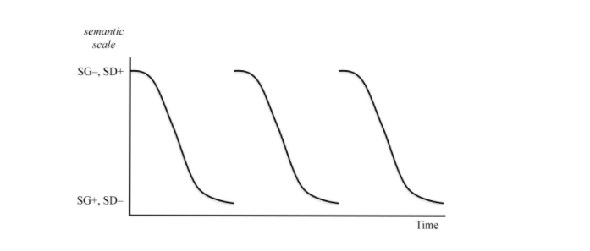
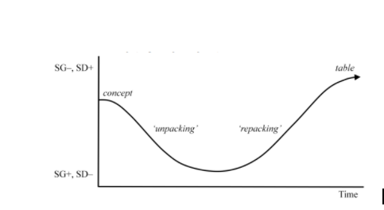
The Semantic Dimension: Unpacking and Repacking
Figure 2. Unpacking (Maton, 2014 p. 40)
Figure 3.Repacking (Maton, 2014 p.41)

Slide 14
How do we use LCT to explain what we want? - Practical Activities
Brooke (2017) designs an instructional model to facilitate gravity waving.
Brooke (2017) reports positive results, although he acknowledges the complexity of LCT he argues that students engaged with it and gave a very good feedback overall.

Slide 15
How do we use LCT to explain what we want? - Practical Activities
Ingold & O'Sullivan (2017)
Example texts are given.
Both ideas & language can be explored
Students are given different semantic graphs and decide which one represent each paragraph.
Cut out key noun groups from example paragraphs. Students place them on graph axes
Students construct the waves
Students write their own paragraph following the template
Students cut up the key nouns/ NPs from their own paragraph and give them to another group who tries to place them in the graph axes

Slide 16
How do we use LCT to explain what we want? - Practical Activities – Semantic Gravity
What does it look like in my classroom? - Structure
Topic Sentence
Durkheim (1933) suggests that deviance exists because actions from those outside the norm “shock the collective conscience” (p. 38).
Examples/ Evidence
From stares from fellow gym users to insensitive comments, female bodybuilders suffer from forms of opposition. Linda agreed wholeheartedly when I brought this up. “People talk about female athletes and they expect track stars and netballers,” she said
Evidence from the literature
In the case of female bodybuilders, pursuing their sport is seen as challenging the social distinction between masculinity and femininity. It is taken as a blatant attempt to defy the traditional notion of the female body (Aitchison, 2006).
Concluding sentence Sentence
Chare (2004) labels the resistance of female bodybuilders against this cultural norm as the “radical politics of muscle”. The female bodybuilder’s physique strongly opposes the traditional female body and representation of femininity.

Slide 17
How do we use LCT to explain what we want? - Practical Activities Semantic Gravity
What does it look like in my classroom? – Structure
Academic Literature
Academic Literature
Example specific to your context
Example specific to your context

Slide 18
How do we use LCT to explain what we want? - Practical Activities Semantic Gravity
What does it look like in my classroom? - Blank model
Topic Sentence
Examples/ Evidence
Evidence from the literature
Concluding Sentence

Slide 19
How do we use LCT to explain what we want? - Practical Activities – Semantic Density
What does it look like in my classroom? – Language
Nominalization
Recognizing Nominalization
Regular but brief communication with the sales forces in the field is essential.
It is essential to communicate regularly but briefly with the sales force in the field.

Slide 20
How do we use LCT to explain what we want? - Practical Activities - Semantic Density
What does it look like in my classroom? – Language
Nominalization
Practice -> What do you need to change?
Researchers have to judge how valid and reliable the web sites are.
Researchers have to judge the validity and reliability of the web sites.
Researchers have to judge how valid and reliable the web sites are.

Slide 21
How do we use LCT to explain what we want? - Practical Activities - Semantic Density
What does it look like in my classroom? – Language
Every day phrases in my essay | Academic version
It is essential to communicate regularly but briefly with the sales force in the field. | Regular but brief communication with the sales forces in the field is essential.

Slide 22
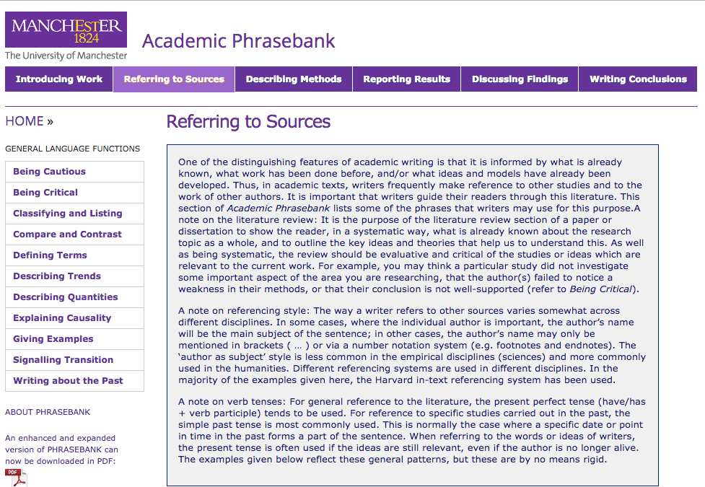
How do we use LCT to explain what we want? - Practical Activities
What does it look like in my classroom? – Language
A helping hand
‘But how do I refer to my sources?’ -> Manchester Phrasebank.

Slide 23
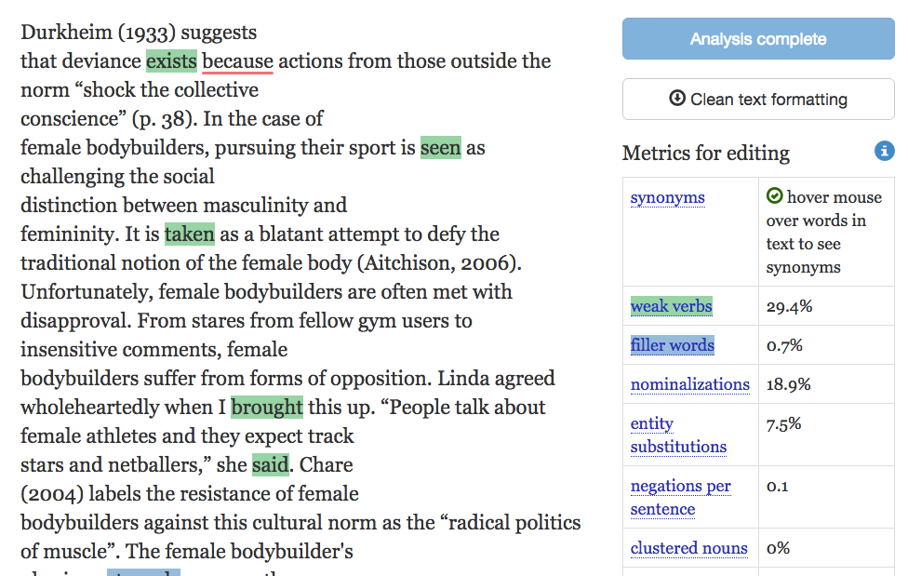
How do we use LCT to explain what we want? - Practical Activities
What does it look like in my classroom? – Language
A helping hand
‘How do I know if my language is academic?’ – expresso text analysis

Slide 24
What is next?
LCT is becoming increasingly popular
Active online community
LCT webpage
Roundtables
Legitimation Code Theory Journal recently founded (Maton, 2017)
It can be combined with other theories, methods or approaches (SFL)

Slide 25
Bibliography
Brooke (2017) Using semantic waves to guide students throughout the research process: from adopting a stance to sound cohesive academic writing. Asian Journal of the Scholarship of Teaching and Learning. Vol 7 Issue 1.
Gillet, A. 2015. Features of academic writing: complexity. [online] Available at: http://www.uefap.com/writing/feature/complex.htm#mod [Accessed 20 April 2015].
Ingold& O'Sullivan (2017) Riding the waves to academic success. English for academic purposes. Vol.26 Issue 2
Maton (2017) Personal Correspondence.
Maton (2014) Knowledge and knowers: towards a realist
sociology of education. Routledge, 2014, 244 pp, ISBN: 978-0-415-47999-8 (hbk)
Maton, K. (2014) Building powerful knowledge: The significance of semantic waves, in Rata, E. & Barrett, B. (eds) Knowledge and the Future of the Curriculum: International studies in social realism, London: Palgrave Macmillan
Maton, K. (2013) Making semantic waves: A key to cumulative knowledge-building, Linguistics and Education, 24(1): 8-22.
Paterson, K. 2013. Oxford Grammar for EAP. Oxford: Oxford University Press. p39.
Queen Mary University of London. 2012. Nominalization. [online] Available at: http://aeo.sllf.qmul.ac.uk/Files/Nominalization/Nom%20LOC.html [Accessed 20 April 2015].
Sowton, C. 2012. 50 Steps to improving your academic writing. Reading: Garnet Publishing Ltd. p.101.
Subject Centre for Languages, Linguistics and Area Studies Materials Bank. nd. Using noun phrases instead of clauses. [online] Available at: https://www.llas.ac.uk//materialsbank/mb063/eap/05/vs70402.htm [Accessed 23 April 2015].
Vandiver, D. M. & J. A. Walsh. 2010. Assessing autonomous learning in research methods courses: Implementing the student-driven research project. Active Learning in Higher Education 11/1. pp 31 – 42. in Queen Mary University of London. 2012. Noun Phrases. [online] Available at: http://aeo.sllf.qmul.ac.uk/Files/NounPhrases/Noun%20Phrases.html [Accessed 20 April 2015].
To
Discover
And
Understand.

