Slide 1
Library? What library? Effectively developing IFP students' library skills
Hannah Gurr (EAP Tutor)
Centre for English Language and Foundation Studies (CELFS), University of Bristol
Sarah Brain (Librarian for Economics, Finance and Management)
Arts and Social Sciences Library, University of Bristol
15:20 – 16:00

Slide 2
In a nutshell:
It is essential for students (whether international or domestic) to develop Library Skills while at university. However, many students come to our departments unaware of the need to do research, evaluate sources, cite or reference at the end of their essays.
In 2017-18, we wanted to get IFP students and subject librarians together, alongside IFP teaching staff, to explore the most effective ways of helping students acquire these essential skills, and moving away from Google/Baidu as a way of finding information for their academic essays.

Slide 3
Outline
Context
Why did we do it?
What we did (first session)
Reflection
What we did (follow up session)
Reflection
What next?
Conclusions / questions

Slide 4
Context
IFP grew from 110 students (2016/17)
to 141 students (2017/18)
Three pathways: STEM (69),
Arts and Humanities (8), Social Sciences and Law (64)
Age range: 16-37
Main nationalities: Chinese (66), Omani (16), Jordanian (6), Emirati (4), Russian (4), S. Korean (4)

Slide 5
Classes at CELFS
 | Academic Writing | Text Response |  | Academic Writing | Text Response
A1 B1 | Alan (A1) Debra (B1) | Ruth (A1) Hazel (B1) | S1 | Hazel | Elizabeth
A2 | Steve | Nick | S2 | Julia | Craig
A3 | Katherine | Donna | S3 | Hannah | Julia
A4 | Blair | Ginny | S4 | Claire | Mike
A5 | Christine | Maggie | S5 | Paul | Claire
AW & TR: 2 hours, 3 times a week
A1, B1, S1 = IFP+ students with an IELTS score of 7 or more (n=39)
2 hours, twice a week (Accelerated Academic Writing / Accelerated Text Response)

Slide 6
Motivation
I began MSc TESOL Sept. 2015 – this was the first time I had to write proper academic essays since Delta in 2010 and BA in late 90s → I realised my library skills were out of date.
In Apr. 2016, during a TEAP course, I met 3 librarians from UWE, → I realised my notion of the profession was naïve!
In Jan. 2017, I invited (Sarah’s predecessor) Economics subject librarian to do a session with just my class.
In 2017-18, I wanted to move towards improving library skills for ALL our IFP students.

Slide 7
Subject Librarian perspective
Role of the Subject Librarian: collection development but also enabling students to find and critically evaluate information sources, and use them ethically in their academic work.
In practice this means that we carry out a lot of teaching in our subject areas in liaison with academic staff. This is a large part of the role of a subject librarian.
Many of us will have an HE teaching qualification along with fellowship or associate fellowship of the HEA.

Slide 8
Considerations for the sessions
Tutors only ‘lost’ one session of teaching (one from TR, one from AW) out of 70. Tutors could opt out.
Push IFP students to physically go to their library.
Give IFP students the opportunity to meet their subject librarians and find out what they can do.

Slide 9
Sarah’s perspective
New to the university and the role (but 10 years at UWE)
Joint session planning with HG
Session carried out in November:
5 x tutors present = legitimising content
About 40-50 students in session

Slide 10
First Library Skills session
 | Academic Writing | Text Response |  | Academic Writing | Text Response
A1 | Alan (A1) Debra (B1) | Ruth (A1) Hazel (B1) | S1 | Hazel | Elizabeth
A2 | Steve | Nick | S2 | Julia | Craig
A3 | Katherine | Donna | S3 | Hannah | Julia
A4 | Blair | Ginny | S4 | Claire | Mike
A5 | Christine | Maggie | S5 | Paul | Claire
Sarah Brain (Economics, Finance and Management)
13 November 2017, 9-10:30 am
Slides and handouts available on Blackboard for A1 and B1

Slide 12
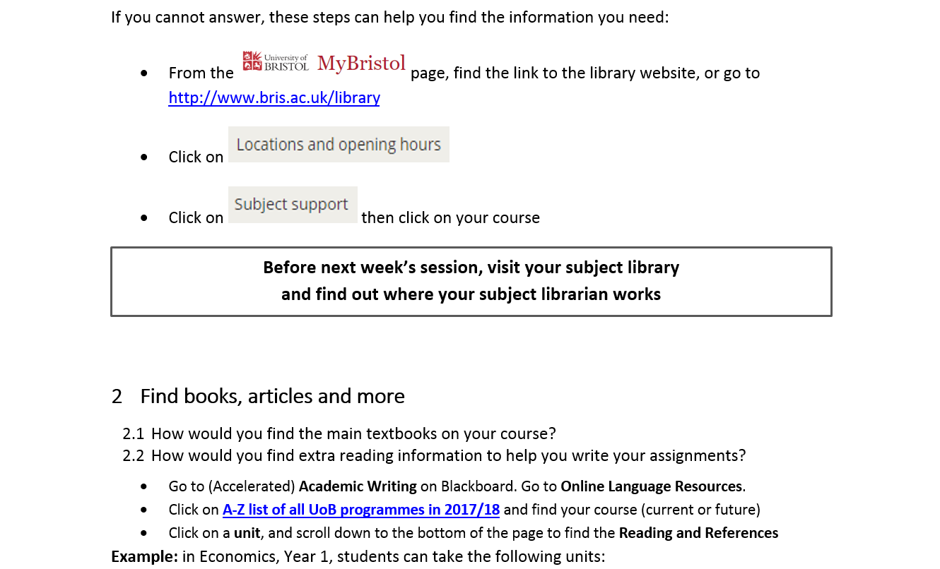

Slide 13
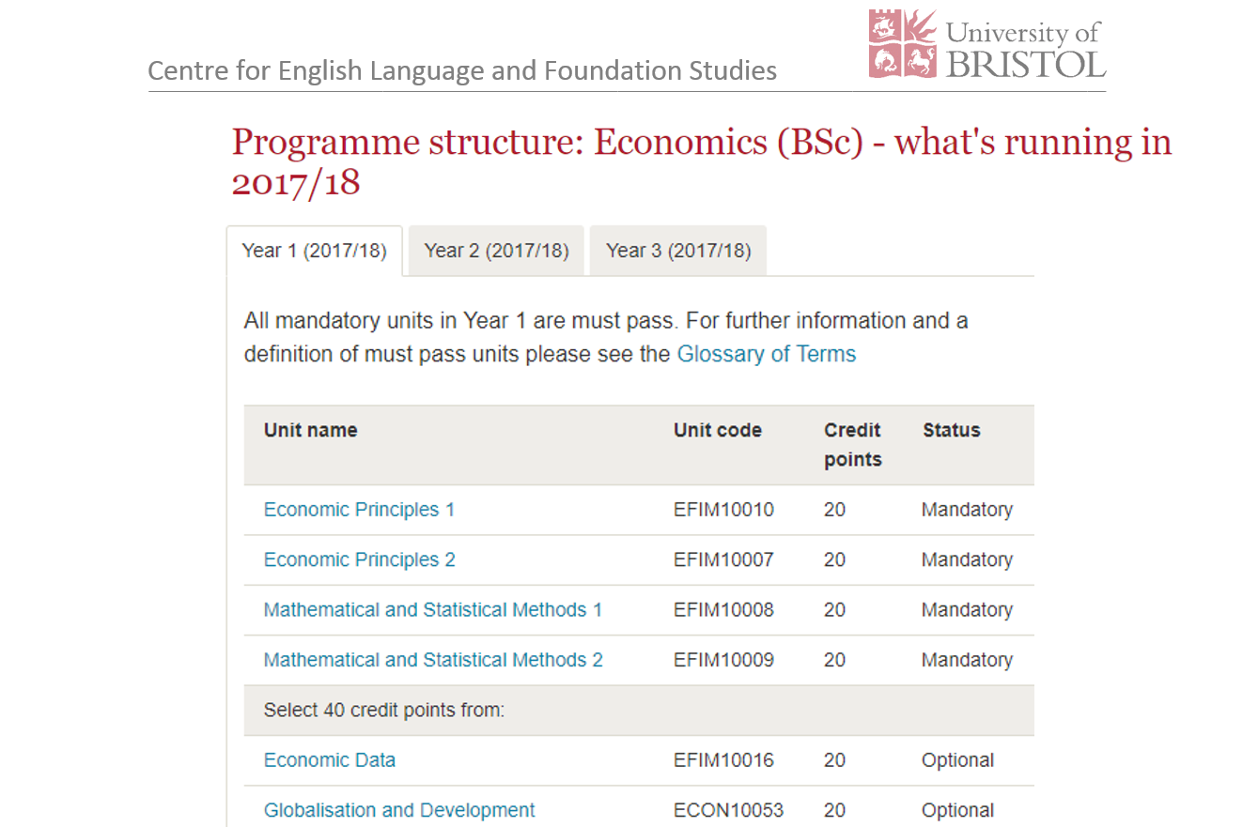

Slide 17
First Library Skills session (STEM)
 | Academic Writing | Text Response |  | Academic Writing | Text Response
A1 | Alan (A1) Debra (B1) | Ruth (A1) Hazel (B1) | S1 | Hazel | Elizabeth
A2 | Steve | Nick | S2 | Julia | Craig
A3 | Katherine | Donna | S3 | Hannah | Julia
A4 | Blair | Ginny | S4 | Claire | Mike
A5 | Christine | Maggie | S5 | Paul | Claire
Lucy Wilkins (Engineering and Physics)
29 November 2017, 2-3:30 pm

Slide 18
Reflection (first session)
Need more time to jointly prepare the content.
Large groups – sometimes difficult to manage.
Students engaged well with the activities
There were a range of abilities amongst students.
Need to get other tutors on board, so they know what they need to do (class management, monitor, keep on task, prompt students to ask questions, flag up problems).
We all learned something new!
Need to check how Library page looks on smartphones & tablets, not just PCs.
Post-its on every table – great for collecting questions and comments during / at end of the session

Slide 19
Student questions (first session)
How to borrow and return book from library?
Can I find PIN CODE on blackboard (MyBristol)? I need to put when I borrow a book
Is every resource available online? Is it better to look for journals or books?
Is the article reliable? Does it matter it was published a long time ago? would be a problem?
No units for “Theatre”
How to use “Westlaw” database?
The above are verbatim from post-its collected during the session

Slide 20
Law Library Skills
20 students British Constitutional History unit
40 hours (2 hours per fortnight over 2 teaching blocks)
CELFS EAP tutor: Katherine High (1 hour per week Link class)
Law librarian: Naomi Nile
Content lecturer: Louise Hatherall
Two sessions:
visit to UoB Law Library

Slide 21
Law Library Skills
20 students British Constitutional History unit
40 hours (2 hours per fortnight over 2 teaching blocks)
CELFS EAP tutor: Katherine High (1 hour per week Link class)
Law librarian: Naomi Nile
Content lecturer: Louise Hatherall
Two sessions:
visit to UoB Law Library
session on OSCOLA and Westlaw database

Slide 23
Student comments (first session)
I will use library to research for assignments / We think everything was useful / Confusing: searching for specific phrases
This session is useful especially the topic search
A very useful session, I have learned where is my library and when is the opening time and how to find the books also about the journal and fine
Thank you Sarah, with your clear explanation, I could get clear information
This talk was very useful and interesting. I want to have more talks like this
The above are verbatim from post-its collected at the end of the session

Slide 24
Second Library Skills session (STEM)
 | Academic Writing | Text Response |  | Academic Writing | Text Response
A1 | Alan (A1) Debra (B1) | Ruth (A1) Hazel (B1) | S1 | Hazel | Elizabeth
A2 | Steve | Nick | S2 | Julia | Craig
A3 | Katherine | Donna | S3 | Hannah | Julia
A4 | Blair | Ginny | S4 | Claire | Mike
A5 | Christine | Maggie | S5 | Paul | Claire
Lucy Wilkins (Engineering and Physics)
21 February 2018, 10-11:30 am
Cancelled due to illness, never rescheduled due to snow, strikes and (exam) stress

Slide 25
Second Library Skills session
 | Academic Writing | Text Response |  | Academic Writing | Text Response
A1 | Alan (A1) Debra (B1) | Ruth (A1) Hazel (B1) | S1 | Hazel | Elizabeth
A2 | Steve | Nick | S2 | Julia | Craig
A3 | Katherine | Donna | S3 | Hannah | Julia
A4 | Blair | Ginny | S4 | Claire | Mike
A5 | Christine | Maggie | S5 | Paul | Claire
Sarah Brain (Economics, Finance and Management)
21 February 2018, 12-2:30 pm
Co-presented with Alan, as Hannah was unavailable

Slide 26
Second Library Skills session
Same location as before, with tutors present
Approx. 70 students
Re-cap of learning from first session
Difference between databases and Google Scholar
Activity looking at journals
HG put C.R.A.A.P. slides into ppt – but tutors and students quickly signalled that this was old ground
Plenty of time for students to search databases

Slide 27
Reflection (second session)
More preparation time needed to enable more joint preparation of content
Original plan modified by SB to include work with journals
Consider revision of some of the content
Feedback from students was that the session repeated content from the first. Next time ask students to participate in a test/quiz at the beginning as a way of recapping first session.

Slide 28
Student comments (second session)
It was very useful to understand new things. Can’t wait for this meeting, I wish If we had this session more often.
The presentation was very useful. I am now able to shorten research time by using the unis database collection
It was incredibly useful, as we found out how to use database!!!
I have learnt database It’s very useful!
It was good. I have learnt about how to use the database to find journal in specific subject, which is useful
To be honest, I think the library session on TB1 was more useful than today. It is because students not only frequently use published journals, but also already know some info on searching sources.
We are told some useful information, but it was almost the same as the previous one, in my opinion.
given more academic website that can be used to search for journal or articles and the introduction was really clear
useful. I can now narrow the filters. Articles are more up to date. Book are at least two years old.

Slide 29
What next? 2018/19
IFP continues to grow from 141 students (2017/18)
FOUR timetabled streams:
Physics
Chemistry
Economics
Arts, Humanities, Law

Slide 30
What next? 2018/19
IFP continues to grow from 141 students (2017/18)
FOUR timetabled streams:
Physics (Lucy Wilkins)
Chemistry (John Hargreaves)
Economics (Sarah Brain)
Arts, Humanities, Law

Slide 31
What next? 2018/19
IFP continues to grow from 141 students (2017/18)
FOUR timetabled streams:
Physics (Lucy Wilkins)
Chemistry (John Hargreaves)
Economics (Sarah Brain)
Arts, Humanities, Law: Link classes? Naomi Nile (Law)
Lucy Langley-Palmer (Film and TV/Theatre)
Damien McManus (English)
etc.

Slide 32
Videos + face-to-face session(s)
Maximise time with subject librarians by ‘flipping’ the very basic content
W1: Library Skills 1 (location / subject librarian)
W2: Library Skills 2 (UCard, PIN, self-service machine)
W3: Library Skills 3 (find a specific book)
W4: Library Skills 4 (reserve a book which is out on loan)
W5: Google Scholar & C.R.A.A.P. test
W6: Enhancement Week = face-to-face session
physical journals / article search + filters / databases

Slide 33
Videos
Made with Camtasia – recording voice over PowerPoint slides, and walking them through the whole process via webpages.
If you make a mistake, just pause, say it again and afterwards edit out the bloopers! It’s easier to cut out extraneous recordings than create content.
Most videos are around 3 mins in length. Some have a follow-up task. Most require students to find info relevant to themselves after watching an example.
Speed of delivery aimed at IELTS 5, audio backed up with visual – the same content could be used for higher levels / home students by recording a video speaking at a more natural pace.
One way of checking whether students have watched the videos and completed the tasks could be to embed them within edpuzzle.com

Slide 34
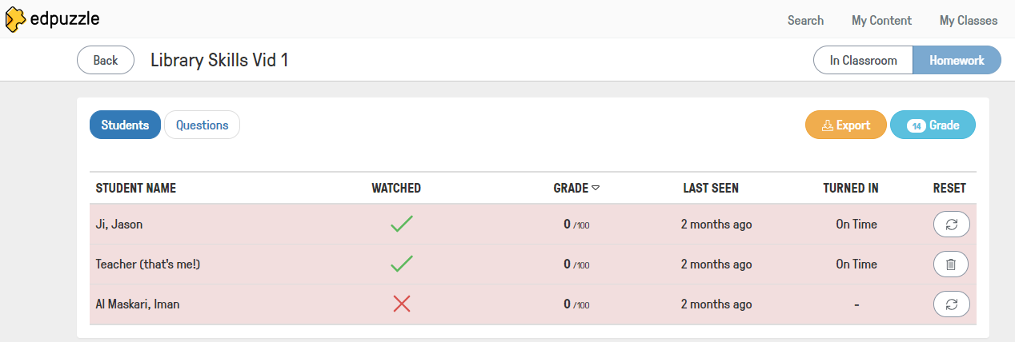
Videos + edpuzzle
3-minute videos on basic skills in Weeks 1-5
Prepare for face-to-face session
Face-to-face session in Week 6
Use edpuzzle to monitor student engagement (i.e. did they watch the video and complete the tasks?)
These do not have a grade because the ‘correct’ answer varies from student to student.
e.g. one may need the Physics library, another may need the Arts and Social Sciences library.

Slide 35
Conclusions
CELFS will continue to help students develop library skills
Forge closer links between CELFS & (more) subject librarians and make use of their expertise
Videos + face-to-face sessions = the best solution
+ bank of resources to build on
+ students work at own pace (differentiation)
+ standardisation of input across students
+ easy for tutors to follow up on tasks
– videos go out of date
Time-consuming process (largely unpaid) to set up – especially at my grade (i.e. not co-ordinator)
IFP co-ordinators take over organisation

Slide 36
Questions?
sarah.brain@bristol.ac.uk
hannah.gurr@bristol.ac.uk

