Slide 1
Unity in diversity – introducing a broad range of students to the requirements of university writing
Shuna Neilson Associate Professor, School of Liberal Arts

Slide 2
Academic Literacies 2013
5000 level Research Methods courses in the disciplines
ARW 4195 Principles of Academic Research
ARW 3195 Principles of Academic Writing
_______________________
EAP

Slide 3
ARW 3195 Principles of Academic Writing FA13
Summative Assessment Items | Weighting
Cause/effect research paper (1,500 words) | 40%
Oral presentation | 15%
Recommendation report(1,250 words) | 35%
Preparatory tasks | 10%
Midterm exam: Critical reading | 15%
Final exam: Essay (2 hrs) | 20%

Slide 4
ARW 4195 Principles of Academic Research FA13
Summative Assessment Items | Weighting
Argument-based research paper (2,000 words) | 30%
Literature review research paper (2,000 words) | 30%
Research tasks | 15%
Information literacy | 10%
Mid-semester exam | 15%

Slide 5
ARW 3195 Principles of Academic Writing FA14
Summative Assessment Items | Weighting
Cause/effect research paper (1,500 words) | 40%
Oral presentation | 15%
Recommendation report (1,250 words) | 35%
Preparatory tasks | 10%

Slide 6
ARW 4195 Principles of Academic Research FA14
Summative Assessment Items | Weighting
Argument-based research paper (1,500 words) | 30%
Literature review research paper (2,000 words) | 40%
Research tasks | 20%
Information literacy | 10%

Slide 7
Accreditation requirements
MSCHE
QAA/OU

Slide 8
MSCHE Standard 12
General Education
The institution’s curricula are designed so that students acquire and demonstrate college-level proficiency in general education and essential skills, including at least oral and written communication, scientific and quantitative reasoning, critical analysis and reasoning, and technological competency.

Slide 9
Programme Specifications: Outcomes eg.BA (Hons): History with Combined Studies
Cognitive Skills
LEVEL 3
Demonstrates the ability to gather, organise and deploy ideas and information in order to communicate arguments effectively in written, oral or other forms, with an understanding of appropriate methods

Slide 10
LEVEL 4
Demonstrates the ability to gather, organise and deploy ideas and information in order to evaluate their strengths and weaknesses, and express them effectively in written, oral or other forms
Demonstrates an ability to judge the reliability of sources, and begins to identify the strengths and weaknesses of concepts and theoretical frameworks

Slide 11
LEVEL 5
Demonstrates the ability to formulate and synthesize arguments cogently, retrieve and generate information, and select appropriate criteria to evaluate sources, with a detailed understanding of quantitative and/or qualitative methods
Delivers work with limited supervision to a given length, format, brief and deadline, properly referencing sources and ideas and making use, as appropriate, of a problem-solving approach
Exercises a degree of independent and informed critical judgement in analysis

Slide 12
Other requirements
University Assessment Norms
SEEC credit level descriptors

Slide 13
University Assessment Norms
Standard Assessment
FHEQ level | Summative items | Normal length per item | Total assessment
3 | 3-4 | 500-1000 | 2000-2500 words plus one 2-hr final exam
4 | 3-4 | 1000-1500 | 2000-3000 plus one 2-hr final exam
Writing Intensive Assessment
3 | 3-4 |  | 3000-3250 words
4 | 3-4 |  | 3000-4500 words

Slide 14
SEEC credit level descriptors:

Slide 15
Research
Research in the field
Practice elsewhere
RAIUL subject faculty
RAIUL final year students

Slide 16
Hardy, C. and Clughen, L., 2012. Writing at University: Student and Staff Expectations and Experiences.
Academic transition to university is often challenging for students.
They are expected to
adapt to ‘new ways of knowing: new ways of understanding, interpreting and organising knowledge’ (Lea & Street, 1998),
become independent in their learning and thinking;
reflect on their beliefs in order to form judgements
demonstrate those judgements through appropriate academic discourse.

Slide 17
Wingate, U., 2006. Doing away with ‘study skills’ in teaching.

Slide 18
https://www.aup.edu/academics/course-catalog/en2020
Practice elsewhere

Slide 19
http://writingprogram.fas.harvard.edu/

Slide 20
http://www.thinkingwriting.qmul.ac.uk/

Slide 21
RAIUL Faculty comments
Huge variation in abilities at RAIUL
Weaker ones cannot interpret what is in the text, read literally
Students do not understand that they have to engage with arguments
Students do not discriminate between different types of sources
Students take few notes
Many don’t know how to structure an essay and present an argument
Problems with paragraph structure and style
Problems with logical flow
Difficulty following a consistent style. Don’t know how to introduce sources or contextualise a quote

Slide 22
Faculty would like the ALP to
help students write structured papers, with concise, precise writing, analytical approach
help with analysis of ideas, and with structure and flow
supply written info’ laying out what is required
teach expository cause and effect essay, presentation, argumentative essay, (narrative) Literature Review
be very explicit, so that students can use the skills in their other classes with different variations, according to need
help students to write more accurate English (grammar/spelling)

Slide 23
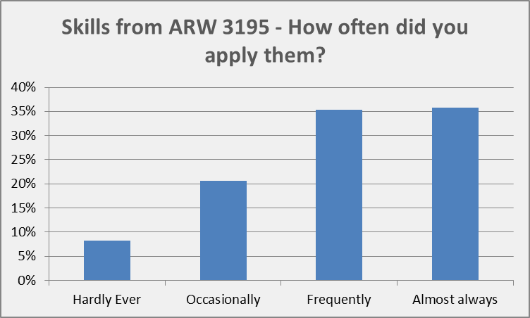
Student Survey results: ARW 3195

Slide 24
ARW 3195
 | Not Useful | Somewhat Useful | Useful | Very Useful
3. Note Taking | 16% | 32% | 39% | 13%
3. Critical reading | 16% | 22% | 43% | 19%
3. Responding instructions | 11% | 32% | 41% | 16%
3. Brainstorming strategies | 11% | 36% | 39% | 14%
3. Organisational strategies | 8% | 33% | 39% | 19%
3. University level writing | 5% | 21% | 37% | 37%
3. Revision and proof reading | 11% | 32% | 42% | 16%
3. Use of citation | 13% | 11% | 45% | 32%
3. Oral presentation | 18% | 39% | 26% | 16%
3. Survey development | 26% | 40% | 29% | 6%
3. Understanding academic honesty | 18% | 21% | 39% | 21%
3. Acting on feedback from tutor | 16% | 13% | 53% | 18%
3. Writing structured, exp essay | 11% | 24% | 34% | 32%
3. Writing a recommendation report | 18% | 45% | 29% | 8%
3. Average | 14% | 28% | 38% | 19%

Slide 25
ARW 3195
 | Hardly Ever | Occasionally | Frequently | Almost always
4. Note Taking | 13% | 28% | 44% | 16%
4. Critical reading | 6% | 16% | 44% | 34%
4. Responding instructions | 3% | 31% | 31% | 34%
4. Brainstorming strategies | 16% | 38% | 34% | 13%
4. Organisational strategies | 13% | 41% | 19% | 28%
4. University level writing | 3% | 10% | 45% | 42%
4. Revision and proof reading | 6% | 16% | 38% | 41%
4. Use of citation | 6% | 13% | 38% | 44%
4. Oral presentation | 22% | 28% | 28% | 22%
4. Survey development | 53% | 19% | 22% | 6%
4. Understanding academic honesty | 9% | 19% | 25% | 47%
4. Acting on feedback from tutor | 3% | 41% | 19% | 38%
4. Writing structured, exp essay | 9% | 16% | 38% | 38%
4. Writing a recommendation report | 28% | 22% | 28% | 22%
4. Average | 8% | 21% | 35% | 36%

Slide 26
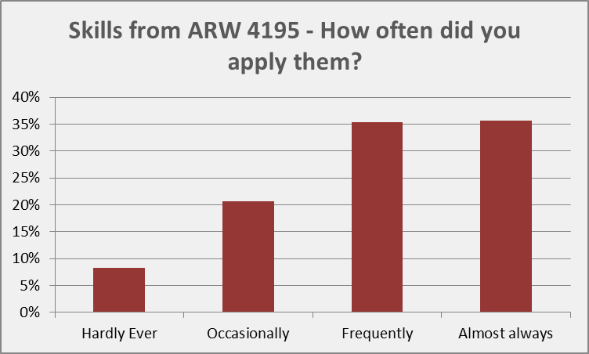
Student Survey Results: ARW 4195

Slide 27
Academic Literacies FA15/SP16-
5000 level Research Methods courses in the disciplines
GEP 4180 Research & Writing II [SP16- ]
GEP 3180 Research & Writing I
_______________________
EAP

Slide 28
3180 Research &Writing I FA17-
Summative Assessment Items | Weighting
Critical evaluation of two texts (c.600 words) | 30%
Oral presentation of research for cause/effect essay (c.600 words) | 10%
Research paper portfolio : Evidence-based Reflection (c.400 words) on : Draft 1 Draft 2 Draft 3 | 20%
Cause/effect research paper (1500 Words) | 40%

Slide 29
4180 Research &Writing II FA17-
Summative Assessment Items | Weighting
Comparative evaluation task (c.750 words) | 10%
Research Portfolio: Research Proposal (500 words) Annotated Working Bibliography (2,000 words) | 40%
Research Paper: Literature review (2,000 words) | 50%

Slide 30
Effects of changes

Slide 31
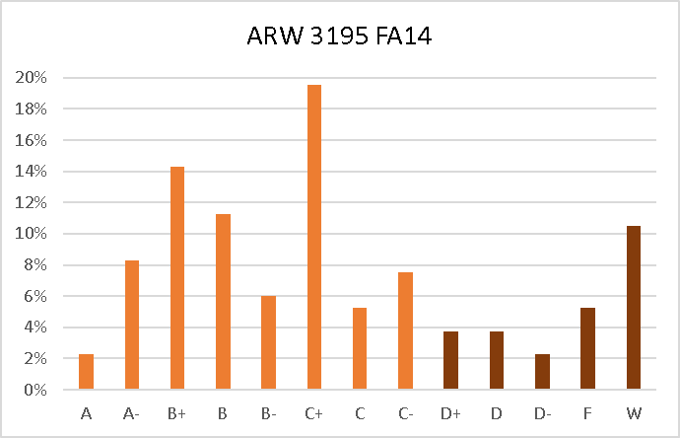
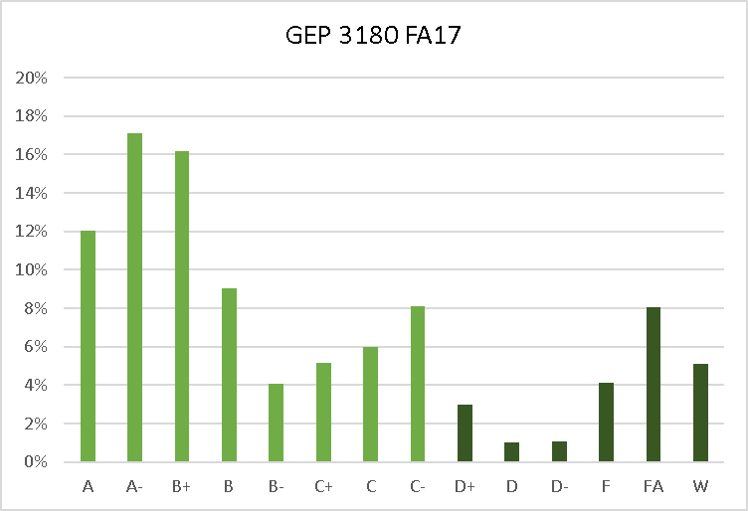
Level 3 Final grades
74% 78%

Slide 32
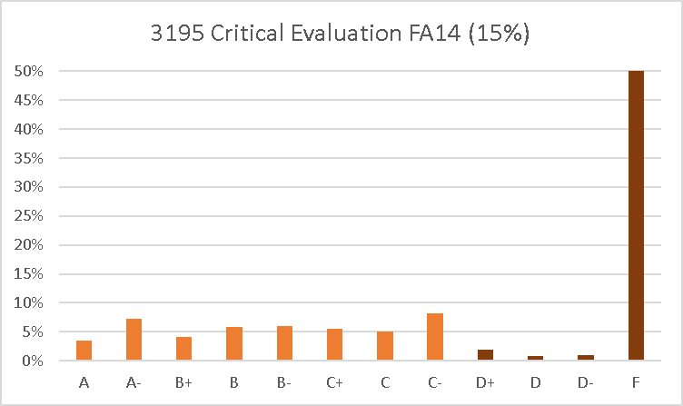
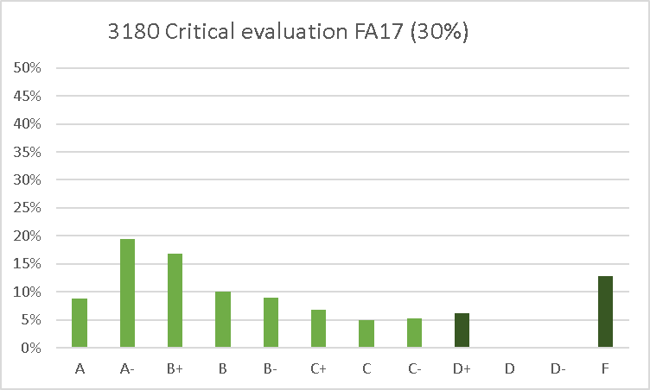
In-class Assessment: Critical evaluation of two texts
45% 81%

Slide 33
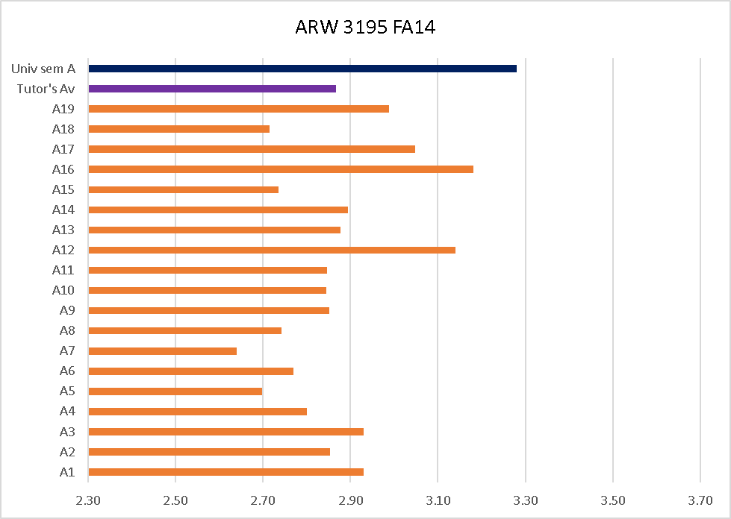
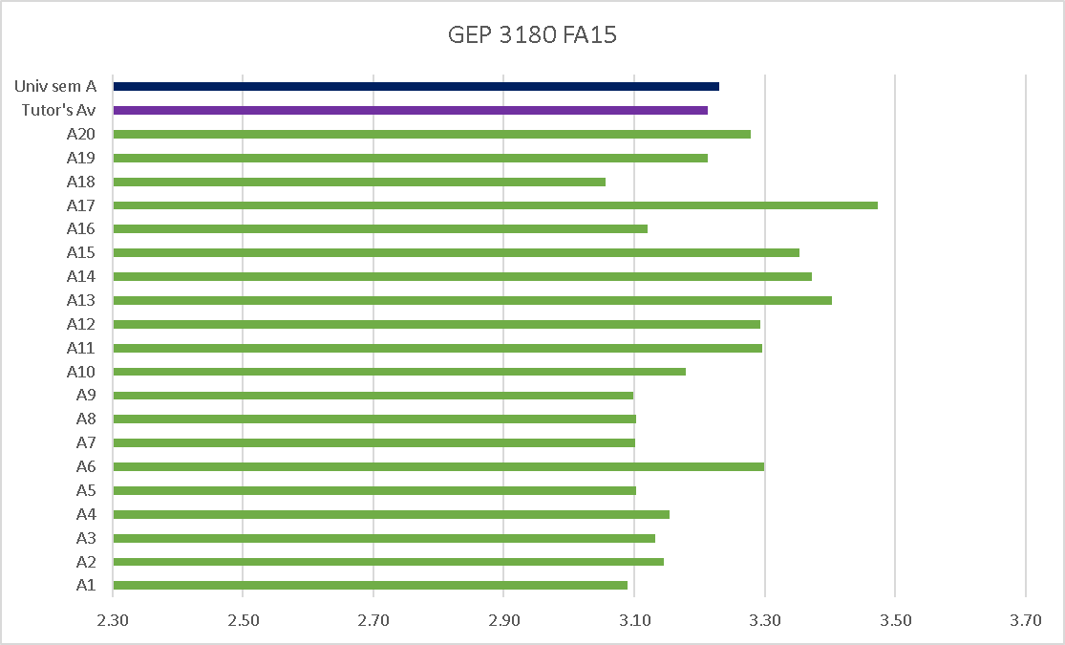
Student feedback

Slide 34
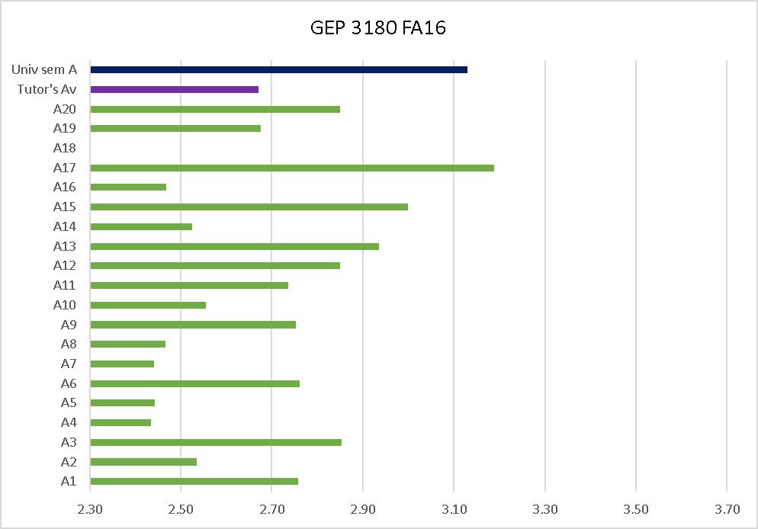
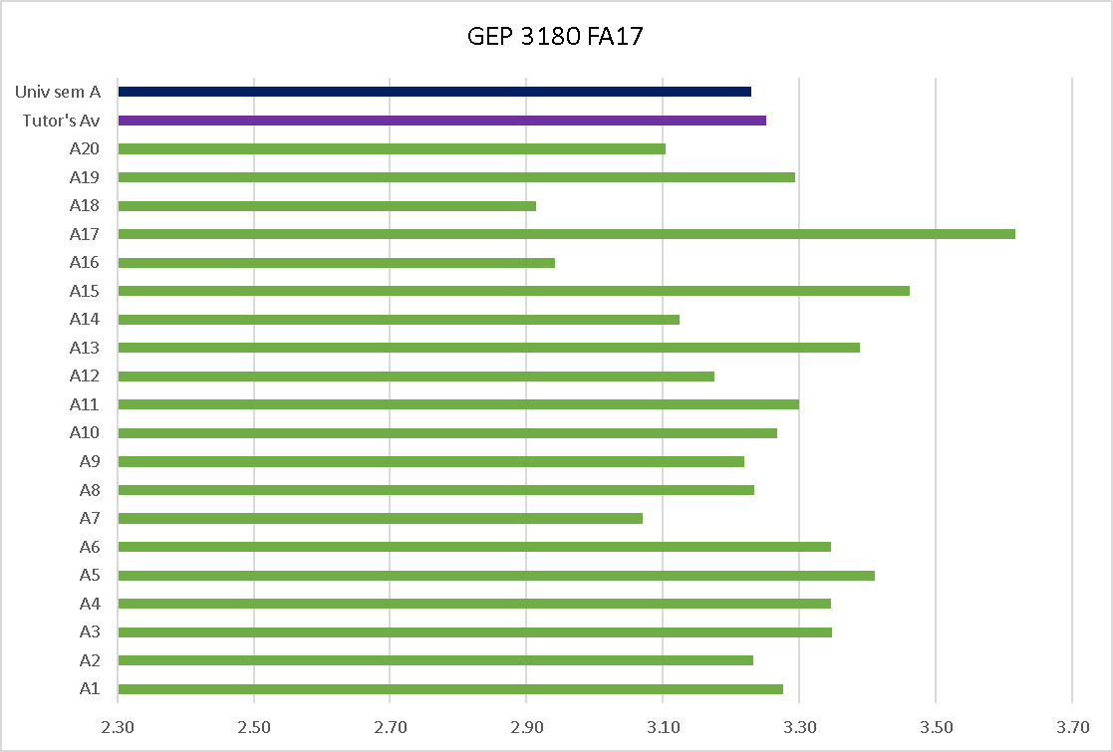
Student feedback

Slide 35
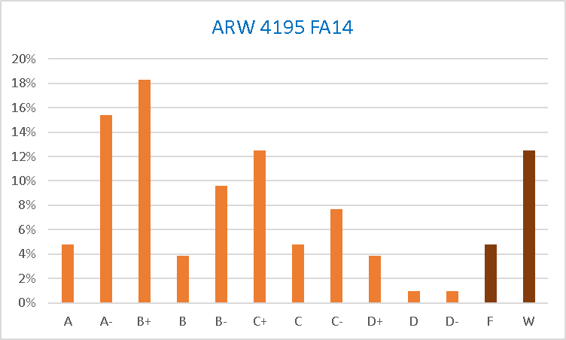
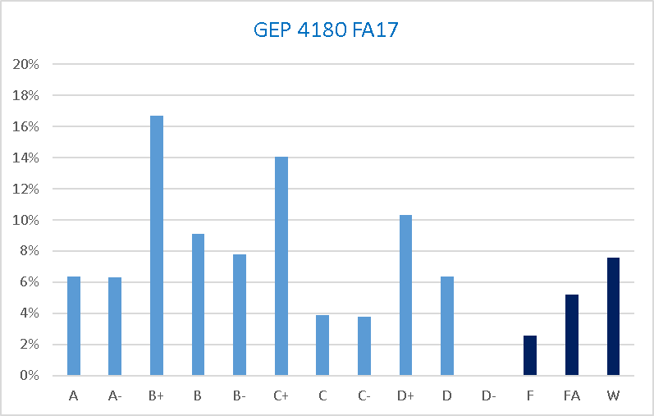
Level 4 Final grades
83% 85%

Slide 36
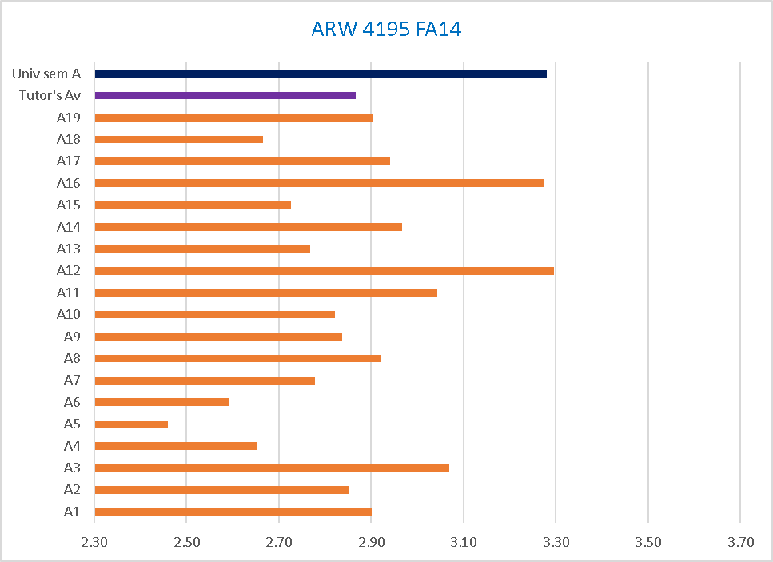
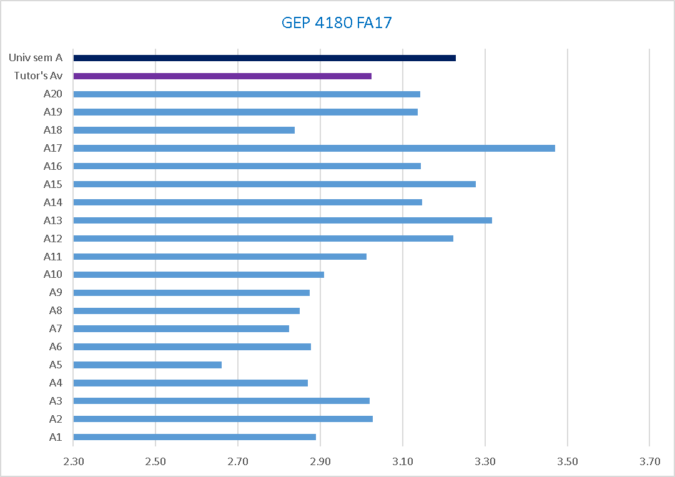
Student feedback

Slide 37
Academic Literacies at RAIUL (Handout)
GEP 3180 Research & Writing I
GEP 4180 Research & Writing II
Course specification documents:
Course descriptions
Learning outcomes
Indicative content
References and further reading
Contact details

Slide 38
Unity in diversity
Shuna Neilson Associate Professor, School of Liberal Arts
neilsos@richmond.ac.uk

