Slide 1
an online study skills course
Aysen Gilroy
Zayed University, Dubai, United Arab Emirates
June 2018

Slide 2
outline of presentation
Our context
Virtual Academic Bridge Program
Study Skills Course - principles
Overview of Units
Features of Learning Activities and Examples
Critical Thinking Skills Unit

Slide 3
OUR CONTEXT

Slide 4
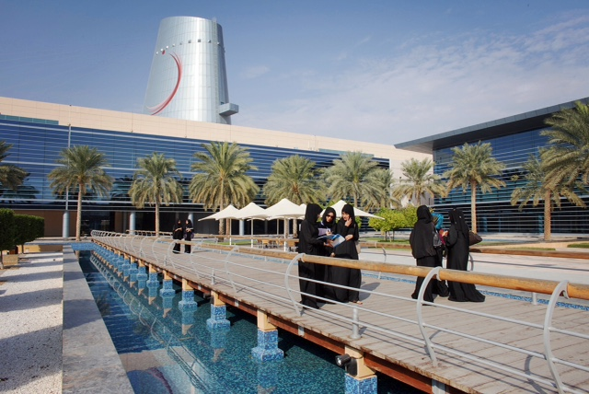
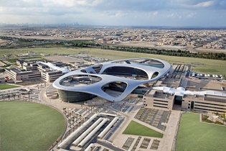
Zayed University
Colleges:
Art and Creative Enterprises
Business
Communication and Media Sciences
Education
Humanities and Social Sciences
Natural and Health Sciences
Technological Innovation
Federal
Emirati
AUH and DXB
Notes:
One of 3 federal universities in UAE
Around 10,000 students..Only 130 international students
2 campuses

Slide 5
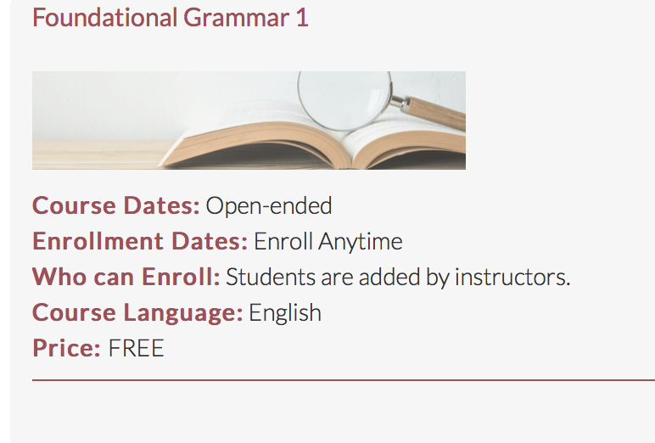
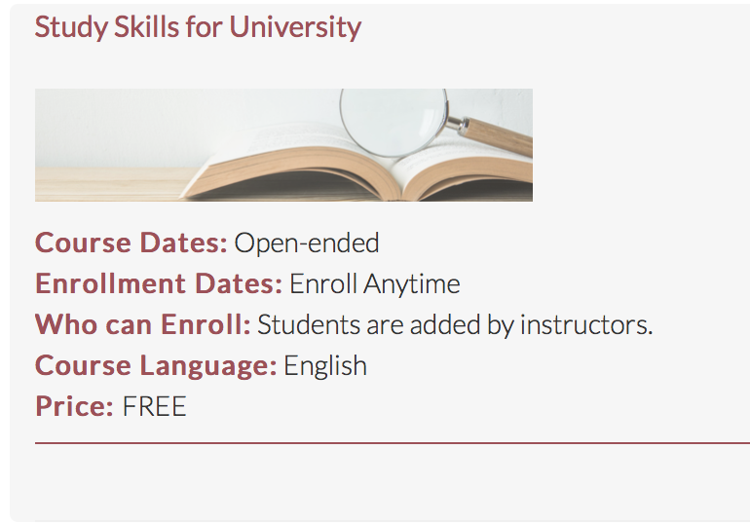
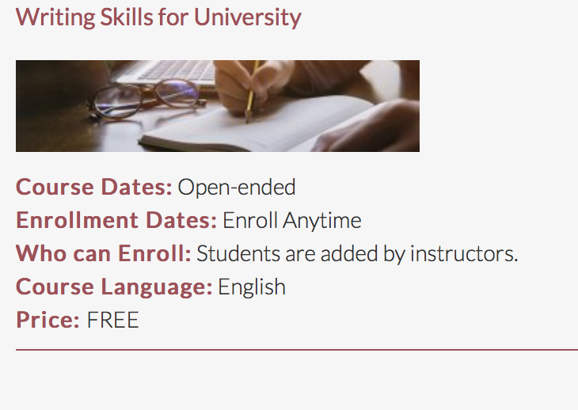
VIRTUAL academic bridge program
Notes:
Recently ZU has been given the responsibility of providing online courses to students graduating from a dual language school system with the overall aim of preparing them for undergraduate studies in an English medium instruction higher-education institution. As part of this brief, the Academic Bridge Program has created a number of online courses, one of which is Academic Study Skills for University. All these courses are short ‘bite sized’ chunks that will encourage learner engagement, success and completion.
Platform:
Bespoke ZU Platform

Slide 6
VIRTUAL ACADEMIC BRIDGE PROGRAM
VISION
DESIGN PRINCIPLES
open course for Arabic speakers who want to study at an EMU
self-accessed, self-paced, no fixed start / end dates
no direct instructor support
aimed at students with CEFR B1 Eng. language level
constructivist pedagogy
interactive tasks
personalized
authentic tasks and scenarios
Notes:
Students will be given opportunity to construct their understanding through, active engagement in learning activities. The input encourages students to construct their own understandings through guided questions.
The course is interactive in the sense that students get feedback on their answers
Courses are ‘personalized’, meaning that course is structured in a way that makes the learner feel as if the instruction is addressed to them as an individual and that they are part of the instruction as opposed to a instructor simply addressing a generic, depersonalized learner.
Authentic tasks and scenarios that learners are likely to experience in their undergraduate studies. Where possible we created fictional students with issues specific to our context.

Slide 7
PRIMARY TARGET AUDIENCE
Arabic speakers, graduating from a dual language school system
Taken up to 12 years of English instruction
Varied levels of English
Developing basic academic literacy skills in Arabic
Developing background and world knowledge
Developing critical thinking and numeracy skills
Muslim (important for cultural sensitivity)

Slide 8
OVERVIEW OF UNITS
UNIT 1: INTRODUCTION
1.1. Introduction to life at university
1.2. Goals, personal responsibility and a positive attitude
1.3. Introduction to study habits
1.4. Attendance and participation
1.5. Use of mobile devices
1.6. Health and academic achievement
Notes:
Needs analysis - literature (Study Skills Handbook by Stella Cottrell, our knowledge of our students needs and weaknesses and consulting the university counsellors

Slide 9
UNIT 2: CRITICAL THINKING SKILLS
2.1. Critical thinking
2.2. Levels of thinking
2.3. Position and evidence
UNIT 3: TIME MANAGEMENT
UNIT 4: ASSIGNMENT MANAGEMENT

Slide 10
FEATURES OF THE LEARNING ACTIVITIES
Notes:
We used ‘bookwidgets’ for the learning tasks

Slide 11
FEATURES OF THE LEARNING ACTIVITIES
Personalized tasks
Ulterior motive
Authentic tasks
Real examples from real students
Explanations from real professors
All videos/visuals with accompanying tasks
A reflective task and a quiz at the end of each unit

Slide 12
Personalized tasks
Notes:
Almost every unit starts with an awareness raising activity making the student think about their current status in the given subject

Slide 13
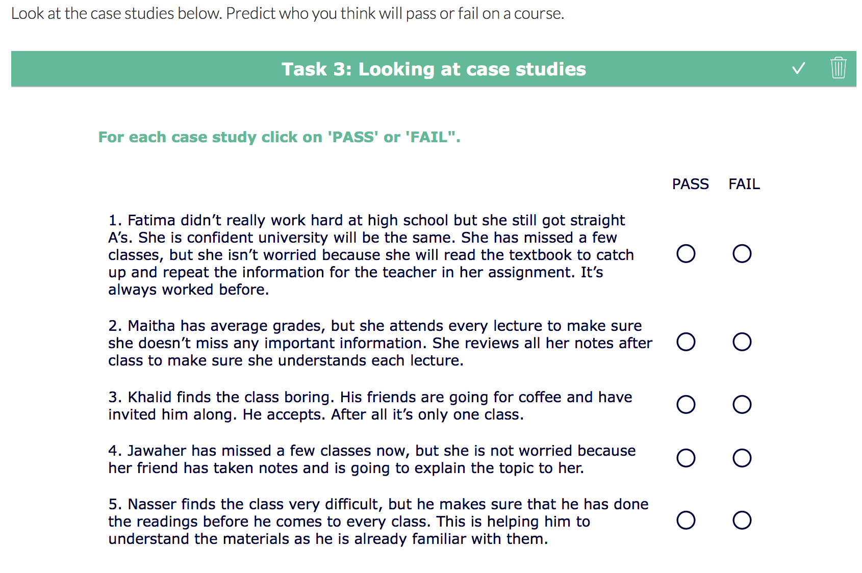
ULTERIOR MOTIVE
Notes:
The fictional students and their cases are always based on our students because we wanted to drop hints (hidden agenda)

Slide 14
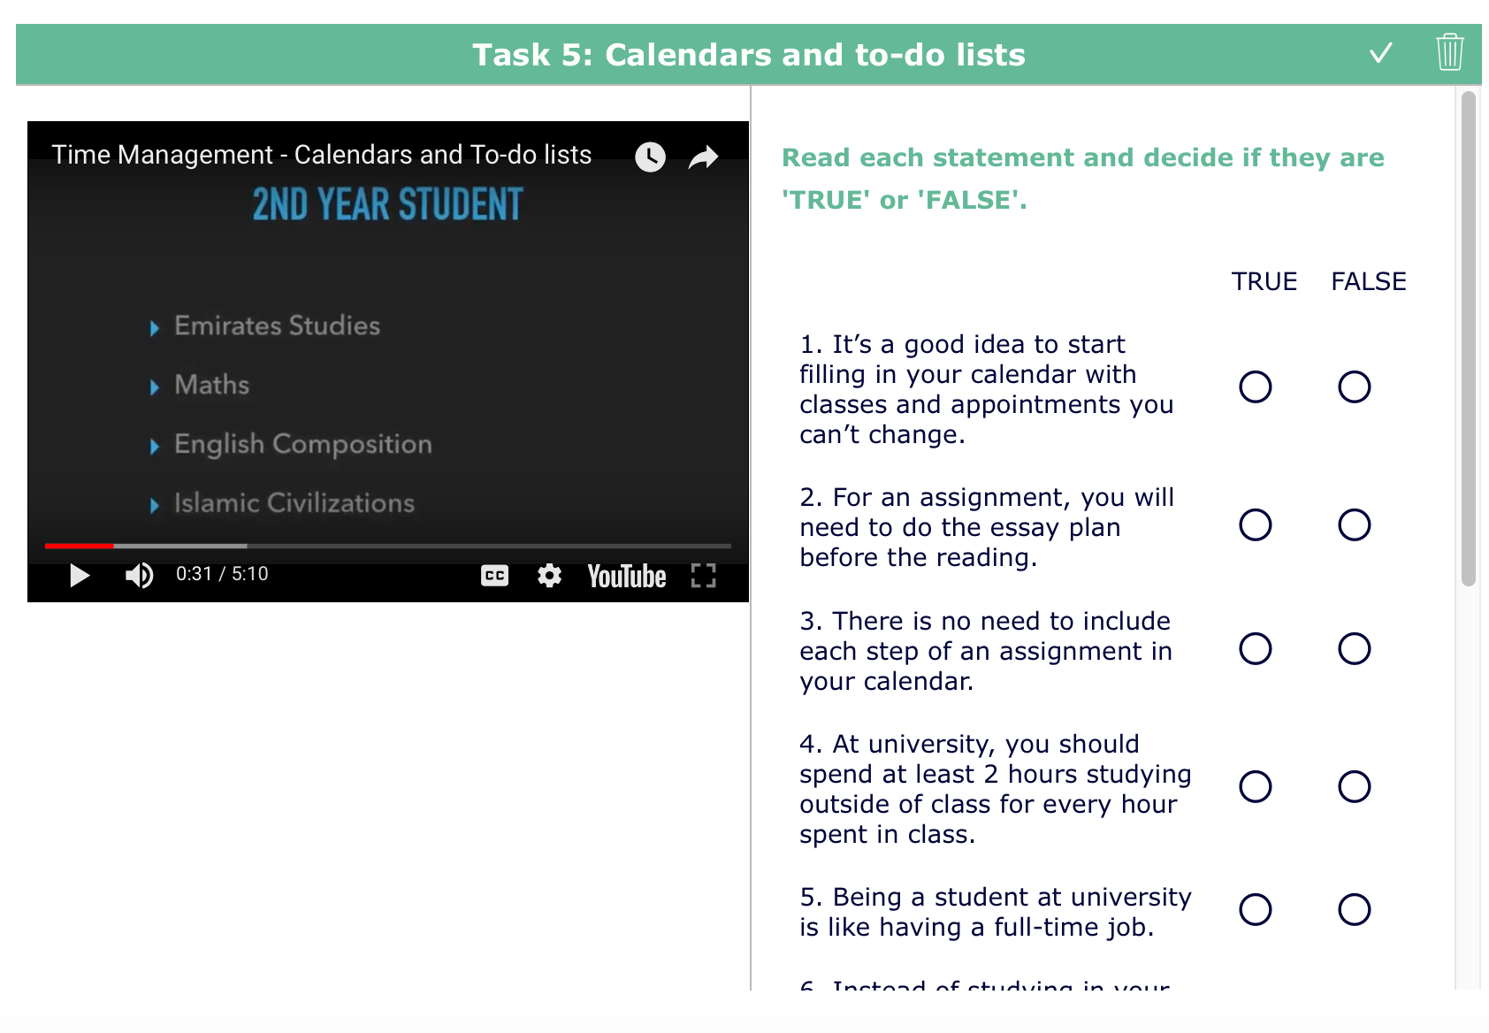
AUTHENTIC TASKS agenda
Notes:
Used a real 1st year student’s timetable

Slide 15
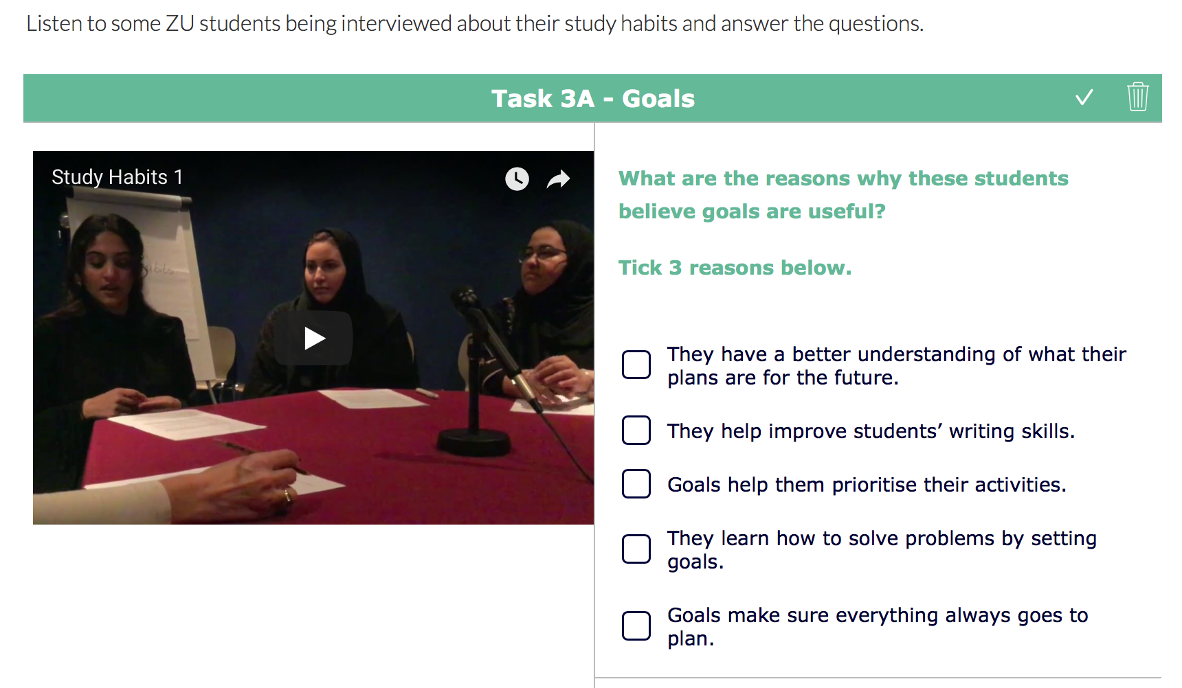
real examples from real students
Notes:
Had real students talking about their study habits

Slide 16
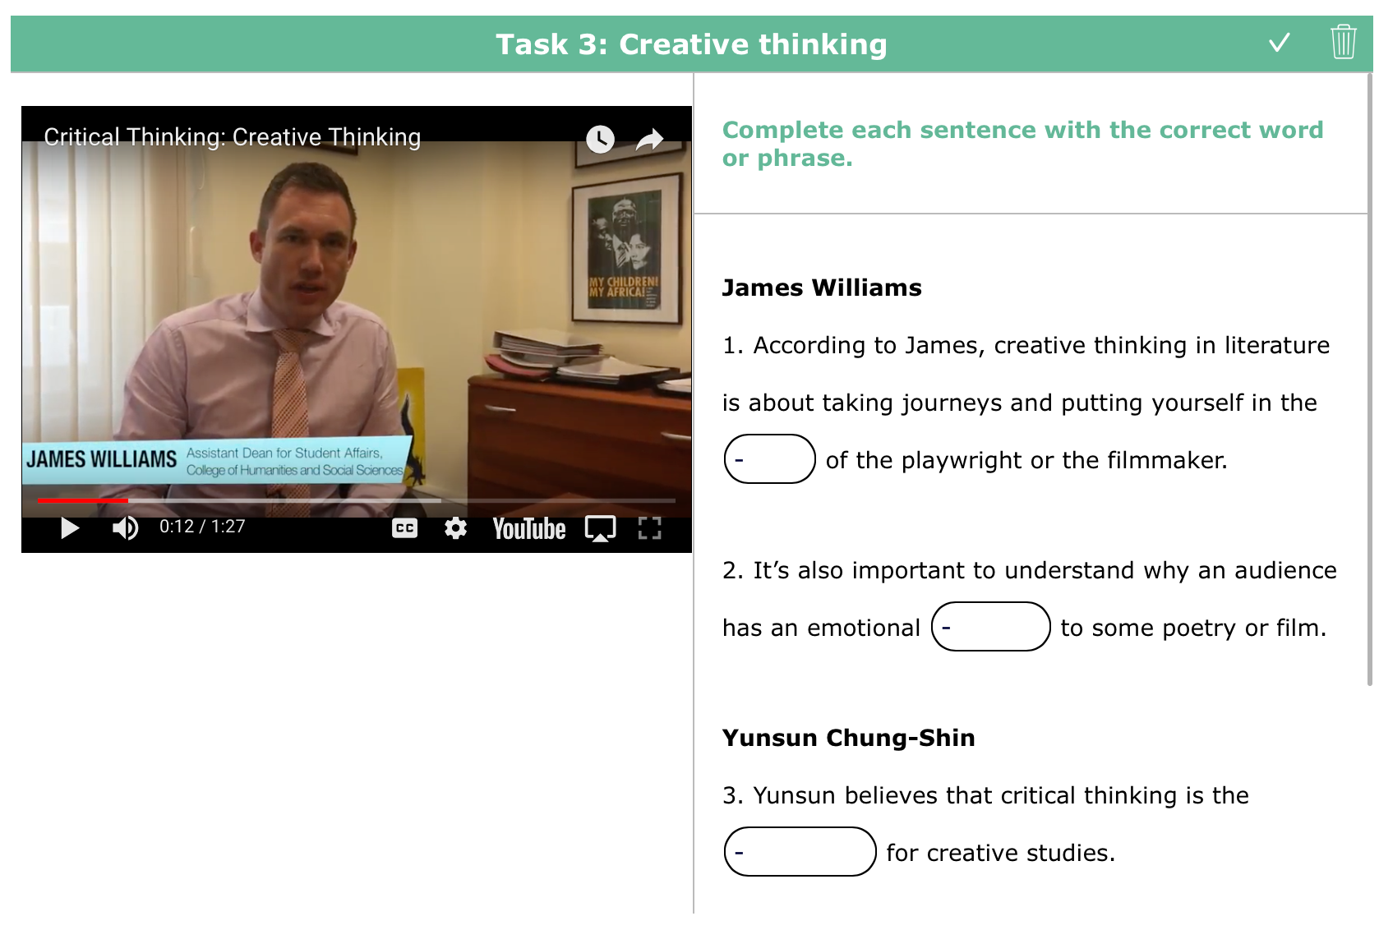
explanations from real professors
Notes:
Had real professors talking about critical thinking skills - created exercises based on their videos

Slide 17
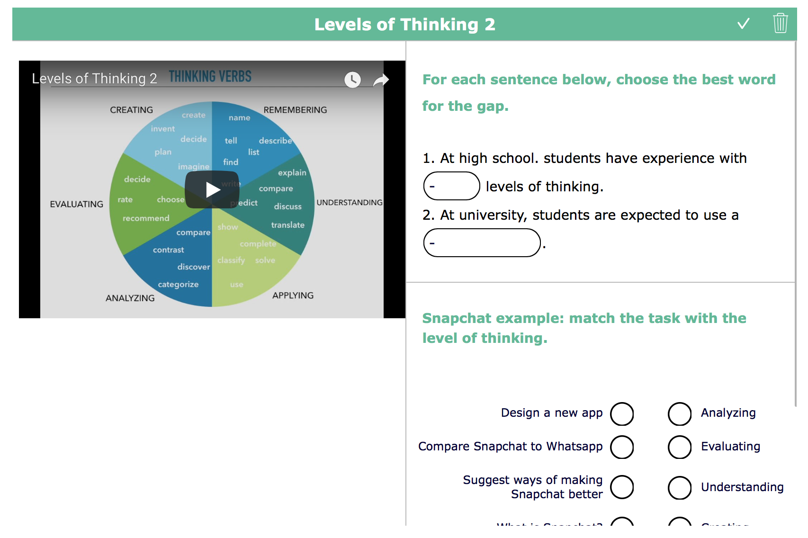
INPUT VIDEOS/ INFOGRAPHICS WITH A VARIETY OF TASKS
Notes:
Task varieties depended on the menu offered by bookwidgets. Some of them are: drag and drop; labelling diagrams; sequencing; choosing words from drop down lists; matching etc.

Slide 18
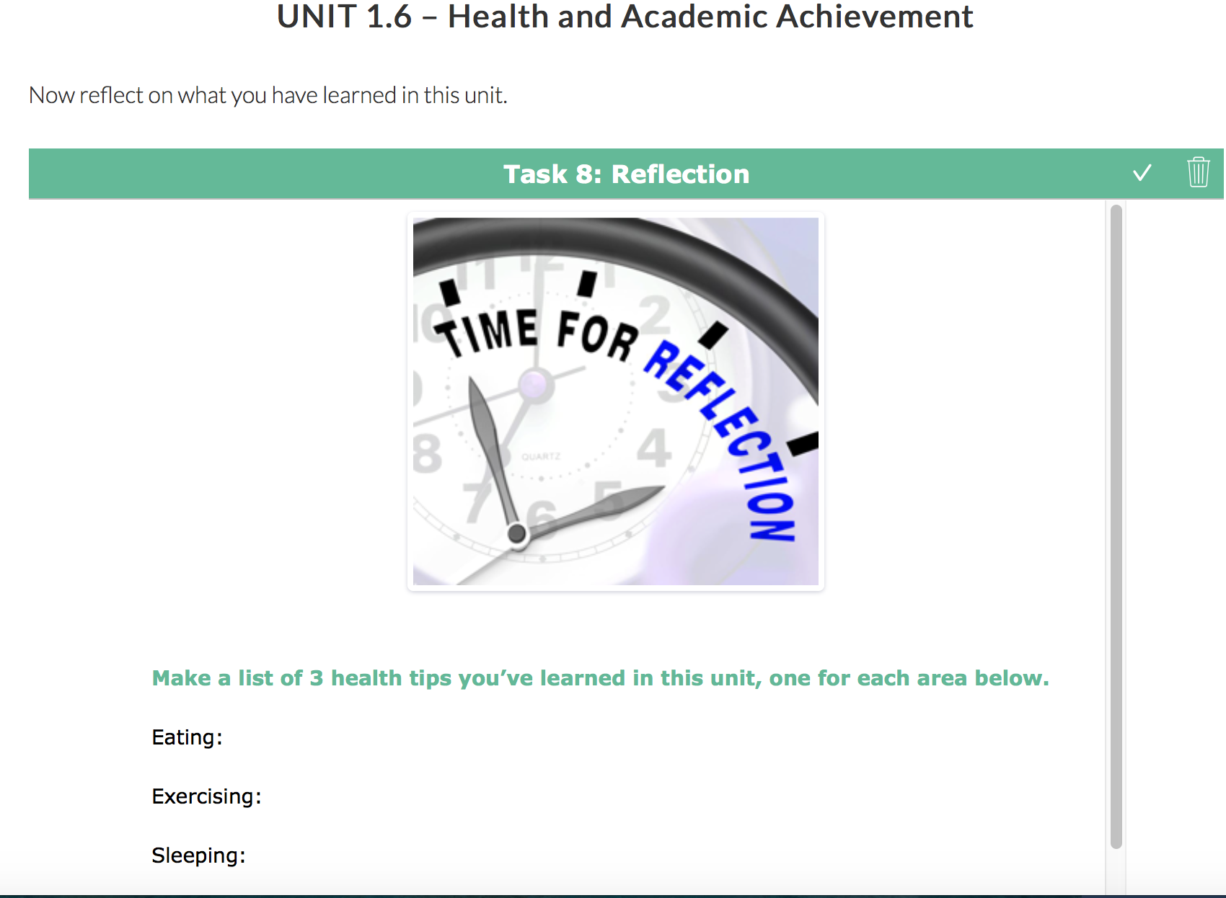
REFLECTION AT THE END OF EACH UNIT

Slide 19
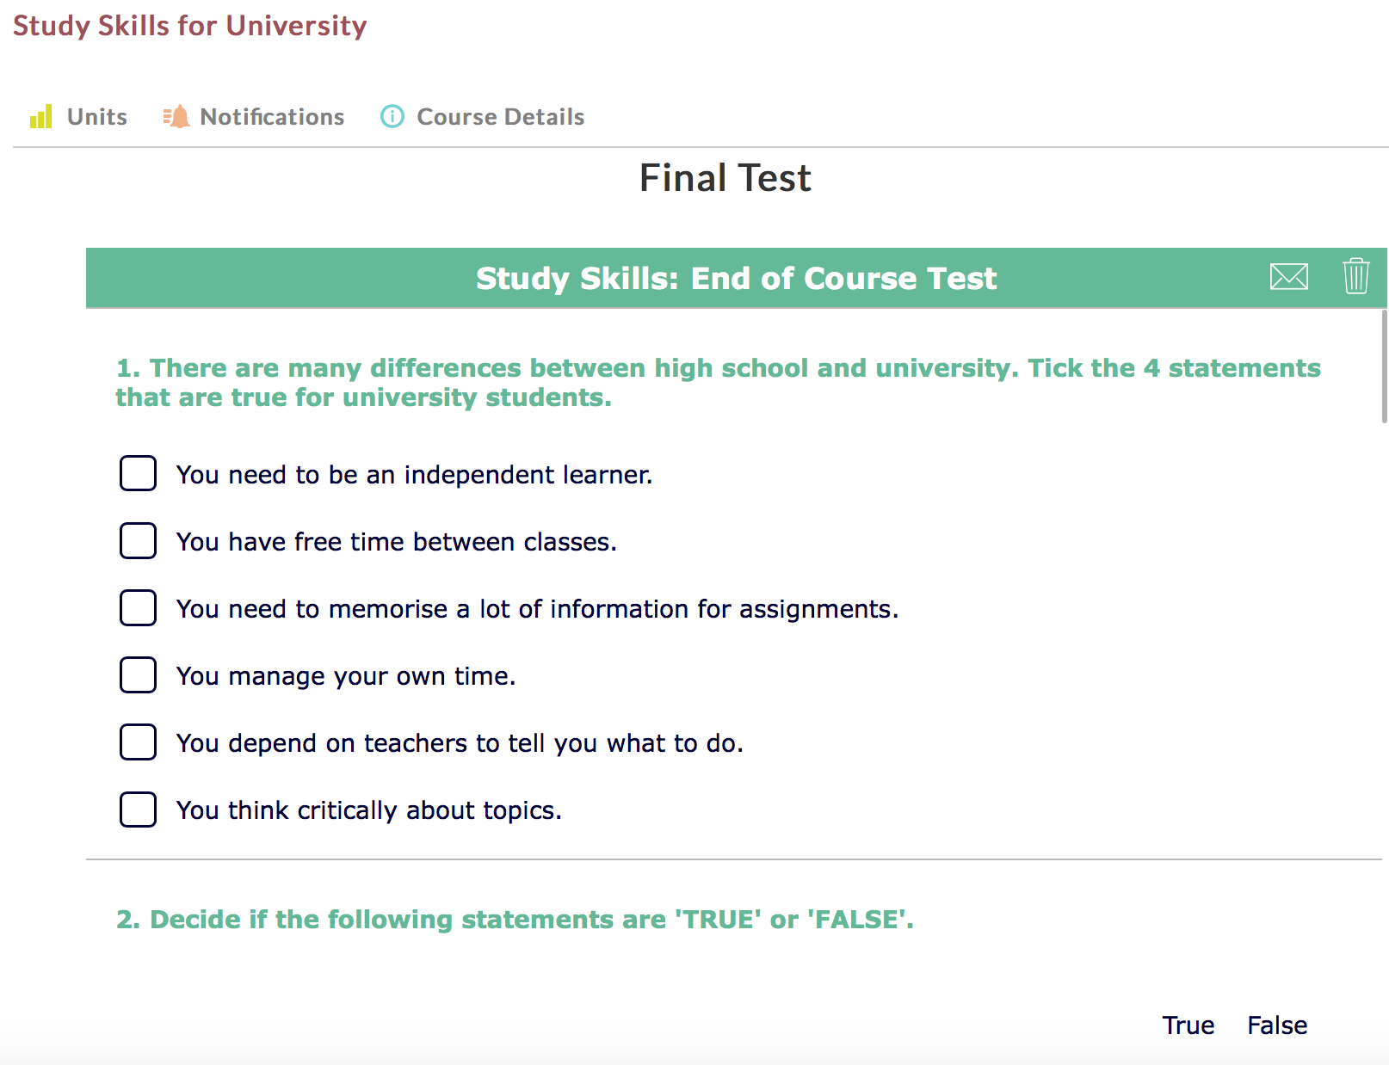
END OF UNIT AND COURSE QUIZZES
Notes:
when the student completes all the quizzes, they get a completion certificate and an e-badge

Slide 20
CRITICAL THINKING SKILLS
What is critical thinking in the ZU context?
Levels of thinking
Thinking about evidence and evaluating sources of evidence
Identifying errors and weaknesses in arguments

Slide 21
What is critical thinking in the ZU context?
According to ZU faculty:
Evaluating information
Different levels of thinking
Creative thinking
Identifying other people’s positions

Slide 22
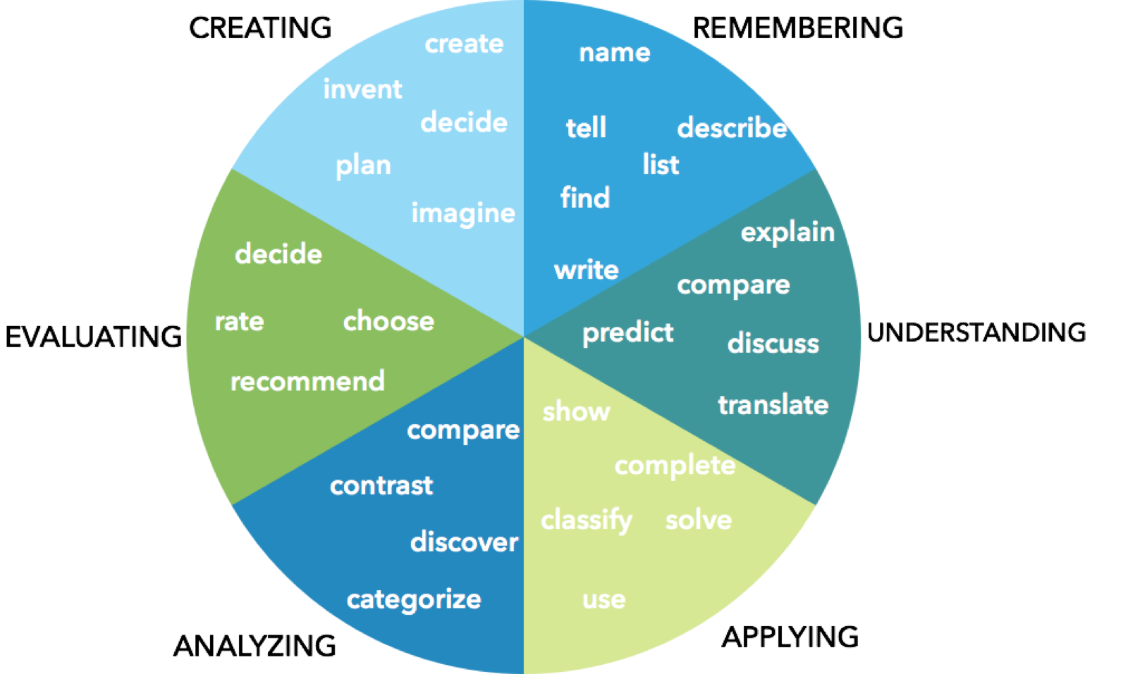
LEVELS OF THINKING
Notes:
Bloom’s taxonomy

Slide 23
UNIVERSITY
DIFFERENCES
HIGH SCHOOL
APPLYING
(يطَبِق)
CREATING
(ينتج)
UNDERSTANDING
(اِسْتيعاب)
EVALUATING
(يقيم)
REMEMBERING
(يتذكر)
ANALYZING
(يحَلِّل)
Notes:
We wanted to highlight how different levels of thinking are required at university.

Slide 24
SNAPCHAT EXAMPLE
CREATING
(ينتج)
Create - Can you design a new chat app including the best features of Snapchat and WhatsApp?
EVALUATING
(يقيم)
Evaluate - Can you suggest ways of improving Snapchat?
ANALYZING
(يحَلِّل)
Compare - How different is Snapchat from other chat apps ?
APPLYING
(يطَبِق)
Use - Can you write a manual of how to use Snapchat for someone who has never used it before?
UNDERSTANDING
(اِسْتيعاب)
Explain - What do people use Snapchat for?
REMEMBERING
(يتذكر)
Define - What is Snapchat?
Notes:
Wanted to make it relevant to students’ every day lives

Slide 25
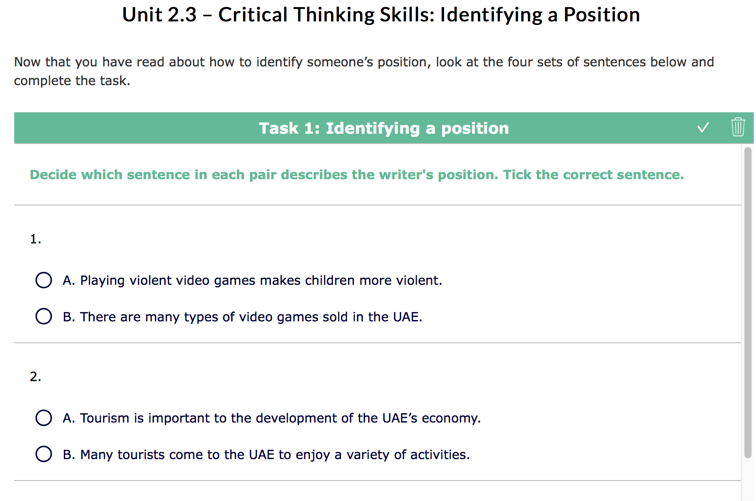
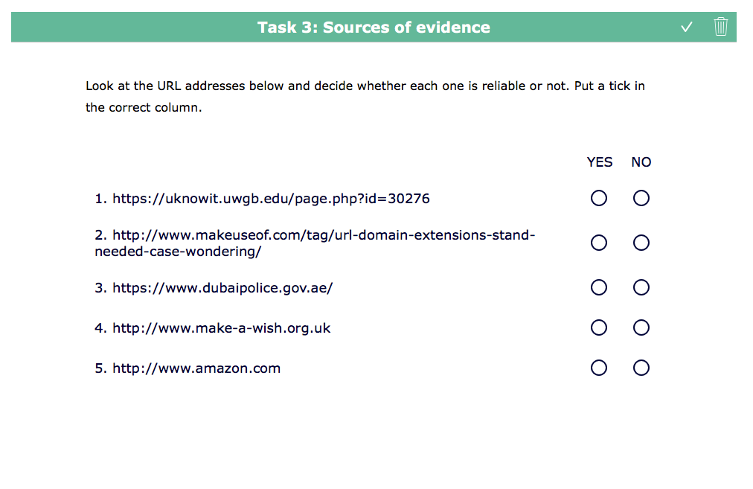
THINKING about ‘POSITION’ & ’evidence’
Identifying other people’s opinion or argument
Looking at the information presented (fact or opinion?)
Evaluating sources of evidence
Evaluating arguments (strong/weak/logical?)

Slide 26
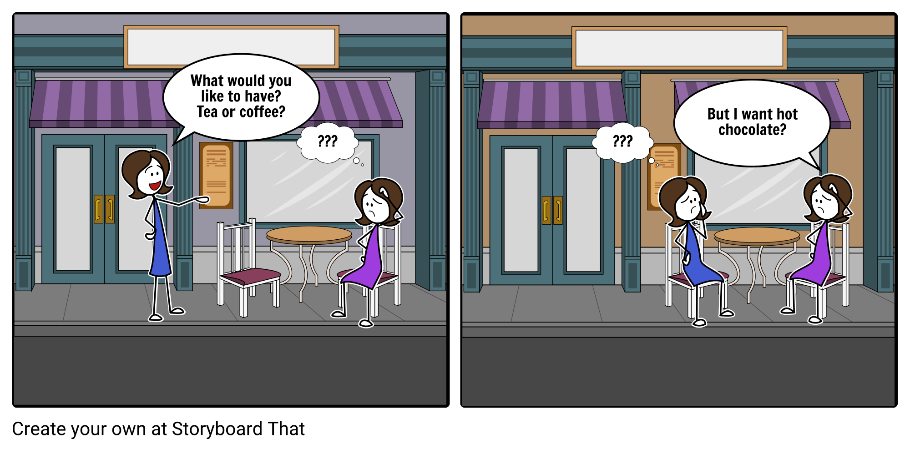
IDENTIFYING ERRORS & WEAKNESSES IN ARGUMENTS
EITHER/OR THINKING

Slide 27
IDENTIFYING ERRORS & WEAKNESSES IN ARGUMENTS
CAUSE AND EFFECT ERROR

Slide 28
IDENTIFYING ERRORS & WEAKNESSES IN ARGUMENTS
SLIPPERY SLOPE

Slide 29
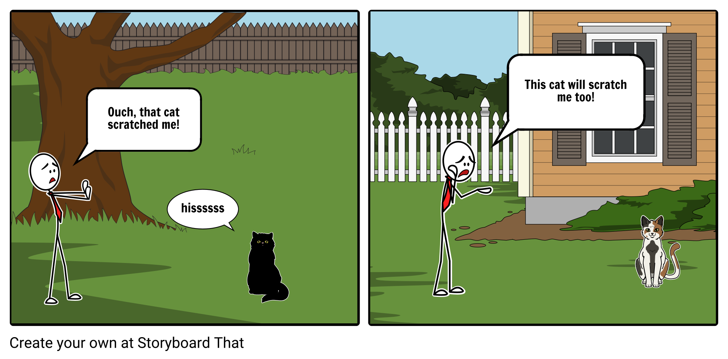
IDENTIFYING ERRORS & WEAKNESSES IN ARGUMENTS
HASTY GENERALIZATION

Slide 30
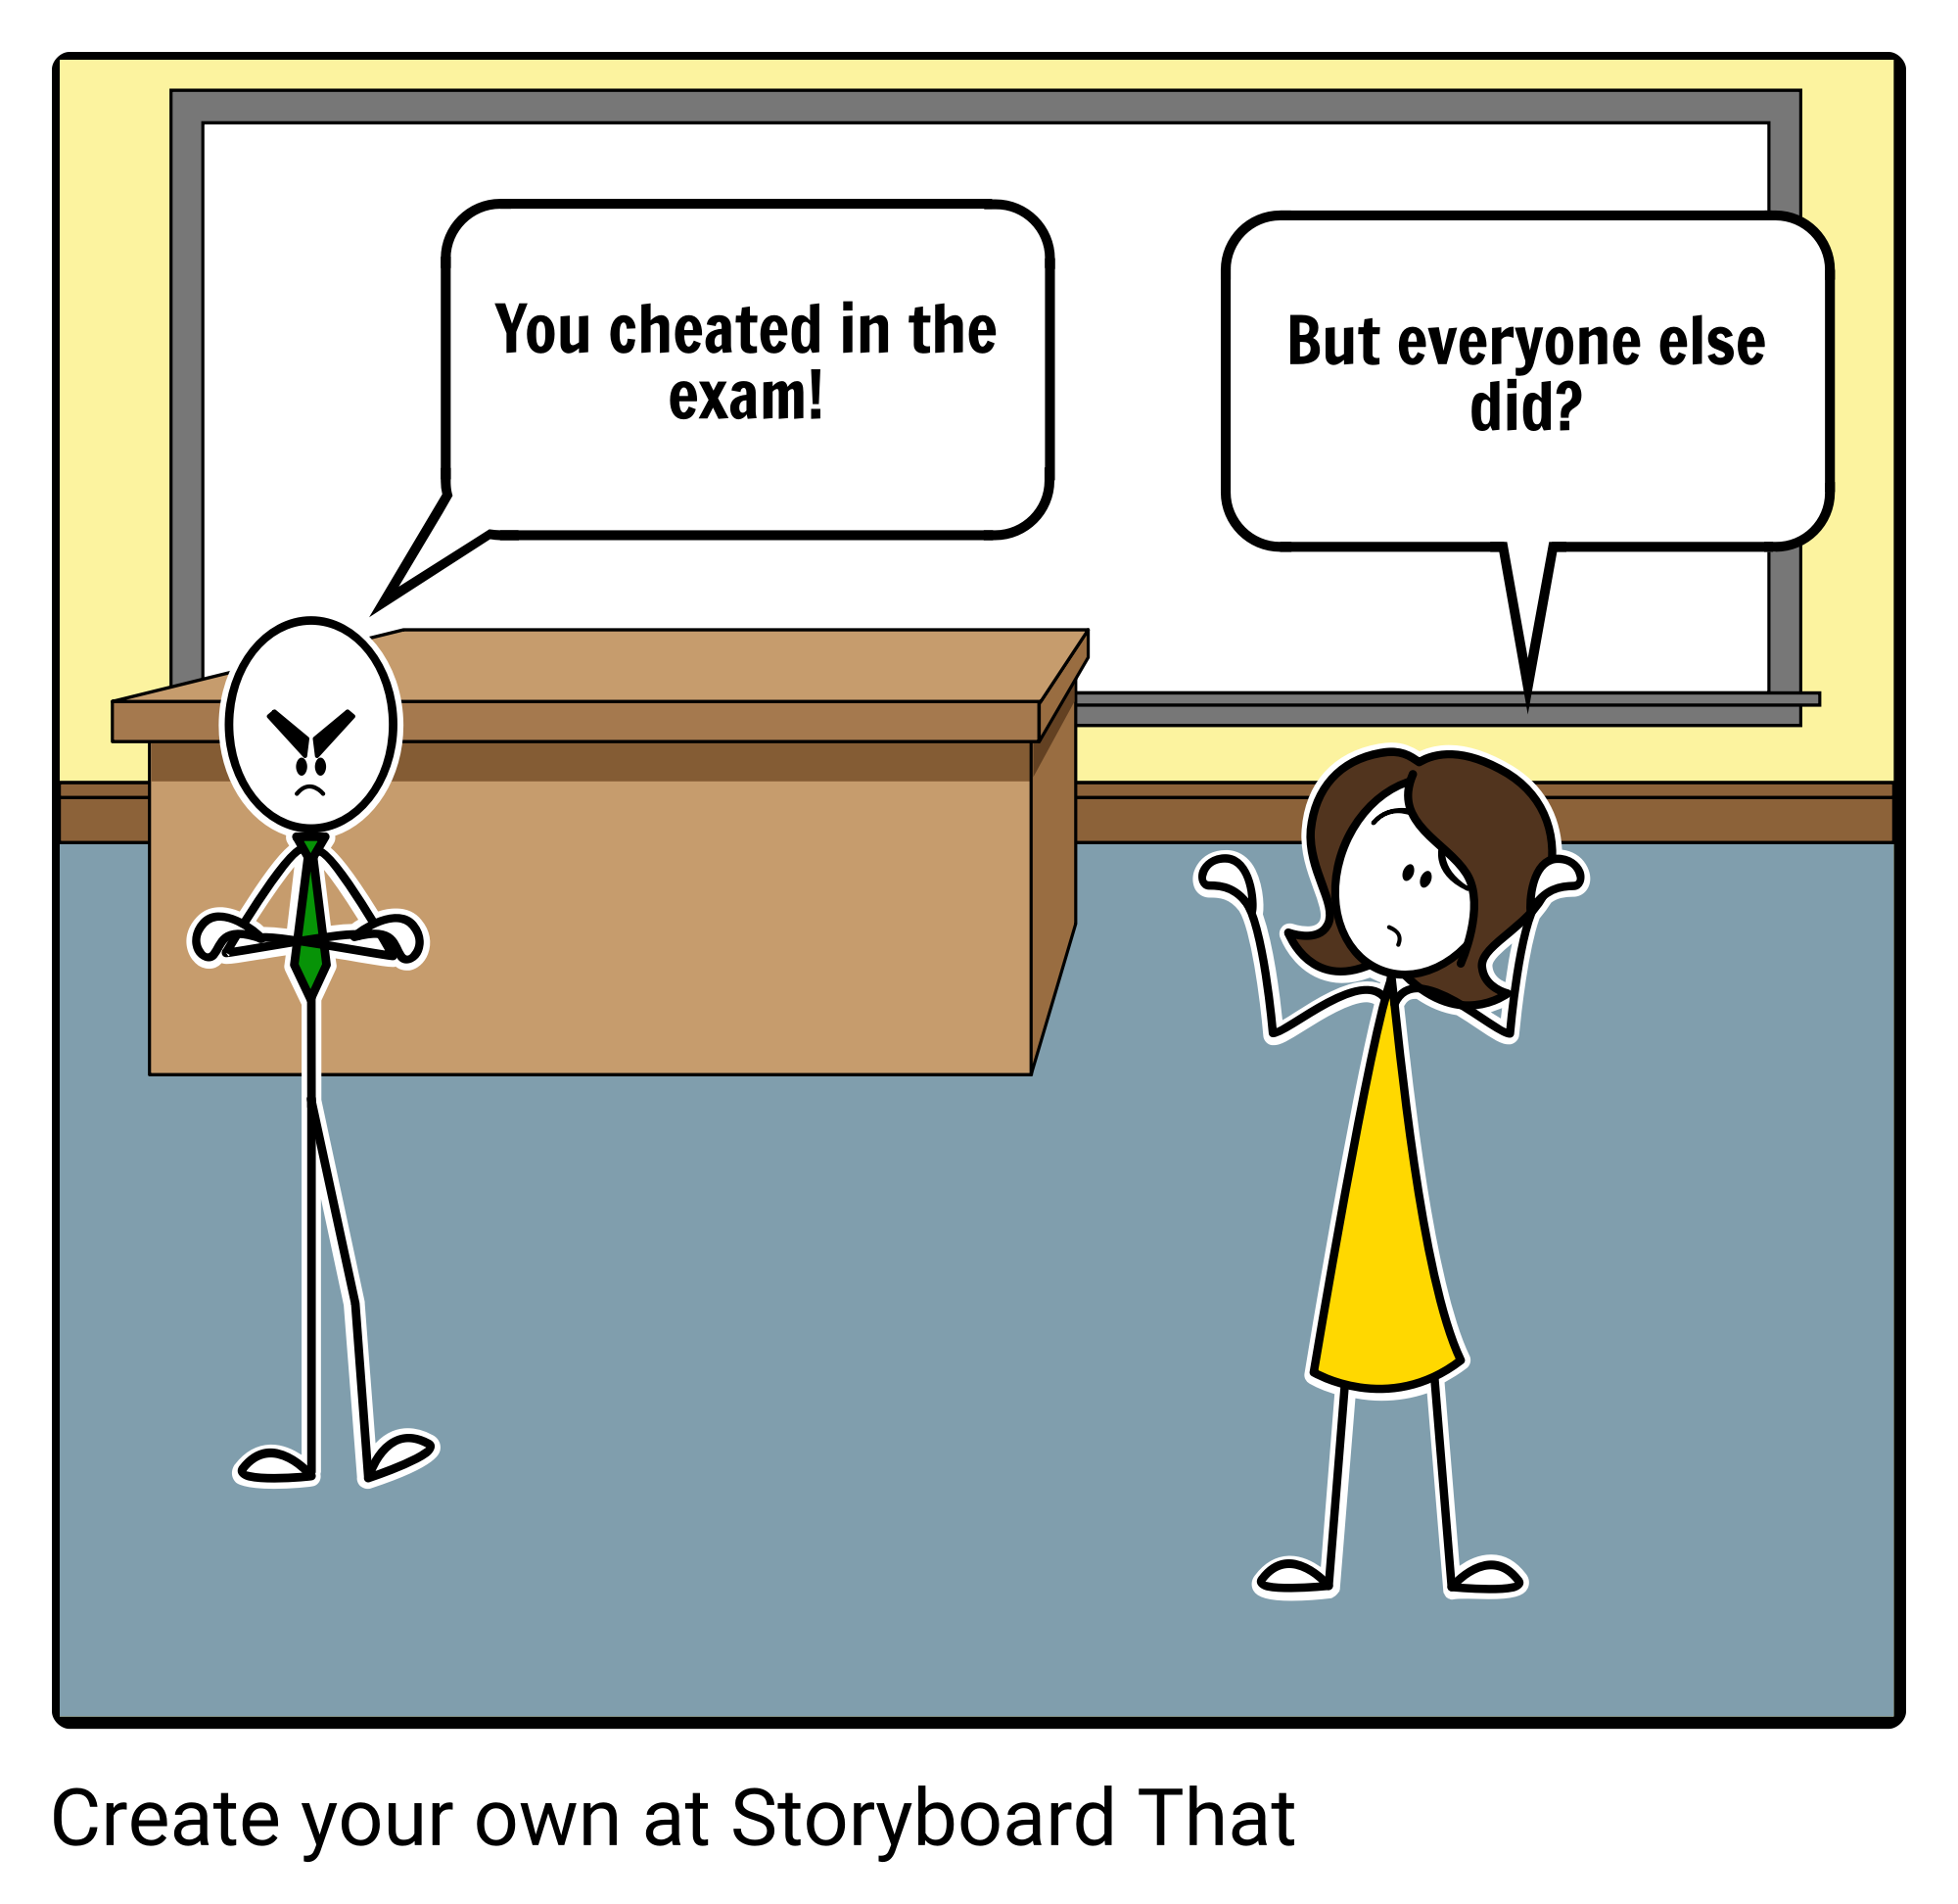
IDENTIFYING ERRORS & WEAKNESSES IN ARGUMENTS
TWO WRONGS

Slide 31
https://zuvb.zu.ac.ae/courses/course_category/vabp/

Slide 32
thank you
aysen.gilroy@zu.ac.ae

