Slide 1
Engaging a mixed native and non-native speaking group in the learning written genres for Psychology
Karin Whiteside, University of Reading

Slide 2
Background
PY1SK <-> PY1SKE
30 (nns & ns) from 150+ first year students
An extra assignment
Workshops in autumn: Practical Reports & Critical Reviews
Workshops in spring: Essays & Reflective Writing

Slide 3
“Discourses are tools – they do things. That is why they have evolved and thus their functionality determines their character” (Martin, 1993, p221)
Content & meaning
‘Moves’/Stages
Discourse/language features
purpose
language

Slide 4
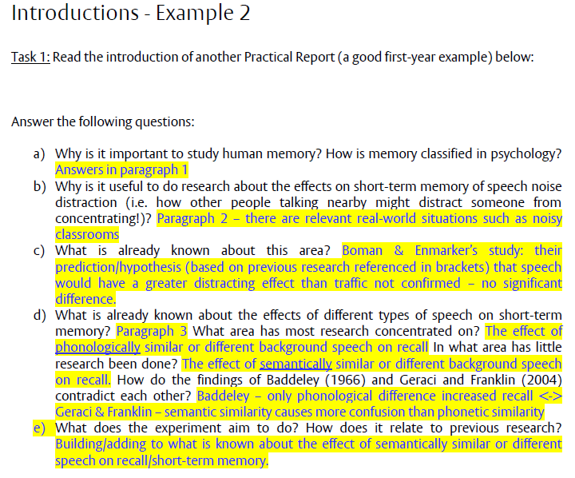

Slide 5
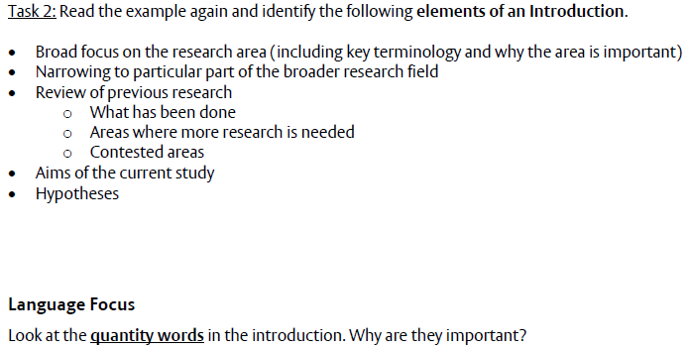

Slide 6
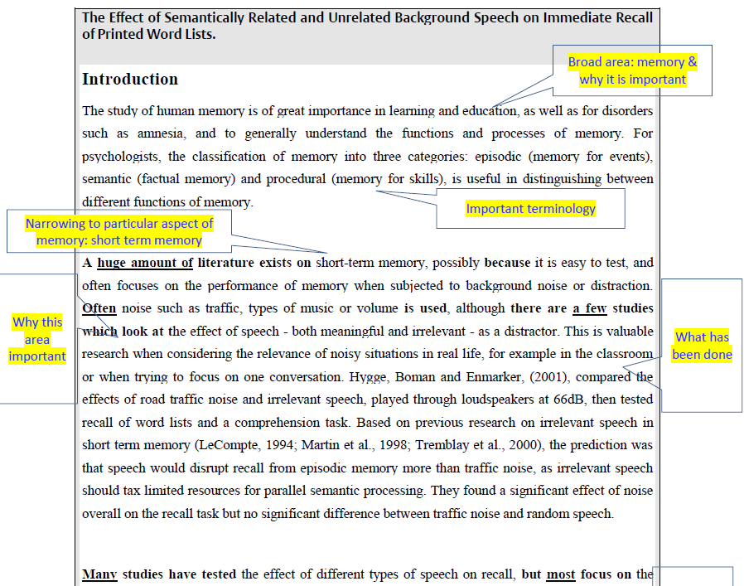

Slide 7
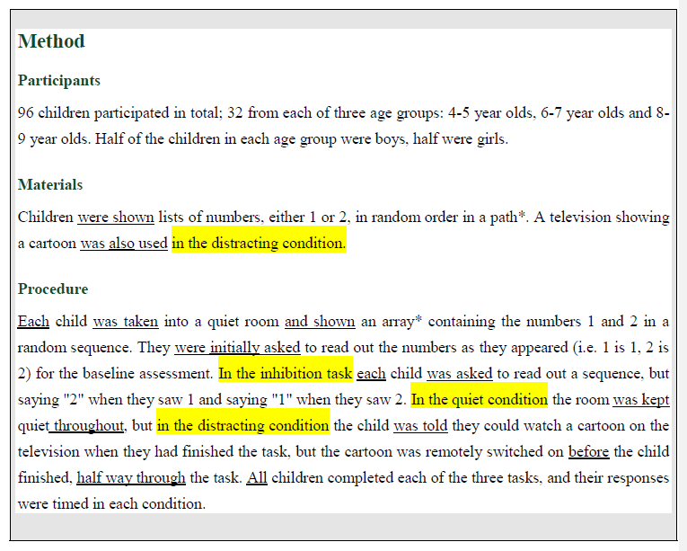

Slide 8
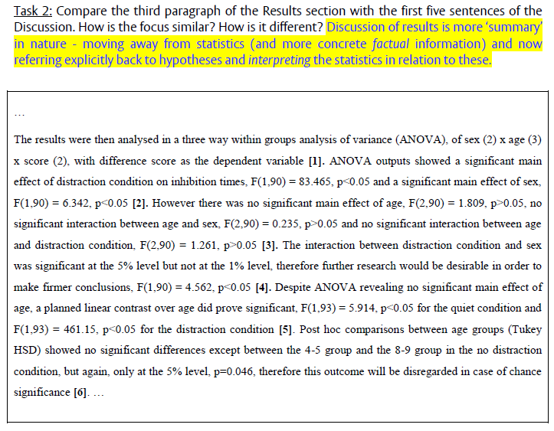

Slide 9
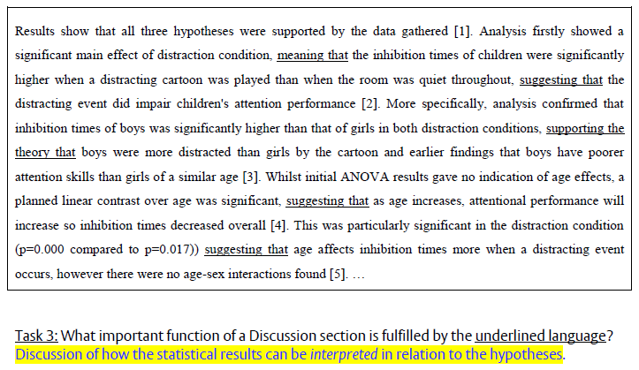

Slide 10
The process of writing an argumentative essay
Select and use information from sources
Identify relevant sources
Establish your stance
Compare & contrast evidence/ideas from sources
Present your stance coherently
State your position clearly
Evaluate which evidence/ideas can be used
Evaluate how evidence/ideas can be used
Find support for your stance
Find rebuttals to counter-arguments
Guide & involve the reader
Write in an appropriate style
Reference your sources
Build your arguments logically

Slide 11
Task: Source Use & Argument
Read the three Versions A, B & C, in your Tasks document for this lecture (pp1-2). Each contains two equivalent short extracts from an essay answering the question In what sense can we speak of animals having culture?
Rank them in order from strongest to weakest for an essay

Slide 12
Version C is the best:
in-depth engagement with the sources
sources used as evidence to make arguments linked to the essay question

Slide 13
In Version A:
no evidence of writer voice or argument
sources have been used heavily and in too much detail without any interpretation by the essay-writer

Slide 14
In Version B:
attempt to make an argument in relation to the essay question, but sources used very superficially
vague, general statements
weak re: progression between ideas and sentences (incl. repetition)
ideas from sources have not been adequately explained within the text

Slide 15
vague/imprecise statement about culture
Version B
Version C
one specific aspect of culture expressed with precision
Human actions are influenced by social context and this is culture, and it can be seen that animals are influenced in the same way so they also have culture. The study by White et al (2000) shows in mating that females make the same choices as others have made, and so learn what to do from the society they are in. The female quail copies other female quails when it comes to mating. Therefore it can be argued animals do have a culture because they are influenced by what other animals in their species do. This can be compared to human behaviour as they are culturally influenced by each other.
A simple form of social interaction is when species learn via patterns of behaviour and therefore exhibit culture (Byrne et al, 2004). White et al (2000) present an example of patterns of mate behaviour which are transmitted from one female quail to another. A focal female is exposed to two types of males with a test female watching, after viewing the mating the test female has to choose a mate for herself. Results showed the test female was more likely to copy the mating preferences of the focal female, suggesting that females make the same choices they have seen others make, and so show patterns of social learning behaviour. It could be said that we can speak of animals having culture at what appears to be a low level of cognitive ability.
a clear link
lacking necessary detail
adequate relevant detail
interpretation
repetition rather than development
vague/simplistic
mini paragraph-level ‘answer’ to the essay question

Slide 16
too vague/broad
Version B
specific, precise
Version C
Numerous studies by psychologists have investigated whether animals have a culture or not. Whiten, (2005) and Boesch et al (1998) note that three different groups of Chimpanzees in three different places have different ways of eating ants. This is a cultural difference. Whiten (2005) states that to prove this conclusively would require removing Tai chimpanzees to Gombe to see if their habits changed or stayed the same. However, this is unlikely to be possible because moving chimpanzees from one place to another for an experiment would be unethical. The chimpanzees could feel stress due to the move. This psychological suffering cannot be justified to extend psychological knowledge.
Whiten (2005) and Boesch et al (1998) noted that ant catching techniques used by Tai forest chimpanzees differ from chimpanzees that live at Gombe. Both ants and sticks are available at each site, yet Tai chimpanzees use a short stick to pick up just a few ants, whereas chimpanzees in Gombe swipe their hands along a longer stick to collect a large ball of ants. At Mahale where sticks and ants are both still available, chimpanzees do not ever eat ants. The varying degrees of behaviour appear to show different cultural traditions within the same type of environment, and so show culture within a species. However, Whiten (2005) states that to prove this conclusively would require removing Tai chimpanzees to Gombe and vice versa to see if the behaviour continued in the new environment, as it should do if both habitats are the same - the ethical implications of this mean it is unlikely to occur.
more detail needed
Why? How?
Explain!
adequate relevant detail
clear interpretation & link to essay question
too much detail, not relevant to Q
caveat (acknowledging limitation of this argument)

Slide 17
Task 2: can you identify three different types of Psychology question in the examples below?
Why are some children more popular than others and what consequences does this have for psychological development?
'Evolutionary psychology provides a single unifying starting point for understanding why we think as we do today.' Archer (2001). Discuss.
How Strong is the Evidence that Animals Understand Words and Signs in the Same Way that Humans Do?
In What Sense can we speak of Animals Having Culture?
What factors influence the accuracy of eyewitness testimonies and how can their effects be explained?
Is face processing a special perceptual process that is present from birth?
How can we improve our treatment of depression with neuroimaging studies?
Which early infant abilities and preferences might facilitate later language development?
What negative consequences may occur when communicating risk information in the “real-world” and how can insights from cognitive psychology help?

Slide 18
critical evaluation of evidence
Critical discussion
'Evolutionary psychology provides a single unifying starting point for understanding why we think as we do today.' Archer (2001). Discuss.
How Strong is the Evidence that Animals Understand Words and Signs in the Same Way that Humans Do?
In what sense can we speak of Animals Having Culture?
Is face processing a special perceptual process that is present from birth?
Cause-Effect
Why are some children more popular than others and what consequences does this have for psychological development?
What factors influence the accuracy of eyewitness testimonies and how can their effects be explained?
Which early infant abilities and preferences might facilitate later language development?
Problem-Solution-Evaluation
What negative consequences may occur when communicating risk information in the “real-world” and how can insights from cognitive psychology help?
How can we improve our treatment of depression with neuroimaging studies?
critical evaluation of possible reasons & implications
critical evaluation of the efficacy of solutions

Slide 19
Task: Different types of argumentation
Read the two essay extracts How does the argumentation differ? How does this relate to differences in essay type?
Re-read the extracts: which sentences contain facts /description?; which sentences contain arguments/interpretations?

Slide 20
argument
evidence
interpretation

Slide 21
more ‘to and fro’ in Extract 2 creating the sense of a ‘debate’

Slide 22
Guiding the reader
Arguing & positioning; engaging with the reader
‘Voice’

Slide 26
N.B. As a UG student, mostly avoid ‘I’!

Slide 27
caution
certainty
certainty
certainty
caution

Slide 28
caution
caution
caution
addressing/involving the reader
attitude/evaluation
attitude/evaluation
attitude/evaluation

Slide 29
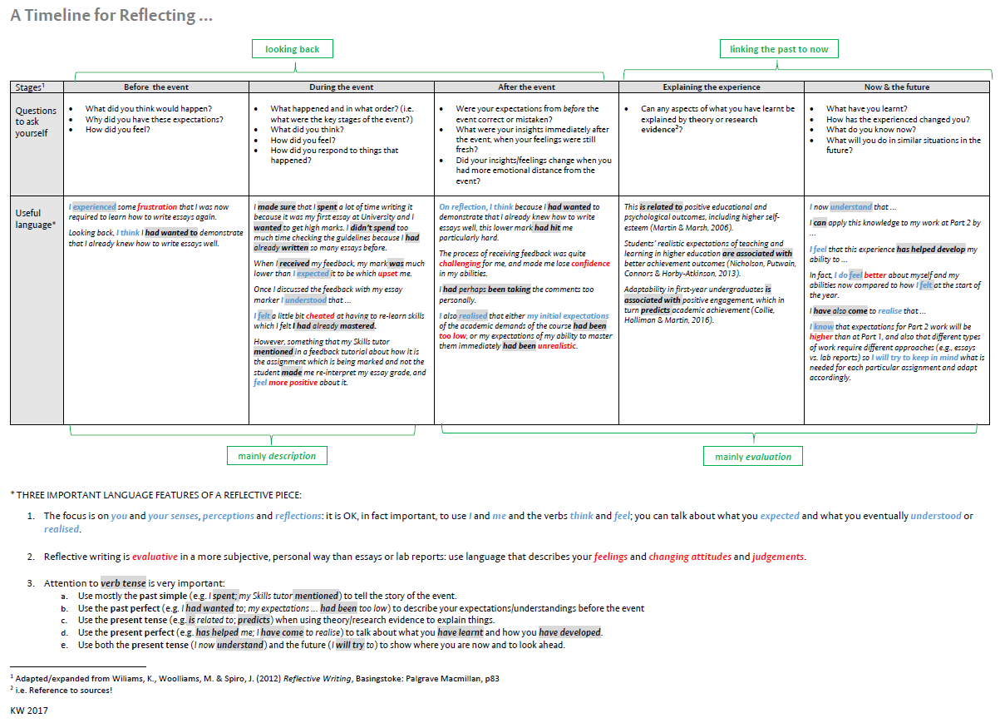

Slide 30
Thoughts/reflections …

Slide 31
References
Extracts from BAWE (The British Academic Written English (BAWE) corpus [http://www.coventry.ac.uk/research/research-directories/current-projects/2015/british-academic-written-english-corpus-bawe/]) Psychology texts were accessed from Flax [http://flax.nzdl.org/greenstone3/flax]
Hyland, K. (2005) ‘Stance and engagement: a model of interaction in academic discourse’, Discourse Studies, 7(2), pp. 173-192.
Wingate, U. (2012) ‘Argument! Helping students understand what essay writing is about’, Journal of English for Academic Purposes 11, pp. 145-154.

