Slide 1
“Embracing the Future”
Synoptic Assessment on the Foundation Certificate for Art, Design and Media
Adam Stewart (English Language and Academic Skills Coordinator) - adam.stewart@kaplan.com
Hanna Mawbey – Programme Coordinator for Foundation Certificate in Art, Design and Media – hanna.mawbey.kaplan.com

Slide 2
Session Outline
Course Structure
Rationale
The Assessment
Benefits and Challenges
Feedback and Results
Next Steps

Slide 3
Course Structure
Term 1 | Term 2 | Term 3 | Summer
Arts, Design & Media An Introduction FC092, NCB 5hrs p/w | Arts, Design & Media Structured Projects FC094, 20 Credits 6 hrs p/w | Arts, Design & Media Specialism Project FC095, 20 Credits 6 hrs p/w | Portfolio & Professional Preparation FC096, NCB 15hrs p/w
Historical, Cultural & Contemporary Practice in Arts, Design & Media FC093, 20 Credits, 3 hrs p/w
Language for Study 1 FC201, NCB 6 hrs p/w | Language for Study 2 FC202, NCB 3 hrs p/w | Language for Study 3 FC203, 8 credits 6 hrs p/w
Skills for Study 1 FC501, 0 credits 4hrs p/w | Skills for Study 2 FC502, 0 credits 4hrs p/w | Skills for Study 3 FC503, 12 credits 4hrs p/w

Slide 4
Synoptic Assessment
Synoptic Assessment involves testing: “connections between different elements of the subject”
(Patrick 2005)
synoptic assessment “may help students to make connections between modules, may increase the level of student engagement…”
(Gorra et al 2008)

Slide 5
Rationale
To build greater and more explicit links for students between Skills for Study (SS), Language for Study (LS) modules and subject modules
(UBIC Learning, Teaching and Assessment Strategy)

Slide 6
Course Structure
Term 1 | Term 2 | Term 3 | Summer
Arts, Design & Media An Introduction FC092, NCB 5hrs p/w | Arts, Design & Media Structured Projects FC094, 20 Credits 6 hrs p/w | Arts, Design & Media Specialism Project FC095, 20 Credits 6 hrs p/w | Portfolio & Professional Preparation FC096, NCB 15hrs p/w
Historical, Cultural & Contemporary Practice in Arts, Design & Media FC093, 20 Credits, 3 hrs p/w
Language for Study 1 FC201, NCB 6 hrs p/w | Language for Study 2 FC202, NCB 3 hrs p/w | Language for Study 3 FC203, 8 credits 6 hrs p/w
Skills for Study 1 FC501, 0 credits 4hrs p/w | Skills for Study 2 FC502, 0 credits 4hrs p/w | Skills for Study 3 FC503, 12 credits 4hrs p/w

Slide 7
Rationale
Student Feedback: Too many assessments in Autumn Term (All Non-credit Bearing)
Staff feedback: Problems with referencing, citations etc in subject modules
Overlapping Module Outcomes

Slide 8
Module Outcomes - HCCP
Generic Learning Outcomes:
1. Work independently and become a more self-directed learner.
2. Demonstrate increasing confidence in the expression of thoughts, opinions and ideas.
3. Communicate ideas effectively: written, oral, visual.
4. Work collaboratively and contribute to group discussions.

Slide 9
Module Learning Outcomes -Skills for Study 1
1. Can understand a lecture, demonstration or presentation where the message is expressed in relatively simple language and take simple notes for specific spoken and written discourse purposes
2. Can understand straightforward factual written texts on subjects related to field/interest and make simple notes for specific written or spoken discourse purposes

Slide 10
Module Learning Outcomes -Skills for Study 1
3. Can understand the basic methods of referring to or using source material and attempt to paraphrase, summarise and cite sources to avoid plagiarism and use as evidence in an argumentative essay or presentation
4. Can plan and deliver a short, relatively simple argumentative presentation or demonstration using IT software

Slide 11
Changes: Previous Assessment Strategy (HCCP)
Assessment element | Weighting (or F if formative) | Indicative timing
Group Presentation and Individual Journal | Formative | End of Term 1
Individual Journal and Short Essay | 40% | End of Term 2
Final Project | 60% | End of Term 3

Slide 12
Changes: Previous Assessment Strategy (SS1)
Assessment element | Weighting (or F if formative) | Indicative timing
Portfolio | Formative | Week 6
Presentation | 40% | Week 11
Essay | 60% | Week 11

Slide 13
Changes: Synoptic Presentations
All students completed a short group presentation
This used the HCCP presentation topic
This topic was also used for the SS1 essay
Texts from HCCP lectures were used in Skills classes
Presentations were marked by Skills and Subject teachers
Separate criteria were used for each module

Slide 14
Marking Criteria - HCCP
Subject Subject Knowledge, appropriate vocabulary, awareness of contexts, evaluation
__________________________________________________
Intellectual Interpretation, coherent ideas, critical awareness, problem solving
___________________________________________________
Practical Appropriate tools & equipment, appropriate techniques & materials
___________________________________________________
Transferable Communication skills, academic practice, time management, independent working?

Slide 15
Marking Criteria – SS1
Structure How well do you organise and link your information and ideas in your presentation?
__________________________________________________
Content How relevant is the content to the question/thesis? How focused is the content? Is the thesis/argument (if required) innovative? How well can you analyse ideas and information (if required)? ___________________________________________________
Support How well can you support your ideas with examples from academic sources and/or information from the notes? How well can you use citations and reference your sources? How effective are your AV materials in supporting your ideas? ___________________________________________________
Clarity of Delivery How clear is your speech? How confident do you appear? How good is your interaction with your audience and partner? How well can you deal with questions from the audience?

Slide 16
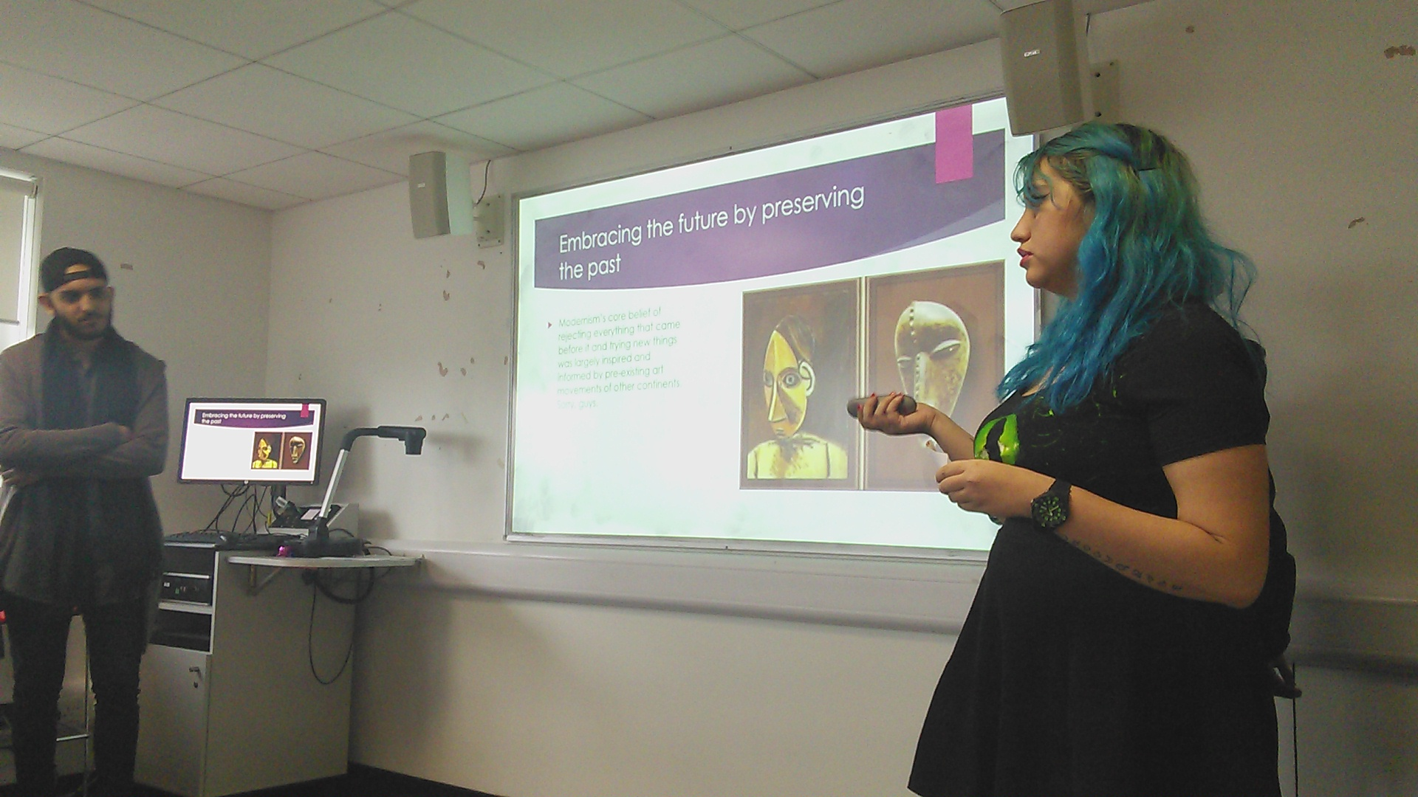
Presentation Topic
“In Arts, Design & Media, is it more important to preserve the past or embrace the future?”

Slide 17
Benefits

Slide 18
Using Academic
Conventions

Slide 19
Preperation
Time

Slide 20
Connections between modules
“Imitation had long been a central academic principle” (Lyntton 1994)

Slide 22
Challenges
Different Expectations
Different Priorities
Question Interpretations
Finding source material
Different goals

Slide 23
Module Results
 | Autumn-15 | Autumn-16
HCCP | 44 Students | 45 Students
Average | 59 | 55
Presentation | 61 | 57
SS1
Average | 62 | 56
Presentation | 63.4 | 60

Slide 24
Student Feedback
 | Strongly Agree | Agree | Partially Agree | Disagree
The connection between Modules was clear | 5 | 3 | 0 | 0
I used HCCP contents in SS1 | 5 | 2 | 0 | 1
I used skills from SS1 in HCCP assessments | 4 | 3 | 0 | 1
The workload in term 2 was higher than in term 1 | 5 | 1 | 2 | 0
I would be happy with more synoptic assessments | 3 | 3 | 2 | 0
I would prefer 1 assessment to be use din 2 modules | 6 | 1 | 0 | 1

Slide 25
Student Feedback - Comments
It would lower the workload so it would make students more focused on art projects.
It depends on the topic of Skills for Study. For example, I couldn't find a connection between the Turner prize and my project for term 2 or exhibition essay.
Less workload
Building on the subject is easier when you are focusing on 1 topic
Save time and could research more details about 1 topic.

Slide 26
Staff Feedback
More interaction between teaching teams
More preparation time in class
Closer connection between the two departments
Students too focused on technology aspect of the question
Some subject text too complex to use in skills classes.
Not enough lesson materials

Slide 27
Next Steps
Develop Lesson materials to support the HCCP input in skills classes
Edit the questions to encourage students to investigate Modernism and Arts relation to history
Include a written synoptic assessment in the second term
Explore the possibility of using the same criteria for both modules

Slide 28
References
Gorra, A., Sheridan-Ross, J. and Kyaw, P (2008). ‘Synoptic learning and assessment: case studies and experiences’. In 9th Annual Conference of the Subject Centre for Information and Computer Sciences (pp. 98-101).
Patrick, H. (2005). Synoptic assessment: Report for QCA. Cambridge: University of Cambridge

