Slide 1
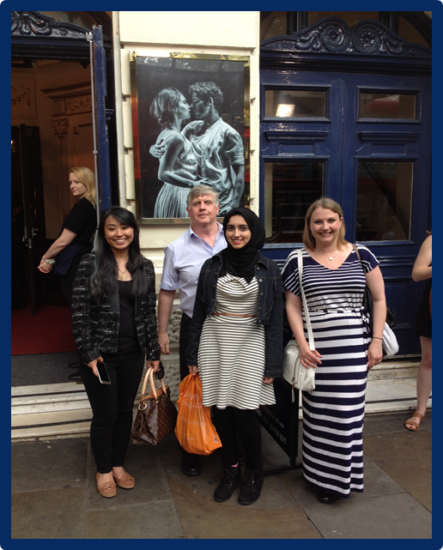
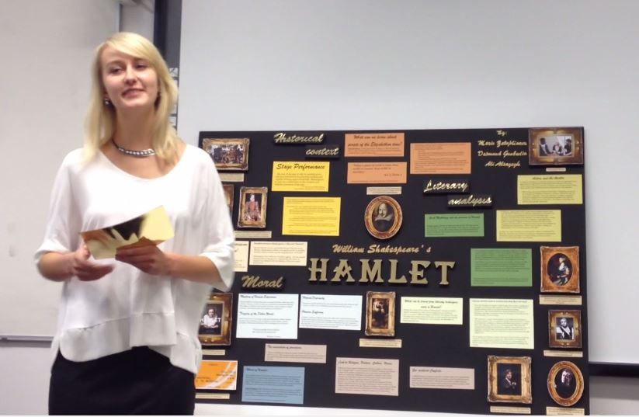

Shakespeare-Globe to Globe:
Accessing plays on IFP Humanities
Alexandra Corrin MA
Foundation Humanities Module Leader

Slide 2
A 360 degree passport for life
“Shakespeare gives you a passport through life-a 360 degree view of what it is to be human” (Doran; in Farr; 2013).

Slide 3
Accessing Shakespeare with IFP Humanities
INTO Newcastle’s Shakespeare Story
Not of An Age, But for all Time
Hamlet Into Historical Context
Hamlet Into Contemporary Context
Visual & Kinaesthetic Learning Approaches
Assessments
Related Projects & Student Feedback

Slide 4
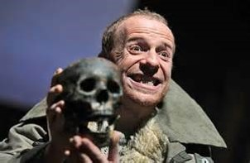
INTO Newcastle’s Shakespeare Story
Unchartered territory
Student ability
Logistics
Can it be done well?
Teacher workload
No direct Pathway to Literature
What a piece of work is a man!
- Hamlet (2.2.295-302), Hamlet to Rosencrantz and Guildenstern

Slide 5
INTO Newcastle’s Shakespeare Story
Theatre Trips: 2013-2017
Hamlet, Newcastle Theatre Royal, 2013
Hamlet, The Globe, 2014
Hamlet, The Manchester Royal Exchange,2014
Macbeth, The Northern Stage, 2015
Romeo and Juliet, The Westonovian Theatre,2015
Romeo and Juliet, The Garrick, 2016
King Lear, The Barbican,2016
The Tempest, The Barbican, 2017
Upcoming: Hamlet, The Northern Stage, 2018

Slide 6
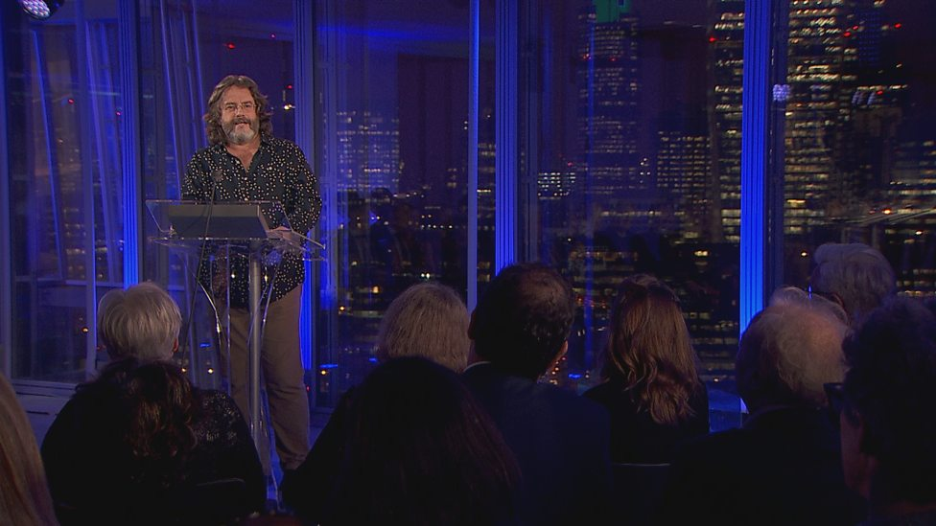
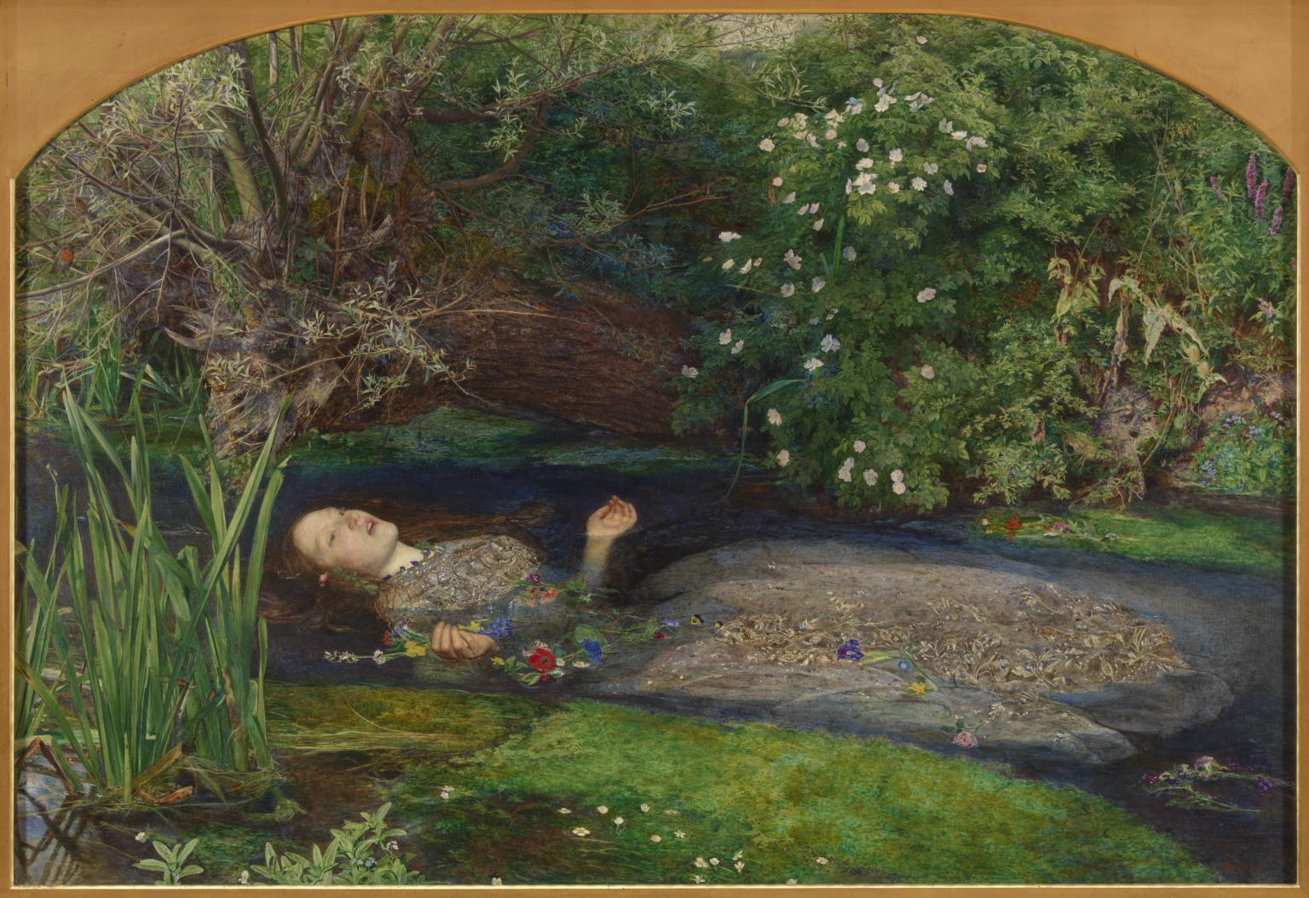

Not of an Age, But for all time
Inspiring creativity
A Benchmark for Mankind
Introductory readings:
‘Why Shakespeare should be child’s play’ (Singh; 2014)
Higher level:
‘Shakespeare in the Bush’ (Bohannan; 1966)
‘Is Shakespeare Chinese?’ ( Doran; 2016)
(Crawforth; 2016)

Slide 7
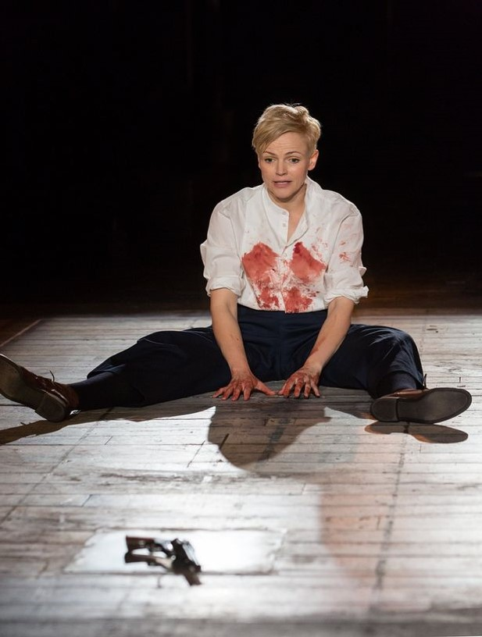
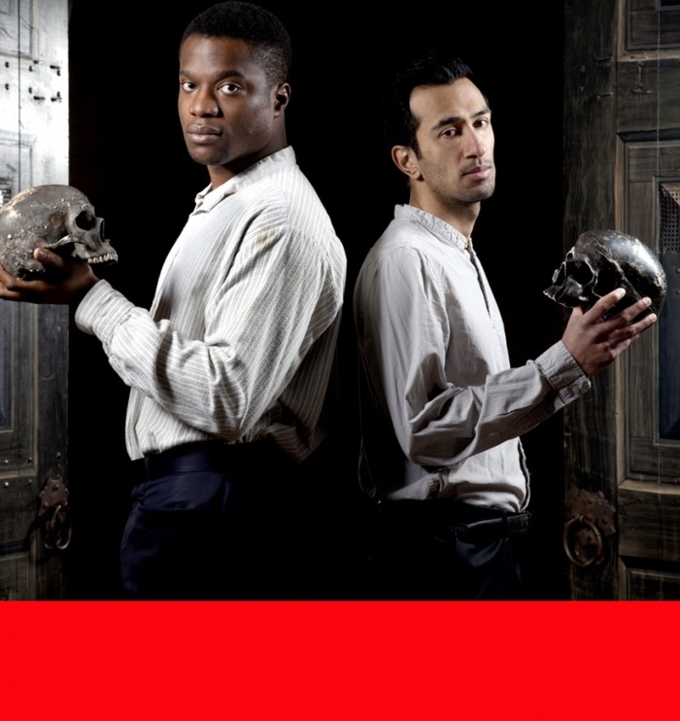
Kaleidoscope of Interpretations
‘Hamlet feels to me to be not necessarily ..an exclusively male character. ..Hamlet feels to be at times an extraordinary combination and kind of mesh of male and female, in essence.’
Sarah Frankcom, Director of Hamlet, The Royal Exchange Theatre, Manchester, 2014
( Hamlet Undressed;2014)

Slide 8
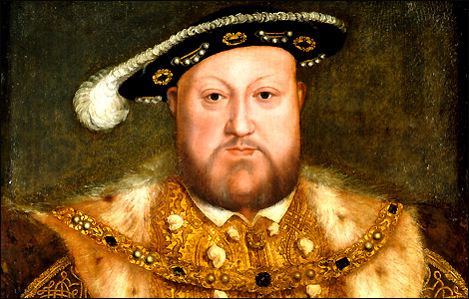
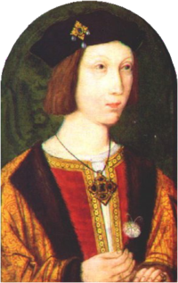
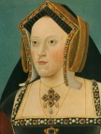
Hamlet Into Historical Context
Parallels between King Claudius husband of Gertrude, and King Henry V111-both married their brother’s wife
Conjugal union of brother and sister-in-law viewed as incestuous- in the Old Testament (Old Testament, Leviticus 20:21)
1509: Henry V111 married his brother Arthur’s widow, Catherine of Aragon
Final laws prohibiting men from marrying brothers’ wives - repealed in 1907
Hamnet & Hamlet (Greenblatt; 2004).

Slide 9
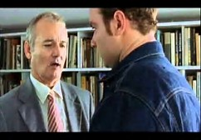
Hamlet Into Contemporary Context
Polonius’ advice to Laertes:
saying goodbye to a child going abroad to study:
Yet here, Laertes? Aboard, aboard, for shame!
The wind sits in the shoulder of your sail,
And you are stayed for. There-my blessing with thee.
And these few precepts in thy memory.
(Shakespeare; 1997).
Task:
What parental advice did you receive before coming to the U.K to study?

Slide 10
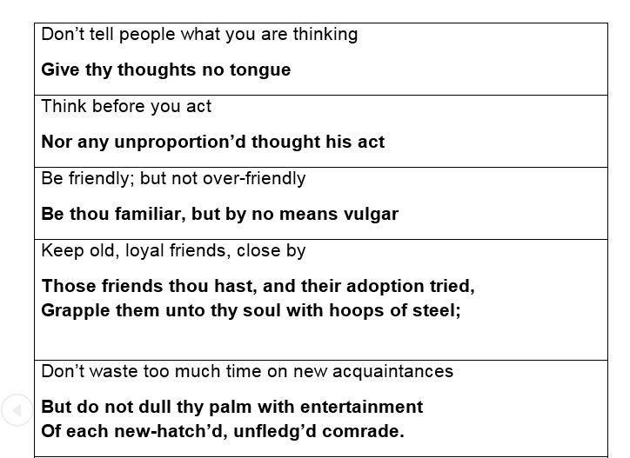
Hamlet Into Contemporary Context:
Polonius Matching Activity & Discussion
Is it good advice? Why? Why not?
What additional advice could you offer, in 2017?
Why are there “modern day” versions of Hamlet?
What do you notice about Polonius’s language ?

Slide 11
Hamlet Into Contemporary Context:
Scrutinising Polonius, 1599 & The “If” Poem, 1910
Students examine Rudyard Kipling’s “IF” poem ( BBC Worldwide Ltd;1998).
Also a father’s advice to his son
Hear recording of the poem
Discussion /Written task:
Similarities?
Differences?
Who gives the best advice?

Slide 12
Exploiting Visuals
What evidence is in the design and imagery for:
Cordelia’s difference from her sisters ?
(Royal Shakespeare Company; 2017)

Slide 13
King Lear’s authority and status?
What else might the images suggest about Lear and his family?
(Royal Shakespeare Company; 2017).

Slide 14
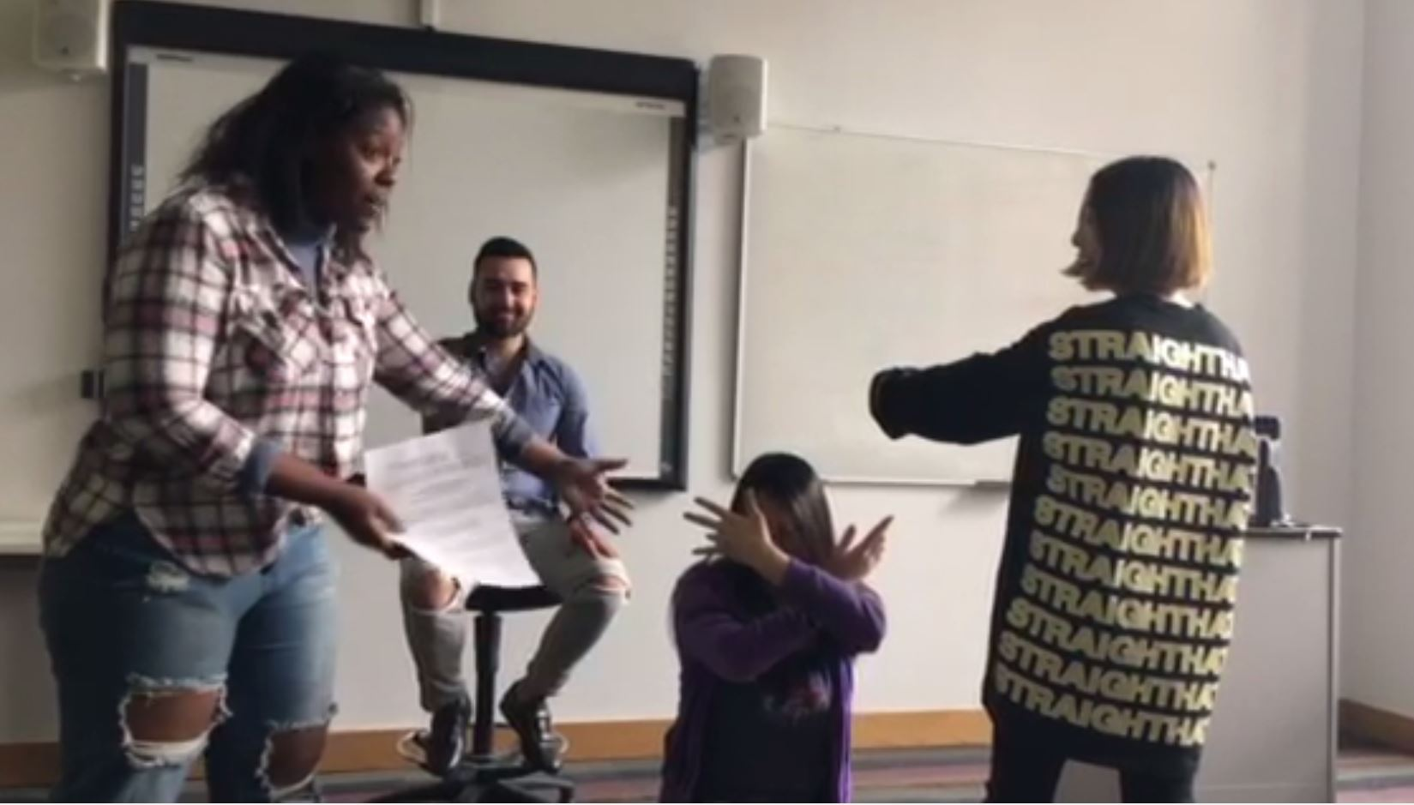
Kinaesthetic Learning Approaches:
Freeze Frames
‘We split, we split!’
(Shakespeare, 2014, 1.1:53).
Possible Learning outcomes
Familiarization with plot
Language analysis in manageable snippets!
Focus on distilling meaning/atmosphere
Insights into characters
Group collaboration; fun!
Reflection activity
From left to right: Kochiwe (Zambia), Bilal (Pakistan), Rachel ( Malaysia), Anni (China)

Slide 15
Why do you think you were asked to do this activity? | ”In order to ‘live’ out the scenes in The Tempest for a more intimate understanding.” Songwei (Singapore) It is very interesting and stimulating, make everyone involve in class. And understand tempest in own way. Phyllis ( China)
Have you done any activity like this before? | “In this activity we were supposed to freeze while acting and it was an unforgettable experience because I have never done this kind of activity before.” Ammara ( Pakistan)
What challenges did it present both individually & as a group ? | “Although we all understood the main concept, each person in the group envisioned the scene differently and this resulted in conflicting ideas. (Kochiwe, Zambia) “Required heaps of creativity to put together, time” (Rachel, Malaysia)
Did you learn anything/develop any skills from it? | I learnt that how to cooperate when I was in a group, and how to face to the audience without nervous. (Kathy, China)

Slide 16
Kinaesthetic Learning
The Language of Love & Hate: RSC 2008
O serpent heart, hid with a flow'ring face!
Did ever dragon keep so fair a cave?
Beautiful tyrant, fiend angelical!
Dove-feathered raven, wolvish-ravening lamb!
Despised substance of divinest show!
Just opposite to what thou justly seem'st,
A damned saint, an honourable villain!
O, nature, what hadst thou to do in hell
When thou didst bower the spirit of a fiend
In mortal paradise of such sweet flesh?
Was ever book containing such vile matter
So fairly bound? O that deceit should dwell
In such a gorgeous palace! (Juliet, Act 3; Scene 2)
Teacher gives context
In pairs, put two chairs opposite each other
One reads the speech, the other listens and moves between the two chairs whenever Juliet introduces a word that presents an opposite idea
sit on one chair on hearing words to do with love/beauty/gentleness
move to the other on a word to do with hatred/ugliness/violence

Slide 17
Antithesis & Oxymoron
Identifying Opposites
Discussion
O serpent heart, hid with a flow'ring face!
Did ever dragon keep so fair a cave?
Beautiful tyrant, fiend angelical!
Dove-feathered raven, wolvish-ravening lamb!
Despised substance of divinest show!
Just opposite to what thou justly seem'st,
A damned saint, an honourable villain!
O, nature, what hadst thou to do in hell
When thou didst bower the spirit of a fiend
In mortal paradise of such sweet flesh?
Was ever book containing such vile matter
So fairly bound? O that deceit should dwell
In such a gorgeous palace! (Juliet, Act 3; Scene 2)
How did you feel doing that exercise?
How does Juliet feel?
Why does Shakespeare uses antithetical phrases in this speech ?
What does it tell us about Juliet’s state of mind & her feelings for Romeo?
Why is conflict important in drama?
Royal Shakespeare Company; 2008).

Slide 18
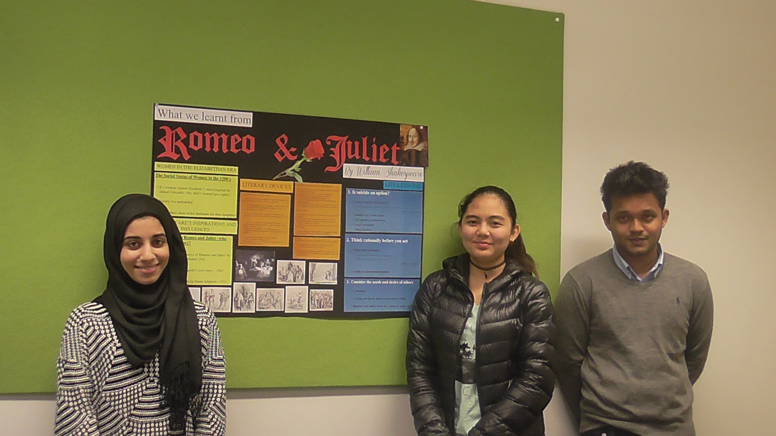
Embedded Assessments
Poster presentations
Relating Live Performance to Assessment-Romeo & Juliet, 2016
Identify and discuss the predominant themes of Romeo and Juliet.
How successfully were these depicted in Kenneth Branagh’s 2016 production, at the Garrick Theatre?

Slide 19
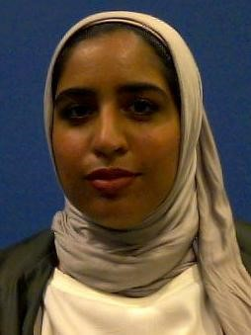
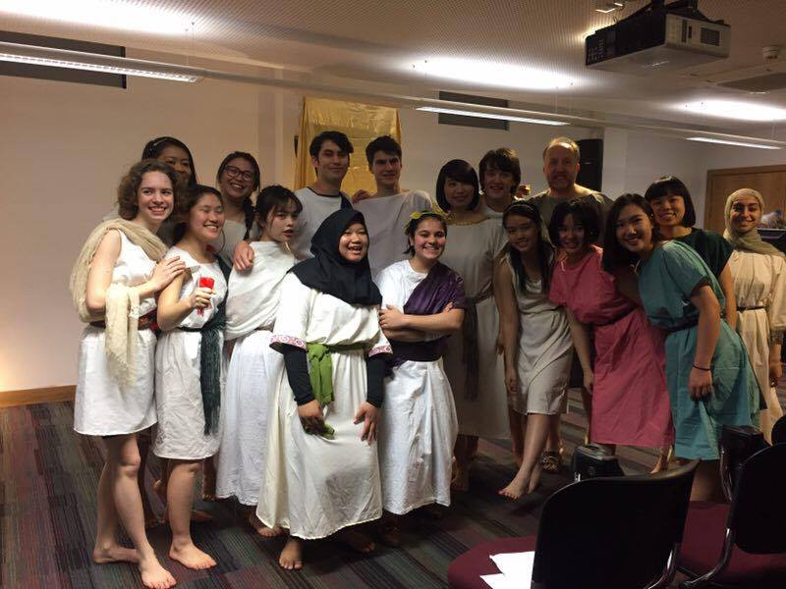
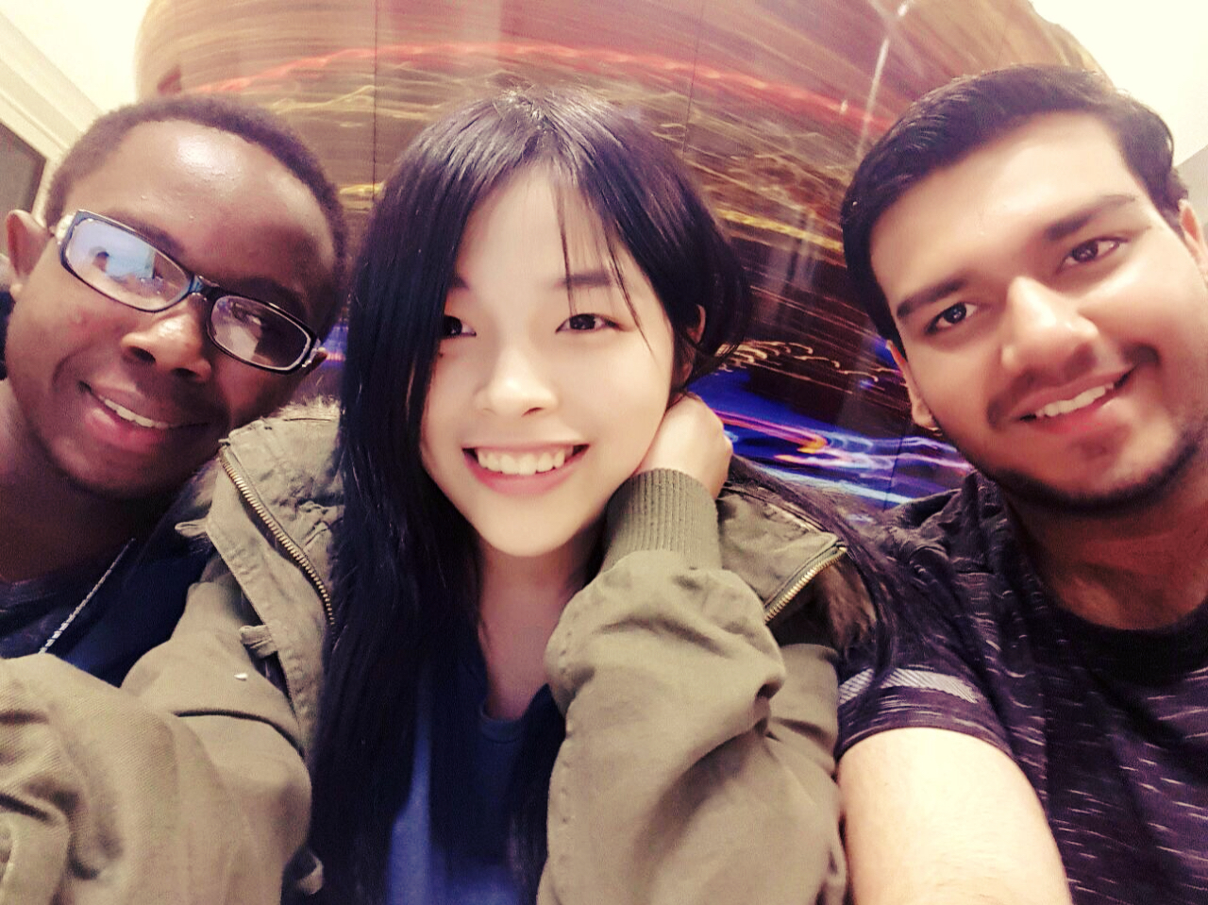
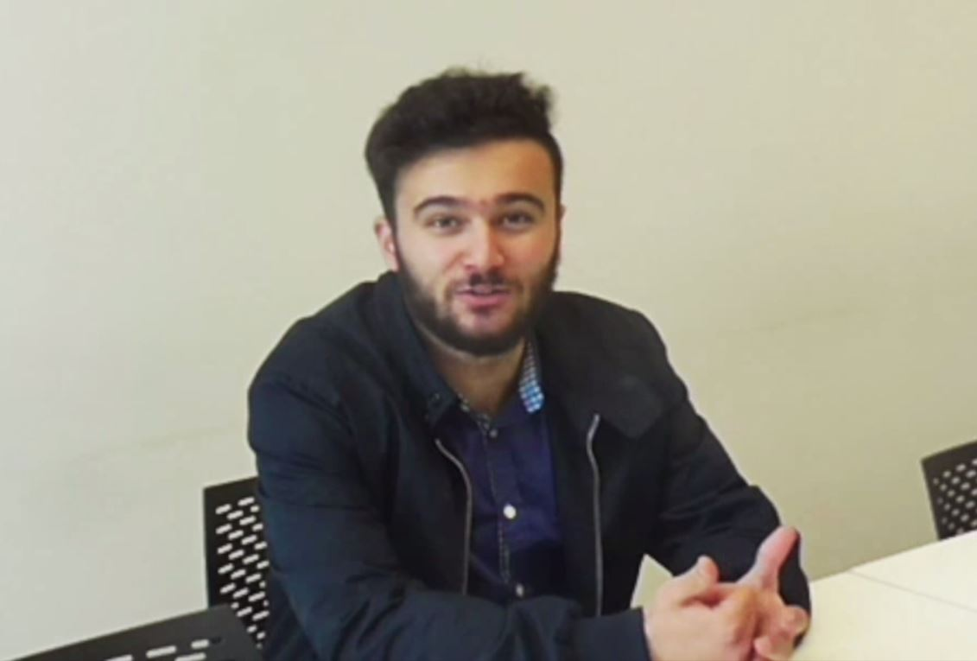
Related Developments
New Pathways
Cross-Modular Links
11 Staff & Student Performances
The Dead Poets’ Society & Great War Poetry
Student Feedback

Slide 20
Contact Information
Alexandra Corrin
Module Leader
Humanities &Social Science
Foundation Programme
INTO Newcastle University LLP
Mobile +44 [0] 7503190674
Email: Alexandra.corrin@ncl.ac.uk

Slide 21
References
BBC Worldwide Ltd. (compiler) (1998) The Nation's Favourite Poems. London: BBC Worldwide Ltd.
Bohannan, L. (1966) ‘Shakespeare in the Bush’, Natural History. Available at:
http://www.naturalhistorymag.com/picks-from-the-past/12476/shakespeare-in-the-bush ( Accessed: June 23rd 2017).
Brown, R. Shakespeare’s sources, RSC website:
https://www.rsc.org.uk/explore/shakespeare/plays/hamlet/sources.aspx
Crawforth, H. and Scott-Baumann (ed.) (2016) On Shakespeare’s Sonnets A Poets’ Celebration. London: Bloomsbury Arden Shakespeare
Doran, G. (2016) ‘Is Shakespeare Chinese? The BBC Richard Dimbleby Lecture 2016’, NATE Teaching English, 11,pp. 32-40. Available at:
https://www.nate.org.uk/file/2016/08/Gregory-Doran.pdf (Accessed: 23rd June 2017).
Doran, G. (Director). (2017, July13th). The Tempest by William Shakespeare, [Programme] The Barbican, London.
Farr, D. (Director). (2013, October 24th). Hamlet by William Shakespeare, [Programme] Theatre Royal, Newcastle-Upon- Tyne.
Greenblatt, S. (2004) 'The Death of Hamnet and the Making of Hamlet', The New York Review of Books, October 2004. Available at:
http://www.nybooks.com/articles/2004/10/21/the-death-of-hamnet-and-the-making-of-hamlet/ (Accessed:14th July 2017).
'Gregory Doran discusses his own personal journey with King Lear.' (2016) The Richard Dimbleby Lecture Series, BBC One, March 22nd 2016. Available at: http://www.bbc.co.uk/programmes/p03npzgt (Accessed: 4th July 2017).
Hamlet by William Shakespeare (2013) Directed by David Farr [Theatre Royal. 24th October].

Slide 22
References
Hamlet by William Shakespeare (2014) Directed by Dominic Dromgoole. [Shakespeare's Globe. London April 26th 2014].
Hamlet by William Shakespeare (2014) Directed by Sarah Frankcom. [Royal Exchange Theatre. Manchester October 15th 2014].
Hamlet Undressed (2014) BBC Radio 4, 13th October 2014. Available at:
http://www.bbc.co.uk/programmes/b04jhn49 ( Accessed: 6th July 2017).
Lavery, H Hamlet and Elizabethan England
Available at: http://www.open.edu/openlearn/history-the-arts/culture/literature-and-creative-writing/literature/hamlet-and-elizabethan-england Accessed: 4th July 2017).
Macbeth by William Shakespeare (2015) Directed by Ali Robertson. [ The Northern Stage. March 11th2015].
Royal Shakespeare Company (2017) King Lear Teacher Pack 2016. Available at: https://www.rsc.org.uk/education/teacher
resources/search/play/lear/type/packs/age/any/(Accessed: 6th July 2017).
Royal Shakespeare Company (2017) Romeo and Juliet Teacher Pack 2008. Available at: https://www.rsc.org.uk/education/teacher-resources/search/play/romeo/type/packs/age/any/
(Accessed:6th July 2017).
Royal Shakespeare Company (2017) The Tempest Teacher Pack 2016. Available at: https://www.rsc.org.uk/education/teacher-resources/search/play/tempest/type/packs/age/any/
(Accessed: 6th July 2017).
Shakespeare, W. (2014) Macbeth. Edited by Brady, L. and James, D. Cambridge: Cambridge University Press. 5: 5: 25-27.

Slide 23
References
Shakespeare, W. (1997) Hamlet. Edited by Blatchford. R. Singapore: Longman Singapore Publishers. 1.3.59-63.
Shakespeare, W. (2014) The Tempest. Edited by Brady L. and James J. Cambridge: Cambridge University Press. 1. 1: 51-3.
'Shakespeare Uncovered Hamlet ‘ (2012) Shakespeare Uncovered [Hamlet / Richard II / The Tempest / The Comedies / Macbeth / Henry IV and V] , BBC 4
Singh, A. (2014) 'Why Shakespeare should be child’s play', The Telegraph, 09 February. Available at: http://www.telegraph.co.uk/culture/theatre/william-shakespeare/10625363/Why-Shakespeare-should-be-childs-play.html (Accessed: 04/07/2017).
The Tempest by William Shakespeare (2017) Directed by Gregory Doran [The Barbican, London. July13th].

