Slide 1
Low-tech for high engagement: Gratitude practices to enhance autonomous learning

Slide 2
Gratitude in education
‘…as they practised more gratitude when they studied, they experienced increased engagement, greater connection to the subject and teacher, a deeper understanding of content, and increased motivation.’ (Howells 2012)

Slide 3
PRESENTATION AIMS
Gratitude described
Educational value of gratitude
Developing gratitude
The issues with gratitude in IFP

Slide 4
What gratitude is not
A fleeting emotion
Positive thinking (although it tends to generate positivity)
Entitlement for (expressions of) appreciation

Slide 5
What gratitude is
Thinking and reflection (acknowledgement of good events)
Generosity and kindness
Purposeful repeated action
Interpersonal behaviour

Slide 6
Gratitude & wellbeing
Stronger emotional intelligence
Reduced anxiety
Increased resilience
Higher self confidence
Courage to take action
Notes:
Higher EQ promotes better CT skills; Higher CT skills promotes lifelong learning skills. Self-directed learning, resilience, academic proficiency,

Slide 7
Gratitude & learning
Promotes higher alertness, enthusiasm and determination (goal-led)
Promotes thinking
Increases social awareness
Encourages responsible decision making
Notes:
Is gratitude a cultural practice/is it more common (and accepted as something that affects one’s life) in some cultures and not in others?

Slide 8
Developing gratitude
Paying attention to life events & paying forward (Emmons and McCullough 2003; Emmons and Stern 2013)
Daily random acts of kindness (Lyubomirsky 2007)
Mental subtraction of positive events (Koo et al 2008)
Gratitude letters (Seligman et al 2005)
Gratitude surprise sticky notes (Campbell 2016)
Notes:
Generalisable across age groups

Slide 9
Where in an ifp can gratitude be integrated?
At start of programme (e.g. induction session)
At start of module/course
During personal tutorials
In counseling sessions
As an integrated in-sessional ‘giving back’ programme (e.g. NEEDS at UNMC)
Notes:
Even at foundation level students can be sent out on volunteer programmes. These progs don’t have to be teaching based i.e. students don’t have to teach at schools but teaching is a way of acknowledging and expressing gratitude (‘I am thankful I am good at Math so I will teach it so others may be good at it, too’).

Slide 10
N.E.E.D.S.
The Nottingham Education Excellence Development Series Programme
e.g. a) NEEDS 2 English workshop
b) NEEDS 5 Microscope Project
Notes:
NEEDS 5 is a collaboration with the Sci faculty who has the Cascade grant funding to borrow microscopes from the UK and loan them to schools to get school children interested in science.

Slide 11
Notes:
From NEEDS 2.

Slide 12
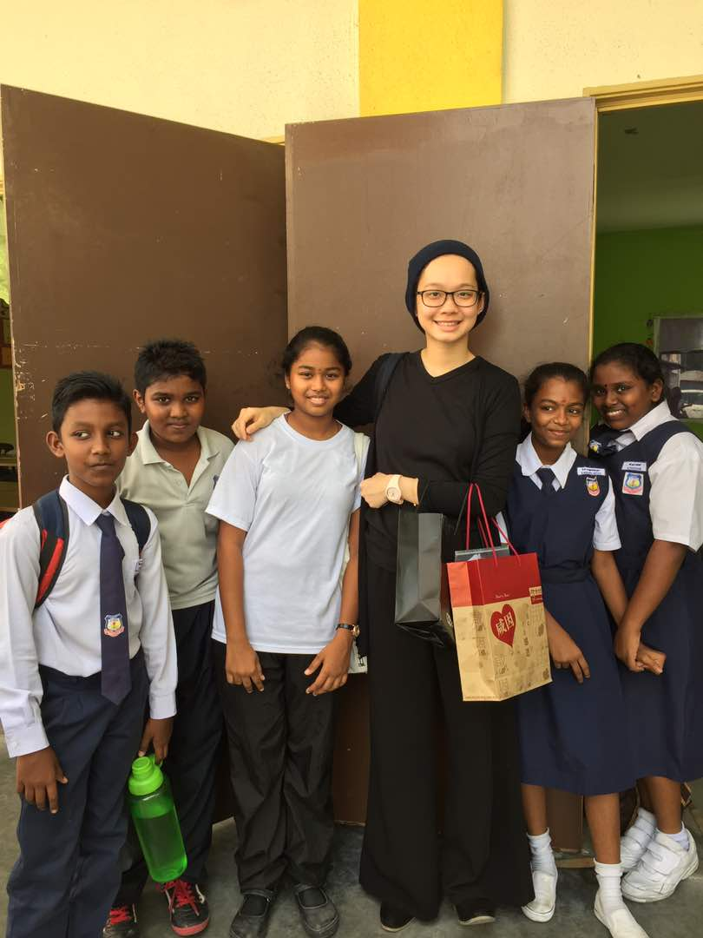

Slide 13
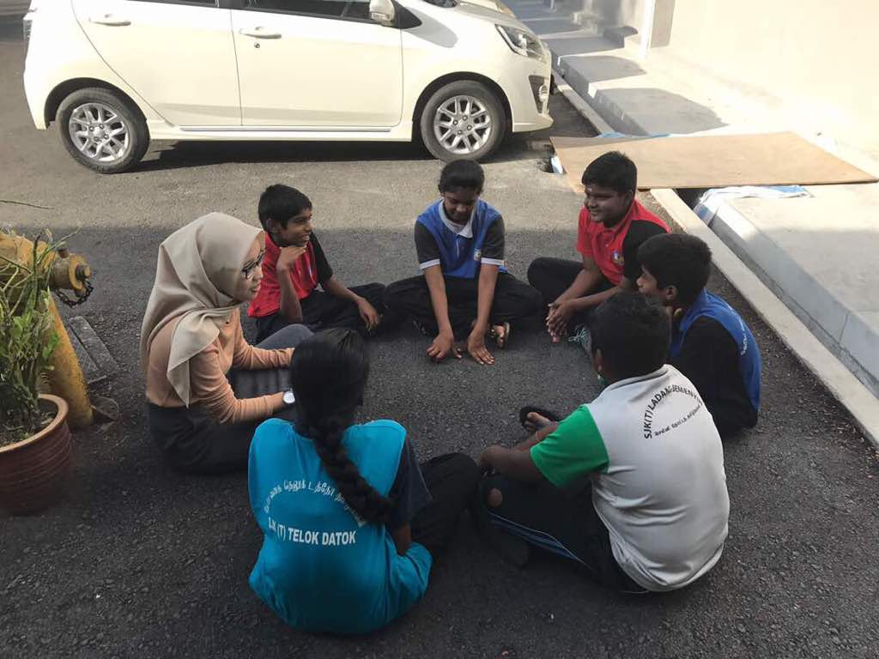

Slide 14
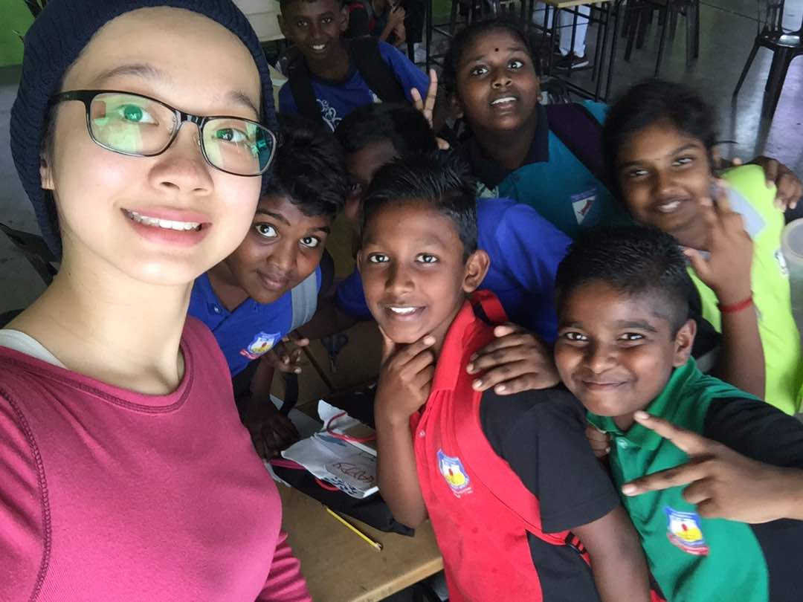

Slide 15
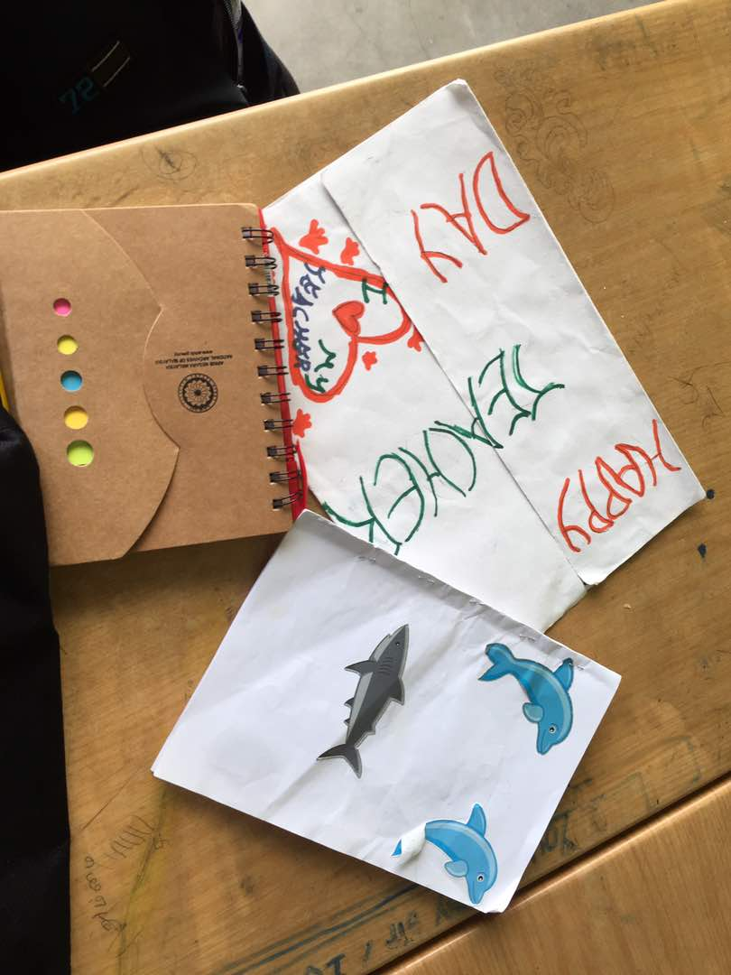
Notes:
Artwork from the school children.

Slide 16
SOME FEEDBACK FROM THE STUDENTS
‘ Thank you for the opportunity to do this! I had the most amazing time and I don’t think I left being the same person as I was when I entered.’
‘I truly enjoyed myself … definitely looking forward to coming back…’
‘…I’m really glad to help the children learn while having fun at the same time’
Notes:
Follow up reflective feedback after the NEEDS workshop.

Slide 17
Some real concerns
Suppressed negative emotions
Abuse of power/position
A flawed sense of entitlement
The teacher’s own gratitude practices
The effects of gratitude interventions are not always sustainable.
(Howells 2012)

Slide 18
Further reading & resource
https://greatergood.berkeley.edu/gratitude
http://www.positiveschools.com.au/

Slide 19
references
Carver, C. S. and Scheier, M. F. (2003.) Perspectives on Personality (5th Ed) Boston: Allyn and Bacon
Emmons, R. A.,& McCullough, M. E. (2003). Counting blessings versus burdens: An experimental investigation of gratitude and subjective well-being in daily life. Journal of Personality and Social Psychology, 84(2): 377-389.
Emmons, RA and Stern, R. (2013). ‘Gratitude as a psychotherapeutic intervention’. Journal of Clinical Psychology. 69(8): 846-55
Howells, K. 2012. Gratitude in Education: A Radical View. Rotterdam: Sense Publishers
Koo, M., Algoe, S. B., Wilson, T. D., & Gilbert, D. T. (2008). It's a wonderful life: Mentally subtracting positive events improves people's affective states, contrary to their affective forecasts. Journal of Personality and Social Psychology, 95(5):1217.
Lyubomirsky, S. (2008). The How of Happiness: A New Approach to Getting the Life You Want New York: Penguin
Seligman, M. E., Steen, T. A., Park, N., & Peterson, C. (2005). Positive psychology progress: empirical validation of interventions. American Psychologist, 60(5): 410.
Vitasari, P., Wahab, M. N. A., Othman, A. and Awang, M. G. (2010). The Use of Study Anxiety Intervention in Reducing Anxiety to Improve Academic Performance among University Students. International Journal of Psychological Studies 2(1): 89–95.

Slide 20
Questions?
Saleha.AbdulRahman@nottingham.edu.my
03 8924 8195 012 349 6589
Thank you

