Slide 1
Innovations outside the classroom to enhance student engagement
Clare Nukui
Senior Lecturer
Oxford Brookes International

Slide 2
Overview
What do we mean by engagement?
Positive effects of engagement
Types of engagement and typologies
How do we try to engage students at Reading before, during and after the course?
Notes:
Note that this talk is not heavy on statistics and evidence and much of what I present will be anecdotal in nature. Will begin by looking at what the literature has to say on the subject of engagement

Slide 3
Engagement?
According to Trowler (2010), student engagement is about…
“ [optimising] the student experience and [enhancing] the learning outcomes and development of students and the performance and reputation of the institution”.
Financial dimension…
“Student retention and throughput rates are of concern to all institutions at least in part because of the financial penalties attached to drop out rates”.
Research is needed on links between institutional expenditure and student engagement.
We believe strongly that investing in activities to enhance student engagement is important and beneficial to all…
Notes:
At least 1 in 10 students at 18 universities across the UK quit higher education – The Guardian

Slide 4
Positive effects of engagement
National Survey of Student Engagement results (2016 ) suggests that engaged students …
are active and collaborative learners (partnership)
participate willingly in challenging academic activities
feel legitimated and supported by the university
Also shows links between engagement and…
Critical thinking
Self-esteem
Improved grades

Slide 5
Types of engagement
Student
Student
Staff
University
Country

Slide 6
Types of students
Home students
Widening participation students
International students
Mature/Part time
Notes:
E.G Student from Zimbabwe but with British passport and has dyslexia

Slide 7
Engagement & international students
Should be positively engaged as tend to live on campus (residential universities and colleges have a positive engagement correlation) but…
New ways of doing things
Different teaching practices
Learning in a second or third + language

Slide 8
“Some students actively engage with the battle and lose. What do we do for them?” (Krause, 2005)
We believe our support and activities help international students fight a successful battle!

Slide 9
Student-staff engagement
Staff
Academics
Administrators
Student Affairs Personnel

Slide 10
Student-staff engagement
Astin (1993) “…faculty-student interaction has a positive effect on both cognitive and affective development”.
Wilson and Gaff (1974) found that faculties labelled as ‘most outstanding’ were those who most frequently interacted with students outside the classroom.
….. “When students engage in personal interactions with faculty, they feel valued and important”. (Cox and Orchovec, 2007)
Notes:
Victoria’s comment re personal tutorials – have to get to know your students on a personal level before they will share with you how they are feeling
Pebble-
How was your weekend?
What did you get up to during the holiday?.

Slide 11
What does engagement (and lack of it) look like on the part of the student?
Levels of engagement | Positive | Neutral | Negative
Behavioural | Attends and participates in class | Skips classes with no excuses being provided | Disrupts classes when attends
Emotional | Interested in what is being taught | Bored by what is being taught | Rejects ideas being taught
Cognitive Source: Kuh, 2005 | Meets or exceeds assessment requirements | Rushed or late submission of assignments | Redefines parameters for assignments
Notes:
Negative scenario probably least familiar to us
Note re OBU Business School re students not attending, not preparing for classes. This emerged out of a university audit on classroom use!

Slide 12
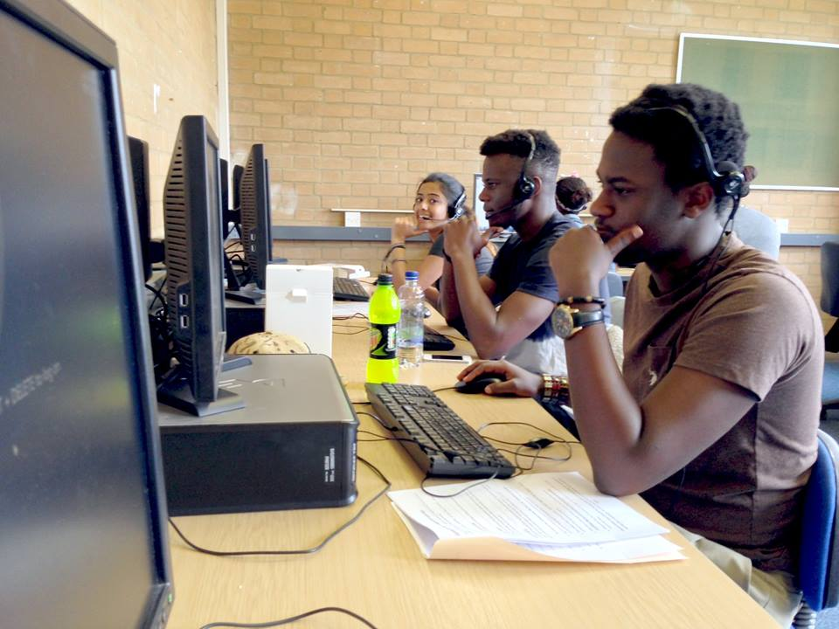
Engagement: pre-arrival
Before arrival
Calling campaigns

Slide 13
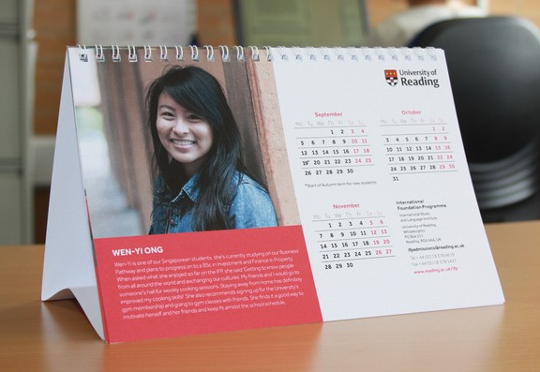
Relationships– student connection
Before arrival
Calling campaigns
Student calendar

Slide 14
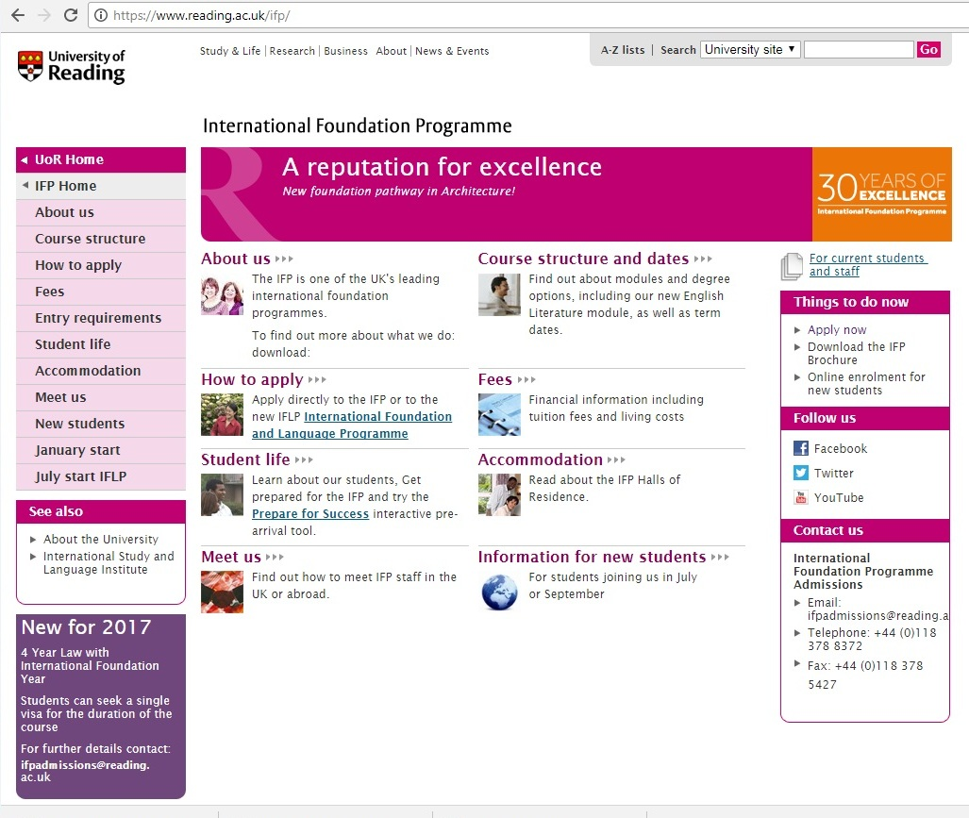
Relationships – Student/staff connection
Before arrival
Calling campaigns
Student calendar
Website

Slide 15
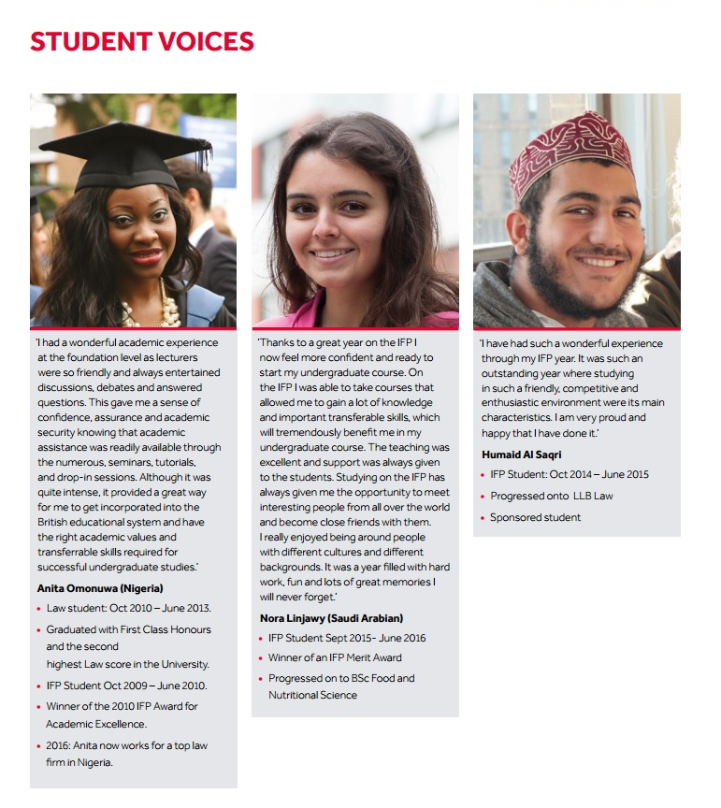
Relationships– student connection
Before arrival
Calling campaigns
Student calendar
Website
Student profiles

Slide 16
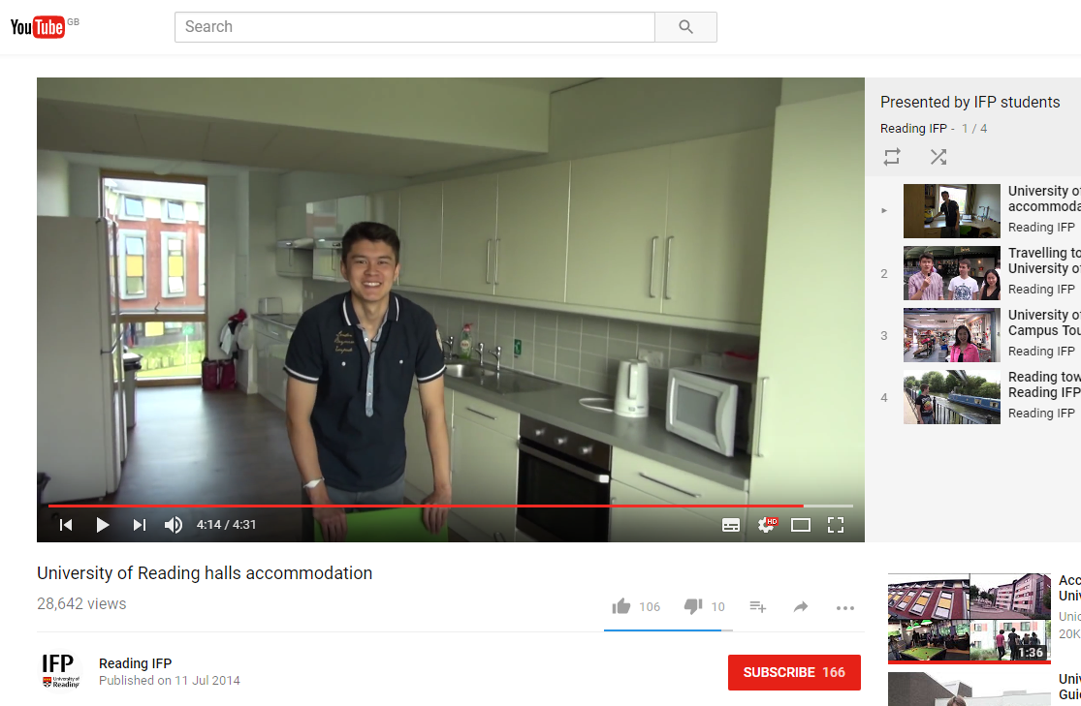
Relationships– student connection
Before arrival
Calling campaigns
Student calendar
Website
Student profiles
Student videos

Slide 17
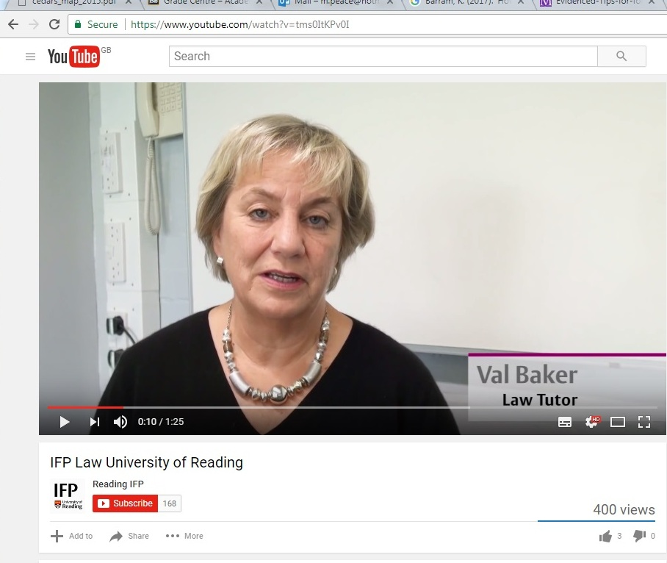
Relationships – Student/staff connection
Before arrival
Calling campaigns
Student calendar
Website
Student profiles
Student videos
Lecturer videos

Slide 18
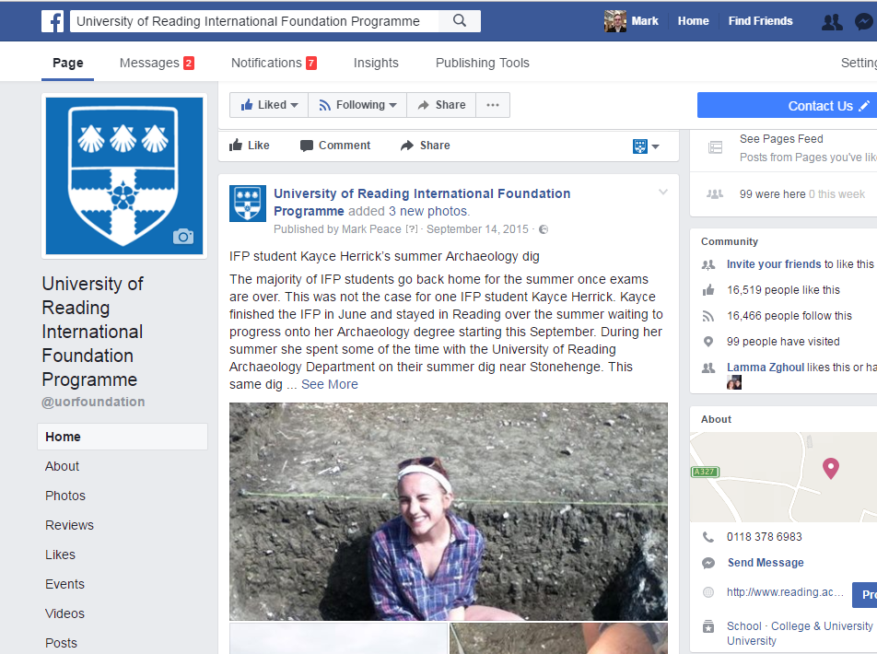
Relationships– student connection
Before arrival
Calling campaigns
Student calendar
Website
Student profiles
Student videos
Lecturer videos
Facebook

Slide 19
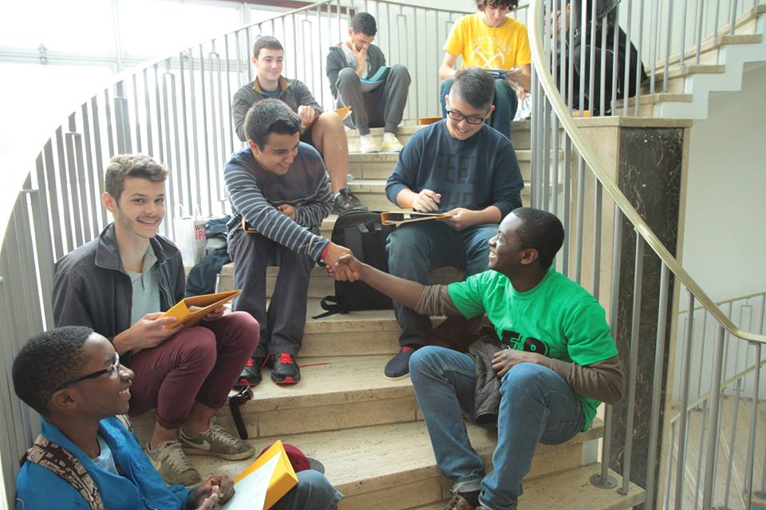
Engagement on arrival
On the programme
Welcome week
Student helpers

Slide 20
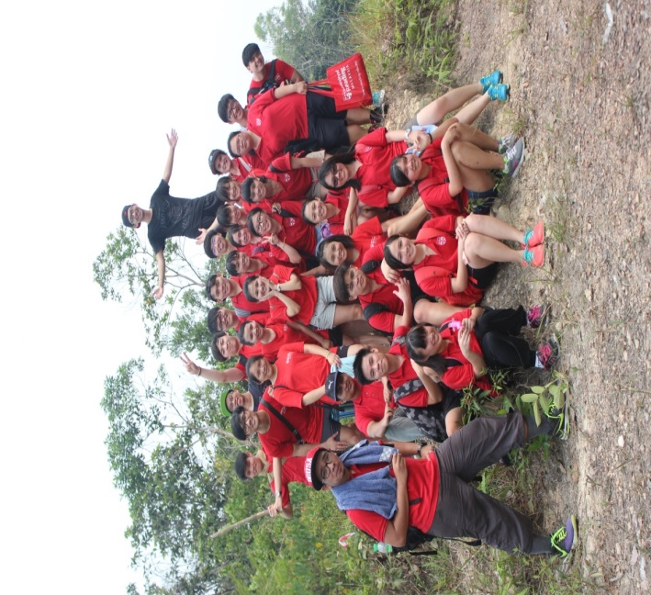
Engagement: on arrival
Welcome week
Student helpers and t-shirts!

Slide 21
Engagement- attendance
We have invested heavily in creating spreadsheets, monitoring and following up on attendance with early interventions and escalation as necessary ( not because of UKVI)
0-10% | 10-15% | 15-20% | 20% plus
Reasons sought | Meeting | Meeting and pre-warning letter | Formal actions

Slide 22
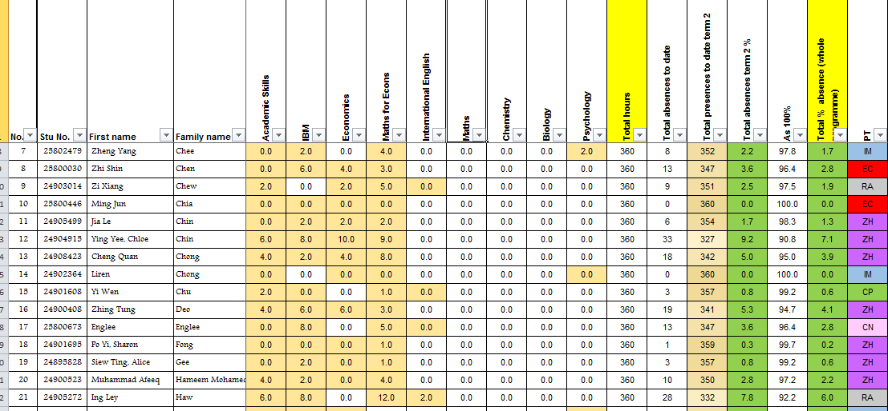
Traffic lights & attendance

Slide 23
Traffic lights & Grades

Slide 24
Engagement: Key questions
Red – What should you stop doing that is not helping you on your goal achievement journey?
Amber – What new actions are to be taken that will help you achieve your goals?
Green – What have you been doing that is working really well for you and should be continued?
Students share these ideas with each other

Slide 25
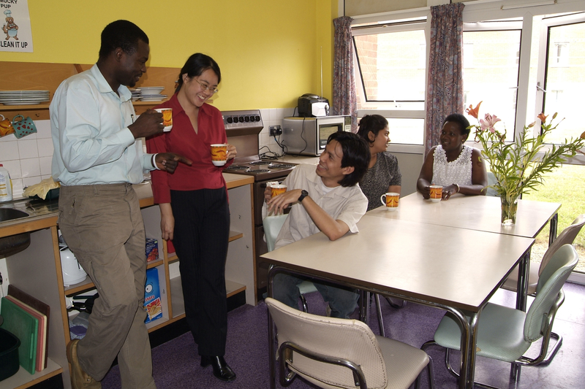
Engagement - Halls
Halls Liaison Tutors
Halls visits
Activities based in Halls
Staff expertise in halls related issues
Halls survival guide
No longer produced as the University now produces a very similar guide

Slide 26
engagement- Halls
Halls Liaison Tutor
Halls visits
Activities based in Halls
Staff expertise in halls related issues
Halls survival guide
No longer produced as the University now produces a very similar guide
Halls survival guide first produced 2010

Slide 27
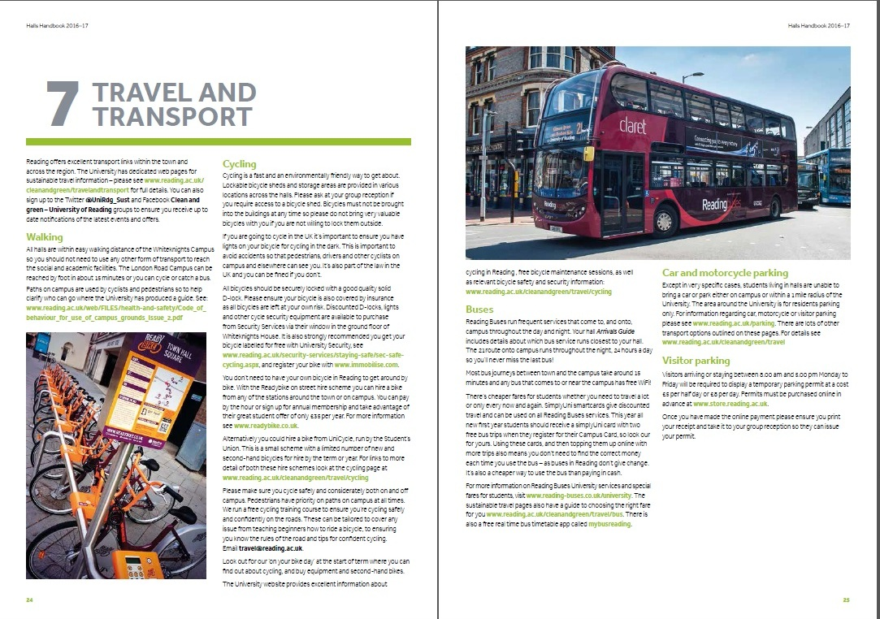
Engagement - Halls
Halls Liaison Tutor
Halls visits
Activities based in Halls
Staff expertise in halls related issues
Halls survival guide
No longer produced as the University now produces a very similar guide
UPP/UoR Halls Handbook 2016-17

Slide 28
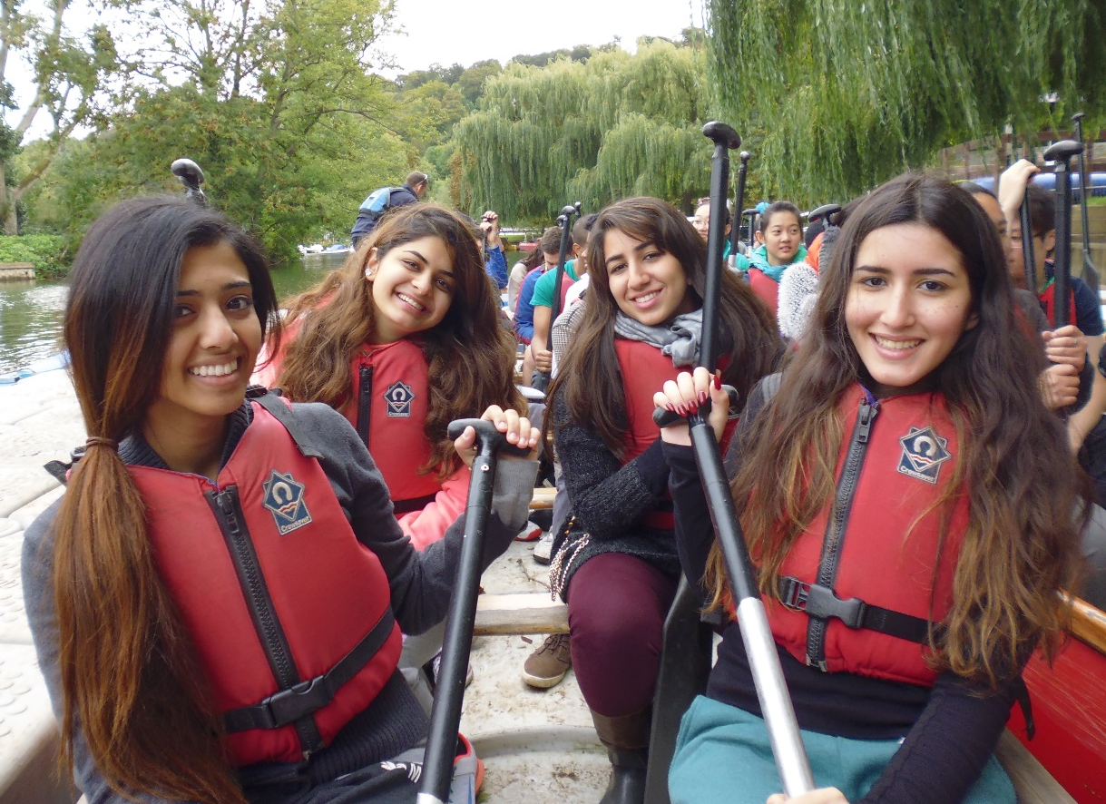
Engagement - away day
On the programme
Away Day
compulsory
challenging
Longridge, Marlow

Slide 29
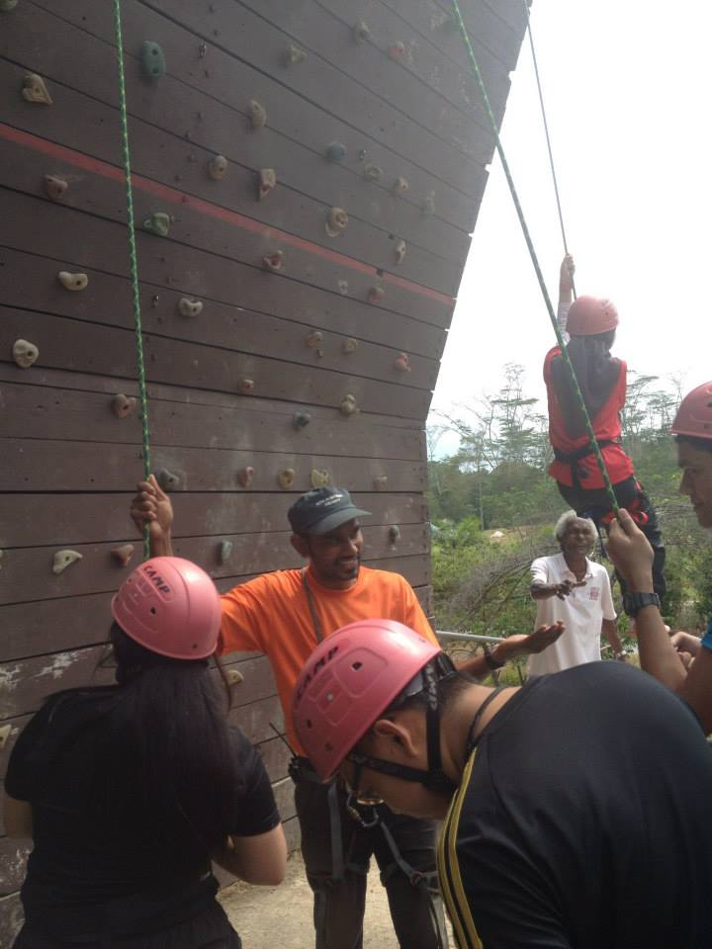
Engagement: away day
On the programme
Away Day
compulsory
challenging
validating
Kota Tinggi Malaysia

Slide 30
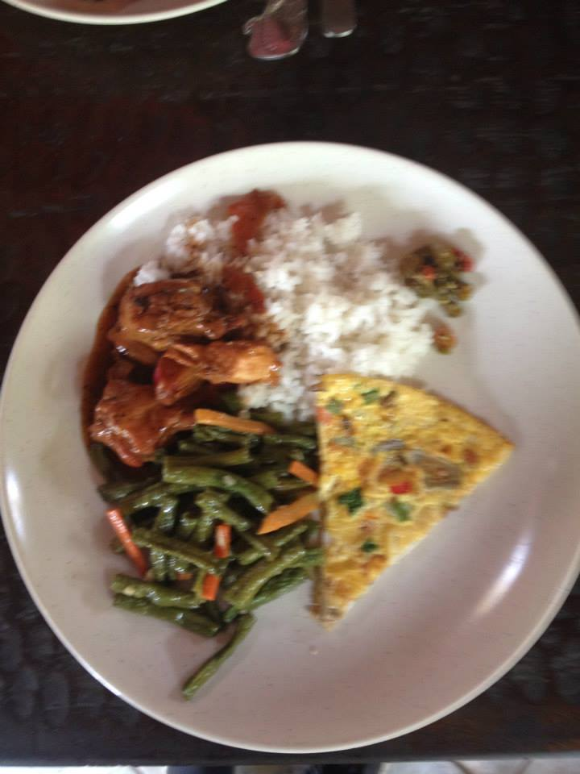
Away day feedback- IT’s all about the food!
“Choose another place with more activities from this previous place. Lunch played a huge role during that day and it was not quite edible so it was quite disappointing. Hopefully next time round, lunch will be much more improved than this time round which will totally make the trip so much more fun and memorable. Tq”
“Provide better food”
“Better lunch. A longer time period would be good”.

Slide 31
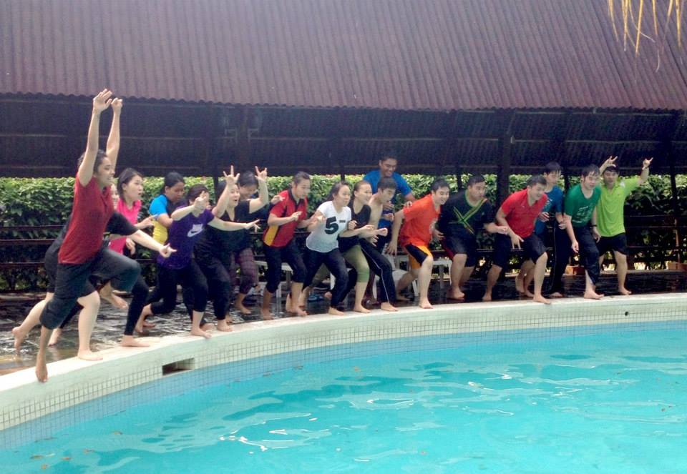
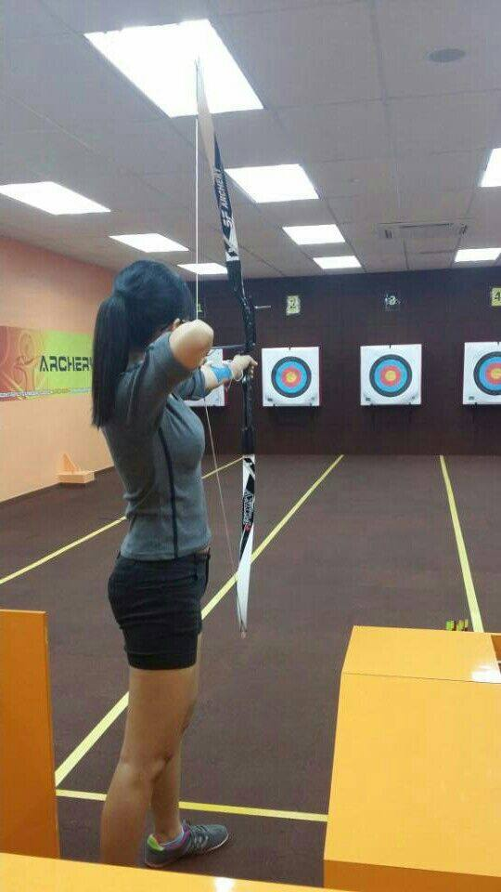
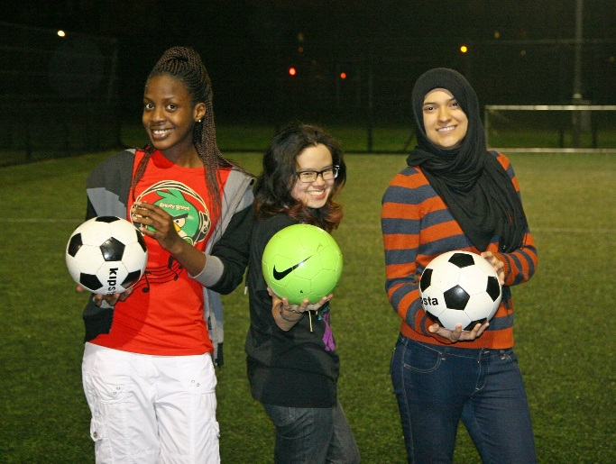
Engagement: social activities
A range of events including sports, activities and trips
Notes:
Note re Chloe versus Mark as social activities organisers

Slide 32
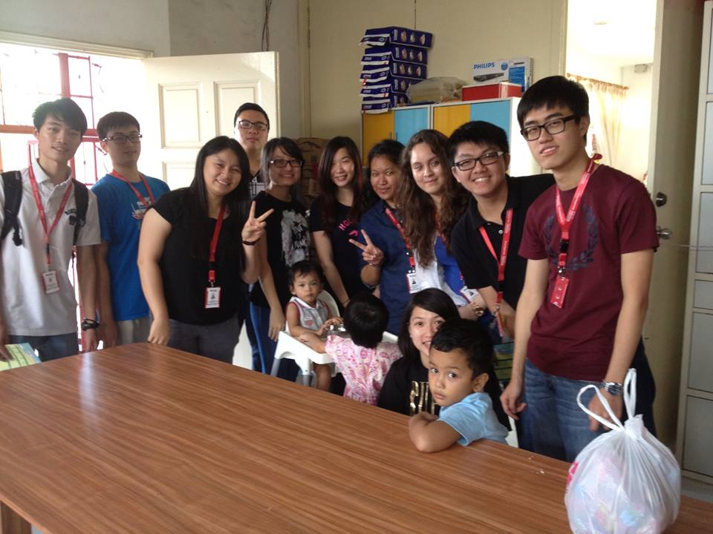
Engagement: social activities & volunteering
A range of events including sports, activities and trips
Outreach to local charities

Slide 33
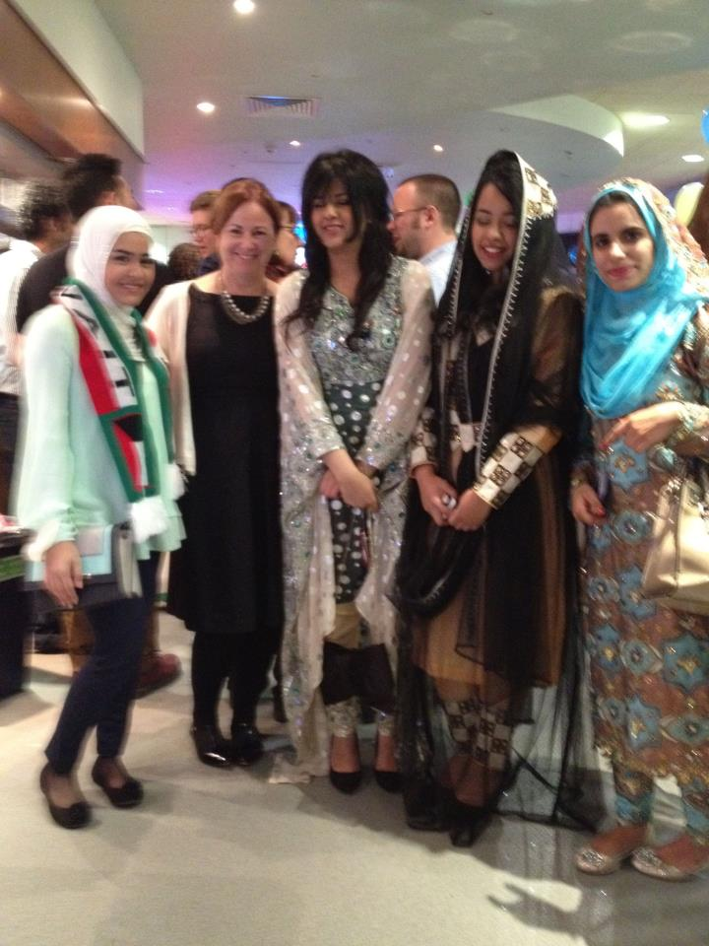
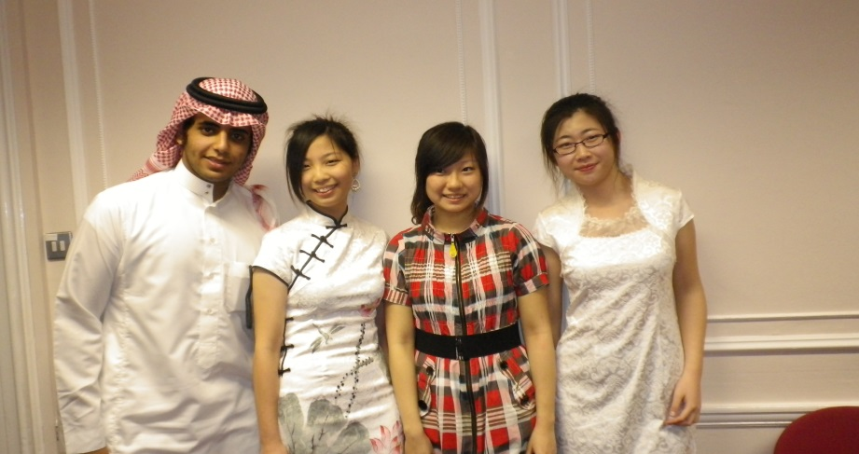
Engagement: social activities and volunteering
A range of events including sports, activities and trips
Volunteering
International Evening

Slide 34
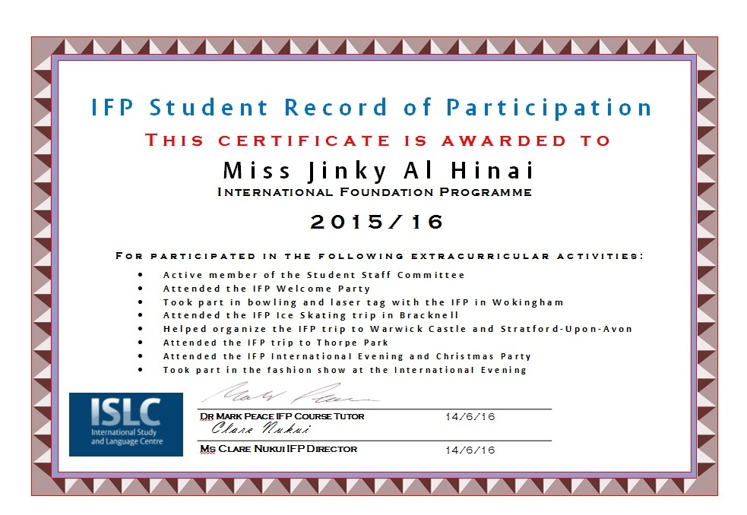
Engagement: social activities and volunteering
A range of events including sports, activities and trips
Volunteering
International Evening
Record of participation
ISLI

Slide 35
Engagement – AREA & UK
International Student Survival guide

Slide 36
Engagement– AREA & UK
International Student Survival guide

Slide 37
Engagement – AREA & UK
International Student Survival guide

Slide 38
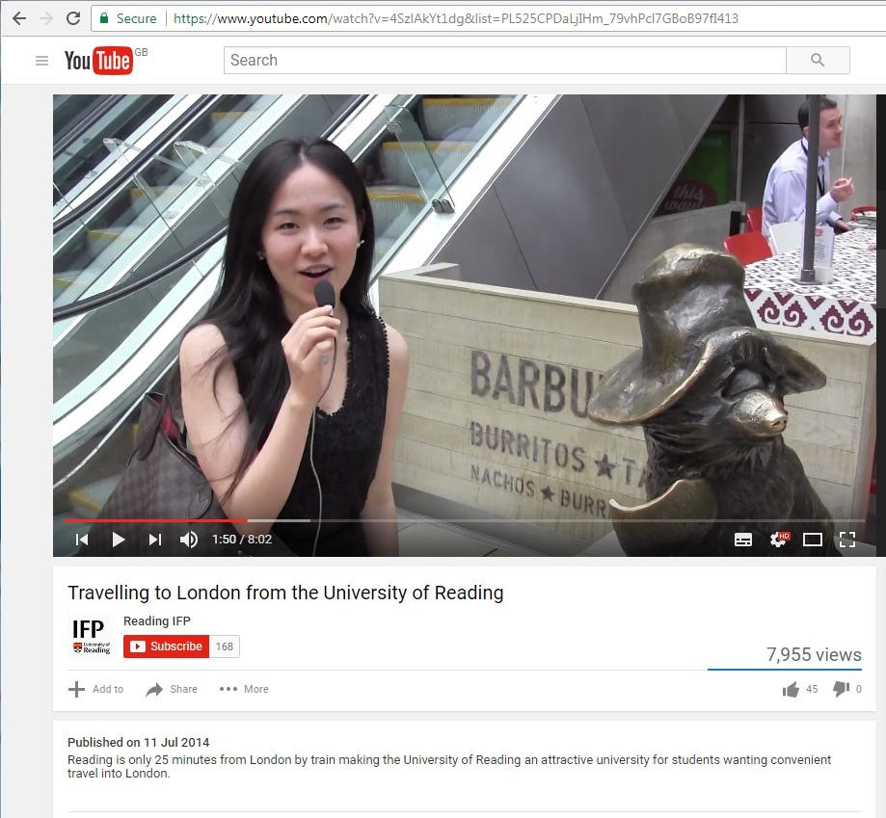
Engagement – AREA & UK
IFP youtube video by students showing how to travel from Reading to London and what to do (nearly 8000 views with 45 likes)

Slide 39
conclusions
In-house, hands-on approach
Investment of time and money in hiring staff, funding events etc.
Foster and reward staff commitment to this approach
Suggestion of theme for next year’s conference:
How to foster independence on a foundation programme!

Slide 40
references
Astin, A. W. (1993). What matters in college? Four critical years revisited. San Francisco: Jossey Bass.
Cox, B. and Orchovec, E. (2007) Faculty-Student Interaction outside the Classroom: A Typology from a Residential College Review of Higher Education; Baltimore 30.4 (Summer 2007): 343-362
Krause, K-L. (2005) Engaged, inert or otherwise occupied? Deconstructing the 21st century undergraduate student. James Cook University Symposium. Sharing Scholarship in Learning and Teaching: Engaging Students. James Cook University, Townsville/Cairns, Queensland, Australia. 21-22 September 2005.
Kuh, G.D. (2005a) Promoting Student Success: What Campus Leaders Can Do. Bloomington, IN: National Survey of Student Engagement.
Trowler, V (2010) Student Engagement Literature Review. York: Higher Education Academy. Available online: https://www.heacademy.ac.uk/studentengagement/Research_and_evidence_base_for_student_engagement
Wilson, R. Wood, L., Gaff, J. (1974) Social-psychological accessibility and faculty-student interactions beyond the classroom Sociology of Education197417492 Google Scholar

