Slide 1
Realising the potential of student engagement
Colin Bryson, Newcastle University
colin.bryson@ncl.ac.uk

Slide 2
To involve and work with students in partnership
To establish an annual conference drawing together leading edge work on SE - and to feed into publication through journals and books. To create a bank of useful resources for us to share.
To disseminate good ideas and practice via our journal and other methods – Student Engagement in Higher Education Journal
Develop and support themes and interests through SIGS
To facilitate communication between us (web, email network etc)
http://www.raise-network.com
(Next conference– Sept 2017, Manchester - registrations open until July 21st)

Slide 3
Realising that student engagement mattered
Early work with colleagues at NTU
Major longitudinal study over 4 years and subsequent studies at Newcastle
And other studies on graduateness, staff perspectives, and action research
Informed by a much wider perspective on the literature e.g. school sector, Dubet, Zepke, Tinto…
Understanding and Developing Student Engagement, Routledge, 2014

Slide 4
Defining student engagement
Student engagement is about what a student brings to Higher Education in terms of goals, aspirations, value and beliefs and how these are shaped and mediated by their experience whilst a student. SE is constructed and reconstructed through the lenses of the perceptions and identities held by students and the meaning and sense a student makes of their experiences and interactions.
As players and shapers of the educational context, educators need to foster educational, purposeful SE to support and enable students to learn in constructive and powerful ways and realise their potential in education and society.

Slide 5
The nature of student engagement
Holistic and socially constructed
Every student is an individual and different (Haggis, 2004)
Engagement is a concept which encompasses the perceptions, expectations and experience of being a student and the construction of being a student in HE (Bryson and Hand, 2007).
Engagement underpins learning and is the glue that binds it together – both located in being and becoming. (Fromm, 1977)
Powerful and deep learning requires strong engagement
Salience of transformative learning
Becoming – self-authorship (Baxter Magolda), self efficacy (Tinto), critical being (Barnett), graduate identity (Holmes)

Slide 6
Key influences on engagement – engaging students (process)
Student expectations and perceptions – match to the ‘personal project’ and interest in subject
Sufficient challenge and appropriate workload
Degrees of choice, autonomy, risk, and opportunities for growth and enjoyment
Trust relationships
Communication and discourse
A sense of belonging and community
Supportive social networks
Opportunities for, and participation in activities and roles – to enable ownership, self-assurance and self-efficacy

Slide 7
The flipside of SE
Alienation, inertia/anomie and disengagement
Performativity and disciplinary power – alienating impact of assessment (Mann, 2001)
Battle between cultures and values (Krause, 2005)
Inclusiveness and recognising what students bring (Hockings 2010; 2011)
Critiques
Compliance (Zyngier, 2008)
Serves a neo-liberal agenda (Zepke, 2014)
The appropriation of SE – the transactional…’doing’ student engagement
But is this fair? What alternatives do MacFarlane (2017), etc suggest?

Slide 8
Transforming to? Becoming what? - Engaging students (outcome)
Seeing the world differently
Knowledge -Intellectually developed (ways of knowing – self authorship)
A critical being – learning, reflection and evaluation
A social being and (global) citizen – morality and ethics
Encouraging the transition to this goal in HE

Slide 9
So what works? Kuh (2008)
First year seminars (e.g. SI and PAL)
Learning communities – cross module
Service learning – experiential
Common intellectual experiences
Writing intensive courses
Collaborative projects
Undergraduate research
Diversity learning
Internships
Capstone courses

Slide 10
Engaging students in the curriculum
Active learning
Assessment for learning/peer assessment
Choice within the module -Integrated projects
Collaborative learning and building trust relationships
Authenticity
Taking risks – opportunities to reflect on mistakes

Slide 11
Engaging students outside the curriculum
Engaging experiences which enable student to build confidence, develop and learn
101 opportunities to be as attractive and inclusive as possible
Showing that we as staff value that….recognising

Slide 12
A holistic SE strategy
Combined Honours at Newcastle
Diverse and complex
Individuals doing unique degree
Missing sense of identity/ belonging
But few resources and so difficult to influence the existing curriculum

Slide 13
Involving the students
Student representation:
Student-Staff Committee
Empowerment- Student led, working groups
Active agenda – providing solutions
The engine room of change
Staff supported
Success stories
Little things and bigger things
Change the name of the degree
Defending the degree
New curriculum and module co-design

Slide 14
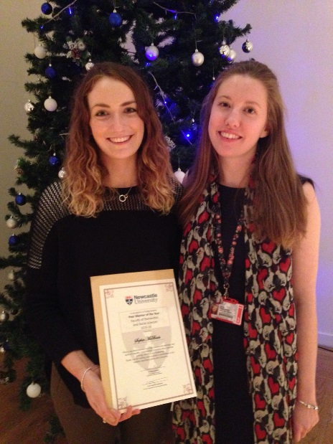
Enhancing engagement in CH
Peer leadership - Schemes student led but strong staff support
Mentors, Welfare ambassadors
PASS scheme
CHallenge
Graduate mentoring
Building community:
Facilities and spaces
Social agenda – the CHS
Joining it all up – events and activities are shared and promoted by all parties
The Graduate Development modules – rewarding good practice and enabling projects

Slide 15
Reflections on the CH strategy
Involves around 80 students in roles per year –over 15%
Wider opportunities for involvement – co-researching and internships, presenting at conferences, new ideas
PICNIC – short term student exchanges
Outcomes very strong – massive improvement in quality of student experience – students and schemes win awards; strong evidence (cohort surveys etc) –satisfaction in the NSS (average 99% over last five years); recruitment growth
But, how do we involve more students more directly? So they all gain the benefits…..

Slide 16
Introducing a partnership model
Grew out of our holistic student engagement strategy (Furlonger et al, 2014)
Resonates with student engagement and seeking transformative learning
Roots in critical and radical pedagogy
Counter to neo-liberalism and the model of students as consumer (A Manifesto for Partnership, NUS, 2012; Neary; McCullough)

Slide 17
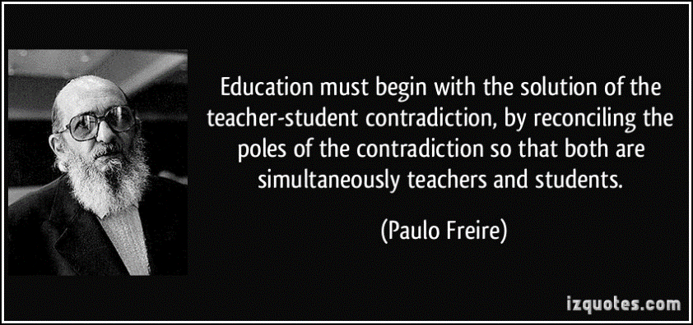
The virtues of partnership
Epitomises positive values in society
Ethical
Democratic
Enables Higher Education to a make a more profound contribution to society
Education should be exemplary but also dynamic, be progressive and ‘public’

Slide 18
Cook-Sather, Bovill and Felten (2014:6)
We define student-faculty partnership as a collaborative, reciprocal process through which all participants have the opportunity to contribute equally, though not necessarily in the same ways, to curriculum or pedagogical conceptualisation, decision making, implementation, investigation or analysis

Slide 19
The ethos of partnership
Principles of respect, repricocity and responsibility (Cook Sather et al, 2014)
The participant must perceive (Bryson, Furlonger and Rinaldo, 2015):
That their participation and contribution is valued and valuable;
A sense of co-ownership, inclusion, and equalising of power relations between students and staff;
A sense of democracy, with an emphasis on participative democracy;
Membership of a community related to learning and educational context
And this needs to be realised in practice – a virtuous circle

Slide 20
A typology of SaP roles e.g. (Cook- Sather et al, Healey et al, 2014)
Consultant to staff
Co-designing
Co-researching
Change-agent (Dunne and Zandstra, 2011)
Peer leading
Focussed on SoTL, curriculum, QA/QE, subject based
http://www.mickhealey.co.uk/resources look under ‘change agents’

Slide 21
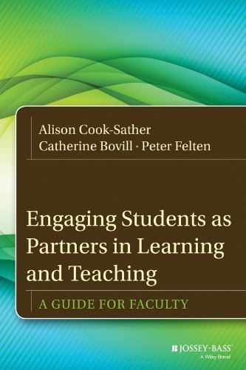
Benefits of partnership
(Cook-Sather, Bovill and Felten, 2014)
Enhances (for both students AND staff)
Engagement (motivation, in the learning process itself, sense of responsibility, recognition)
Metacognitive awareness and identity
Actual teaching and classroom experiences

Slide 22
Some advice – context is important
Start small, in the spaces that you can find
Start early in the student journey
Be patient
Form alliances
Don’t coerce or rush in – induct and nurture (staff too!)
Be conscious of your behaviour and how it is perceived
BE ETHICAL!
Seek advice and listen to it
Learn from mistakes

Slide 23
Conclusions
Partnership works and enables strong SE and transformative learning in a mass HE system and offers much – has rejuvenated me!
Working and thinking outside comfort zones, but not too far outside…
A mixed model legitimated by student representation mechanisms

