Slide 1
A lexically focused IFP? Working with staff, students and the curriculum to join the dots
Steven Herron
Head of Pathway College,
Northumbria University

Slide 2
Overview
Background
to this presentation
Categorising lexis and how much is required
Challenges of lexis on our IFP
Bringing it all together
Some observations/assumptions
Some ideas
Categorising lexis with some thoughts
Some examples of joining the dots

Slide 3
Background
Inform 2013 – INTO Diploma, presentation about pathway staff working together (EAP + subject)
Follow up presentation with Reichard and Stephenson (InForm, 2014) examining joint assessment in more detail
Northumbria pathway (new partnership with QAHE) established 2014 with four routes

Slide 4
The challenge of provision diversity
University or university partner
Targeted or generic programme
Grouping of different routes altogether or separated
Grouping of level abilities or separated
Level of target programme (English and subject) for progression

Slide 5
Categories of lexis
According to Nation (2001):
General (2,000 frequently used items)
Academic (the AWL)
Technical (high/moderate frequency level within a limited range of texts)
Low Frequency

Slide 6
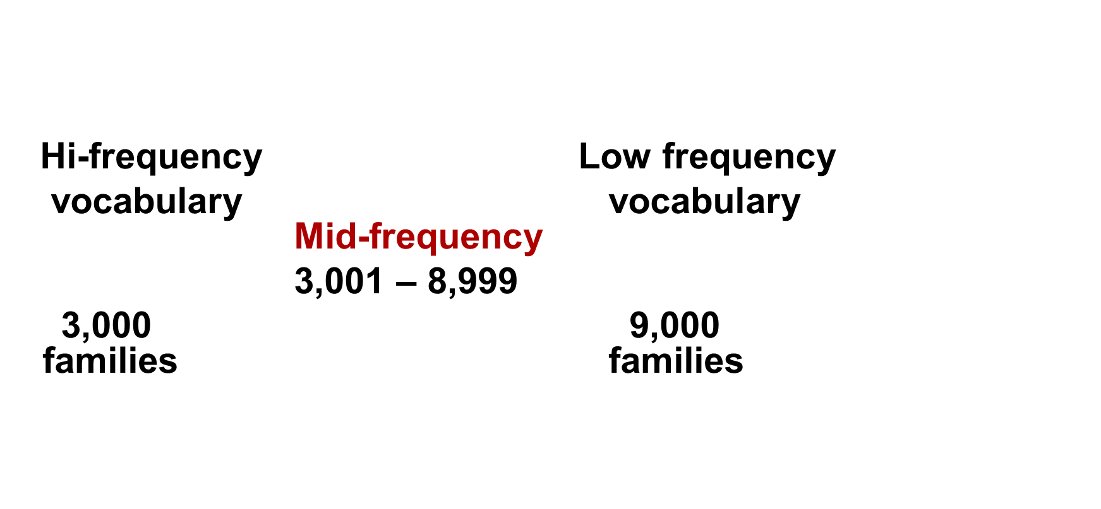
How many words are needed?
According to Schmitt and Schmitt (2014), the ranges are as follows:

Slide 7
How many words are needed?
range | examples
3,001–4,000 | academic, consist, exploit, rapid, vocabulary
4,001–5,000 | agricultural, contemporary, dense, insight, particle
5,001–6,000 | cumulative, default, penguin, rigorous, schoolchildren
6,001–7,000 | axis, comprehension, peripheral, sinister, taper
7,001–8,000 | authentic, conversely, latitude, mediation, undergraduate
8,001–9,000 | anthropology, fruitful, hypothesis, semester, virulent

Slide 8
The problem
Schmitt and Schmitt (2014):
The mid-frequency words (MF) are the most important
MF is not taught particularly well or substantially enough on programmes of learning
MF is also rarely covered well in textbooks

Slide 9
The lexical journey
If A is the beginning / first contact…
…and B is the ability to use the word fully (all word forms, collocations, etc.)
Where is each student now on that journey and how will they continue to move forward?

Slide 10
“It is important to acknowledge the incremental nature of vocabulary learning, and to understand that an effective vocabulary learning program needs to be principled, long-term, and one which recognizes the richness and scope of lexical knowledge.”
(Schmitt, 2008, pp.354)

Slide 11
Our IFP provision

Slide 12
How lexical terms are used
Subject | Interpretation / use: Reflection
English | Reflection of what you have learnt from a class (etc.)
ADM | Art crit of work (self and others) / examining perspectives
Business | Looking at theory into practical real-world examples
Engineering | How successful the testing or formula / calculations were
Maths (app) | What do the stats (or other item) testing mean within the context / situation they were given

Slide 13
How lexical terms are used
Subject | Interpretation / use: Critical
English | Opposite of descriptive writing / oral response with evidence-based response to create an argument
ADM | A systematic composition of negative and positive traits of a piece of work (perhaps then compared to others)
Business | Make a case for one stance based on a comparison of approaches, theories, etc.
Engineering | Describe why a process or system would not work (completely) or be less/more effective than another
Maths (app) | Evaluate what the stats mean and what they might suggest in a real world context

Slide 14
Meanings
We also use different lexical terms for the same / similar meaning, e.g. :
Brackets, parentheses
Addition, plus
Angle, perspective
Laws, rules, policies

Slide 15
Bringing this all together
Dot to dot

Slide 16
Some assumptions / observations
Students see lexis by module / subject
Students do not provide the same attention to learning all they can about a word outside the class
Recording lexis is problematic in this digital age – record by book, cards, e-database, app? Collation?
Increasing lexical range can be done much more outside rather than inside the class
Increasing lexical accuracy can be done much more in learning activities (in class or set work)

Slide 17
How are we going to join the dots?
Moving assessment to align and then offer further practise in the following semester (e.g. report writing)
Ensure knowledge of what is being covered in each module / subject set
English LOs in subject / Subject LOs in English?
Incorporating lexis within tasks, listening/reading texts, a wide range of situations

Slide 18
Pedagogy (CiLL, lexical-approach?, etc.)
Corpus (or many?)
Classroom tasks
Study books
Self directed work
Social activities
Engagement with academic and local community
General
Day-to-day situations
Academic
EAP / Subject
Academic discourse / policies, etc.
Technical
Subject specific
Low Frequency
Connecting language from academic and day-to-day contexts

Slide 19
Examples of joining the dots
Linking the content and English together in modules at top-down level (curriculum)
Building links within the university provision and fostering student engagement with the wider community (events, etc.)
Exchanging word lists, creating a corpus, helping students to record and recall words (cognitive dev.)

Slide 20
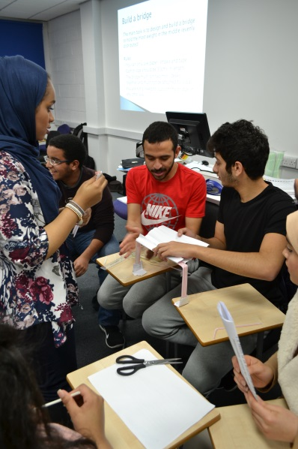
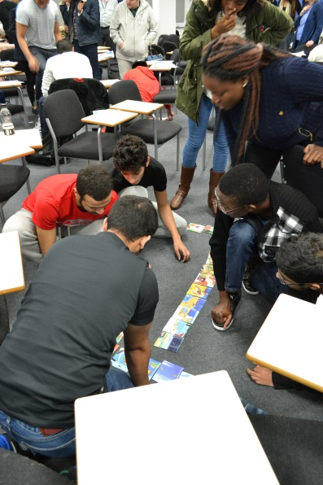
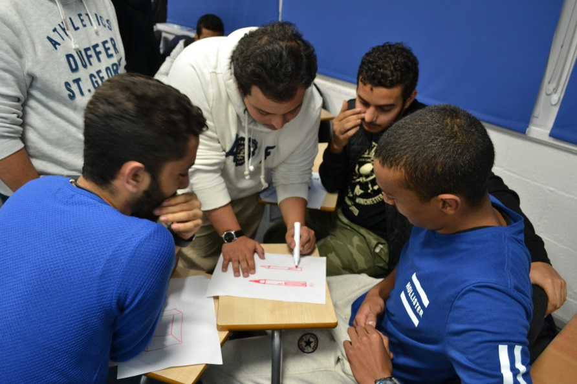
Examples of joining the dots
A critical thinking team building activity afternoon with students

Slide 21
Final thought
“The variety of factors which affect vocabulary learning means that there will never be one ‘best’ teaching methodology, but the meta-principle of maximizing sustained engagement with the lexical items which need to be learned appears to underlie all effective vocabulary learning.”
(Schmitt, 2008, pp.354)

Slide 22
References
Nation, I.S.P. (2001) Learning Vocabulary in Another Language. Cambridge: CUP
Schmitt, N. (2008). Instructed second language vocabulary. Language Teaching Research 12,3 pp. 329–363. DOI: 10.1177/1362168808089921
Schmitt, N. & Schmitt, D. (2014). A reassessment of frequency and vocabulary size in L2 vocabulary teaching. Language Teaching, 47, pp. 484-503. DOI:10.1017/S0261444812000018

Slide 23
Thank you
Thank you for listening
Do you have:
any questions?
any comments?
steven.herron@northumbria.ac.uk

