Slide 1
Chemical linguistic demand in multiple dimensions and implications for developing understanding in non-traditional students
Simon Rees
Durham University Foundation Centre
July 2016

Slide 2
Overview
Durham context
Why is corpus-based teaching particularly helpful?
How have we designed our corpus?
Chemistry project
Sport project
What are the next steps for the project?

Slide 3

Widening participation and access to Higher Education.
Individuals who would traditionally not have considered studying at University and lack the required formal qualifications.
Over 200 students based at two campuses progressing on to all Durham undergraduate departments.
Around 2/3 local mature students and 1/3 international students.

Slide 4
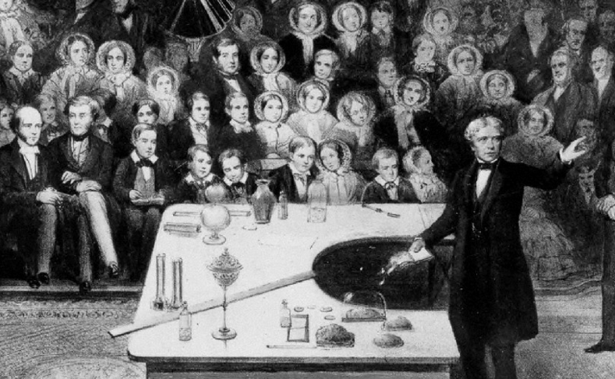
“But how does the flame get hold of the fuel? There is a beautiful point about that – capillary attraction, ‘Capillary attraction!’ you say – ‘the attraction of hairs’. Well never mind the name; it was given in old times, before we had a good understanding of what the real power was.” (Faraday, 1861, p. 12)

Slide 5
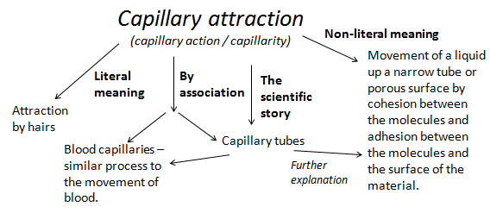

Slide 6
1. Exploring the scientific story.
“But how does the flame get hold of the fuel? There is a beautiful point about that – capillary attraction, ‘Capillary attraction!’ you say – ‘the attraction of hairs’. I say ‘no – certainly not!’ This name was given by the eminent scientist Robert Boyle two hundred years ago when he observed water rising against the force gravity within glass capillary tubes as fine as a hair on your head.”
2. Removing unnecessary terms.
“But how does the flame get hold of the fuel? There is a beautiful point about that – the candle wax molecules are attracted to each other and to the wick such that they are able rise inexorably against the force of gravity.”

Slide 7
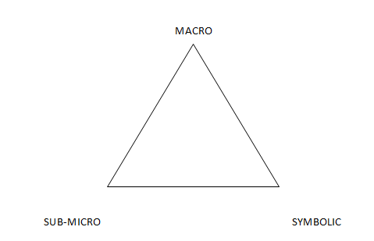
Johnstone’s triplet (Johnstone 1991)

Slide 8
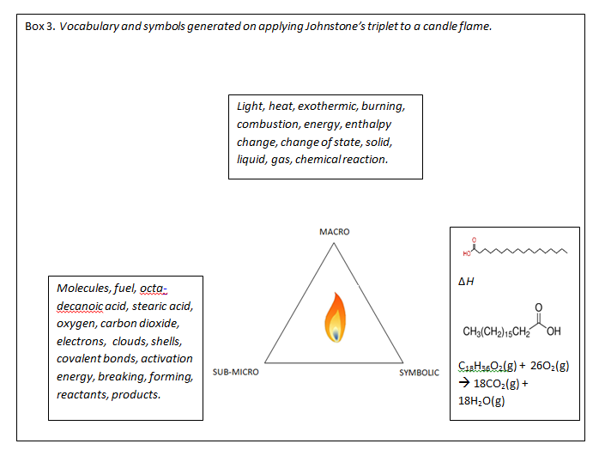

Slide 9
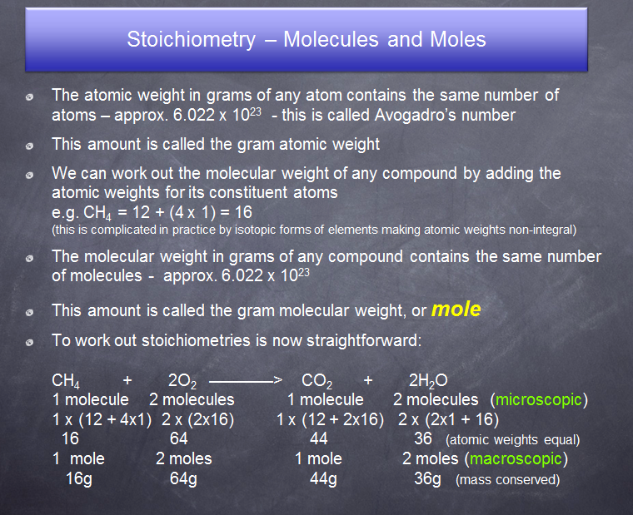
mixture of macroscopic quantities (atomic weight in grams i.e. molar mass) and sub-microscopic entities (atom).
Unclear which amount is being referred to and a confusing macroscopic term that would be unfamiliar to Foundation and A-Level students.
Mixture of sub-microscopic (molecular weight) concepts and macroscopic entities (compound).
Implies gram molecular weight and mole are synonymous.
Showing comparison between sub-microscopic and macroscopic.
Vague use of “atomic weights equal”.

Slide 10
Scientfic words |  | Semi-technical words |  | Non-technical but widely used in science
Unique to science | Everyday meanings too | One meaning | Dual meaning | One meaning | Dual meaning
cathode | substance | emit | light | linear | standard
electrolysis | field | repel | positive | source | contrast
anode | conduct | displace | negative | external | effect
electron | mass | deflect | valid | limit | volume
neutron | potential | particle | neutral | sufficient | crude
ion | energy | flow | contract | adjacent | complex
Wellington and Osborne, 2001

Slide 11
Research Questions
- In what ways does chemical language comprehension ability impact on potential undergraduates’ outcomes and success?
- In what ways does potential undergraduates’ understanding of chemical language develop during a one year, full-time foundation programme?

Slide 12
Research methods
Intervention study exploring use of linguistic strategies e.g. corpus linguistics.
Development of a Chemical Language Diagnostic Test.
Semi-structured interviews with scientific scenarios

Slide 13
Chemical Language Diagnostic Test
Seven sections:
Affixes
Fundamentals
Word families – kinetic theory
Word families – acids and bases
Symbolic language
Non-technical words
Word choice - Technical words

Slide 14
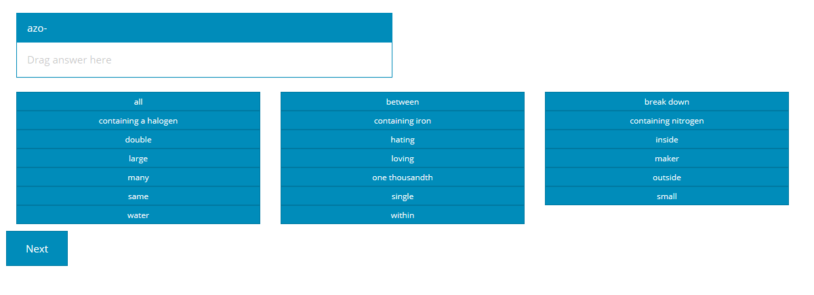
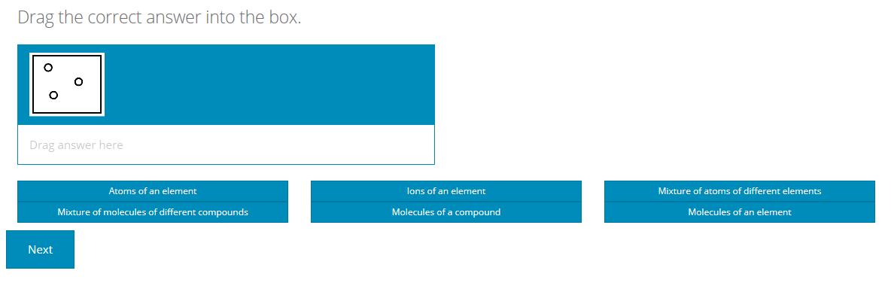

Slide 15
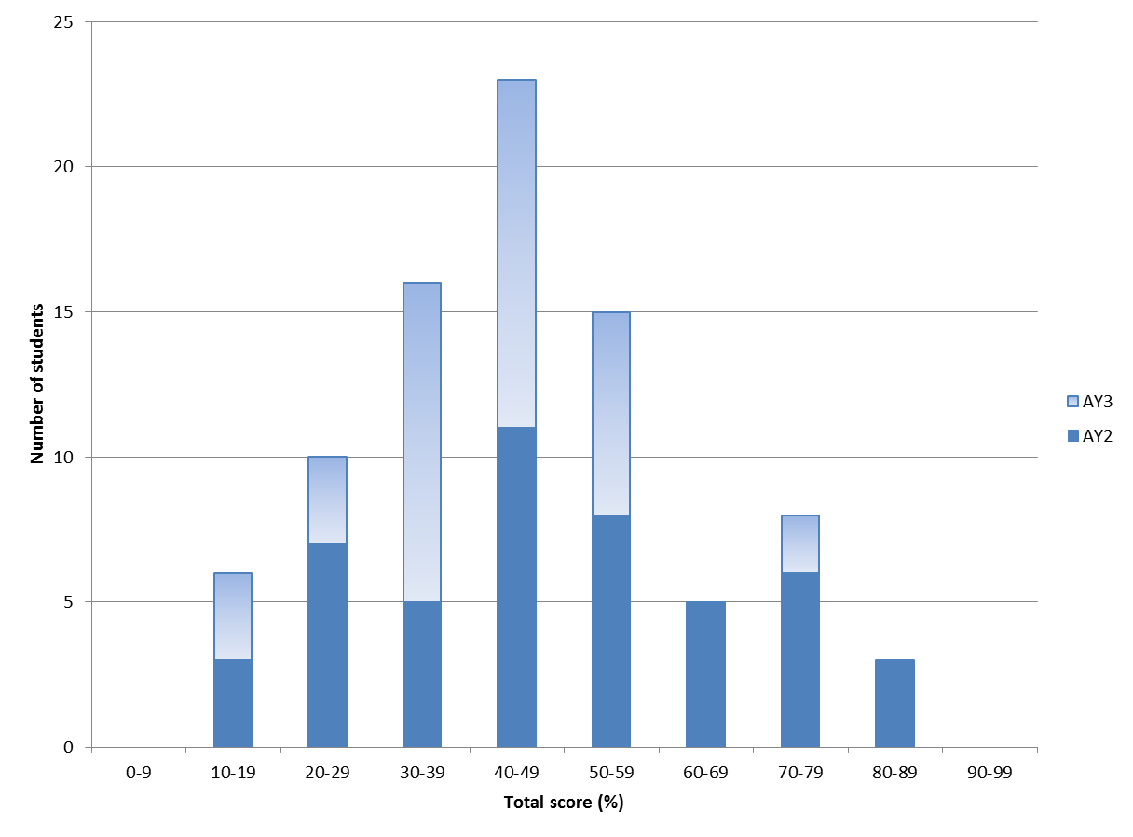
n = 86
Initial CLDT results

Slide 16
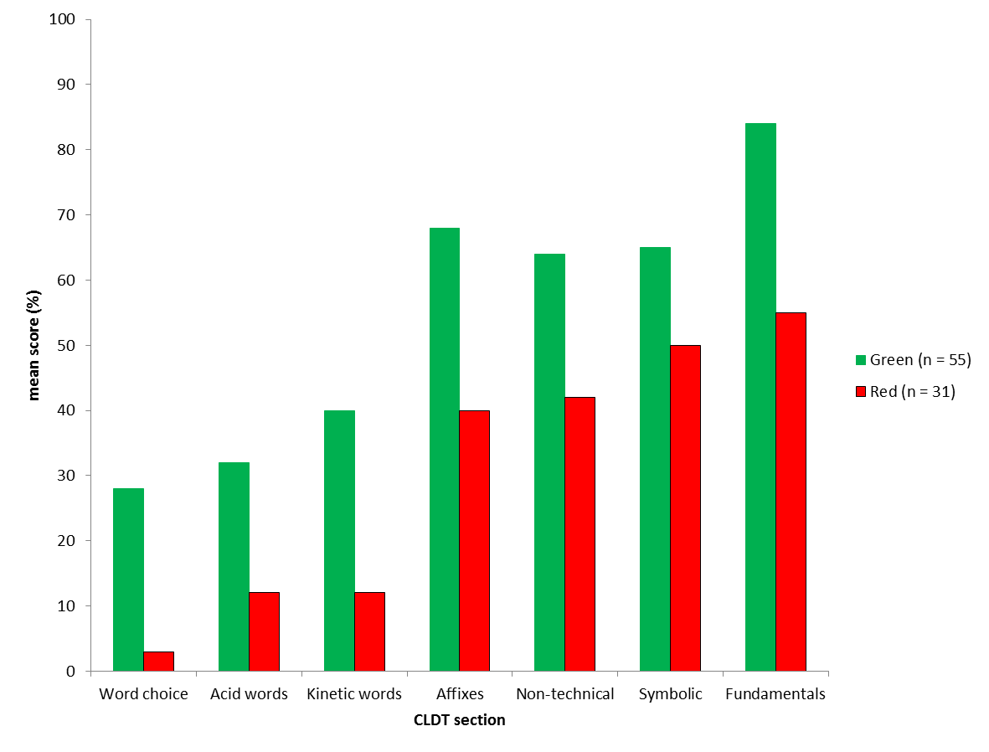
Initial CLDT results by section

Slide 17
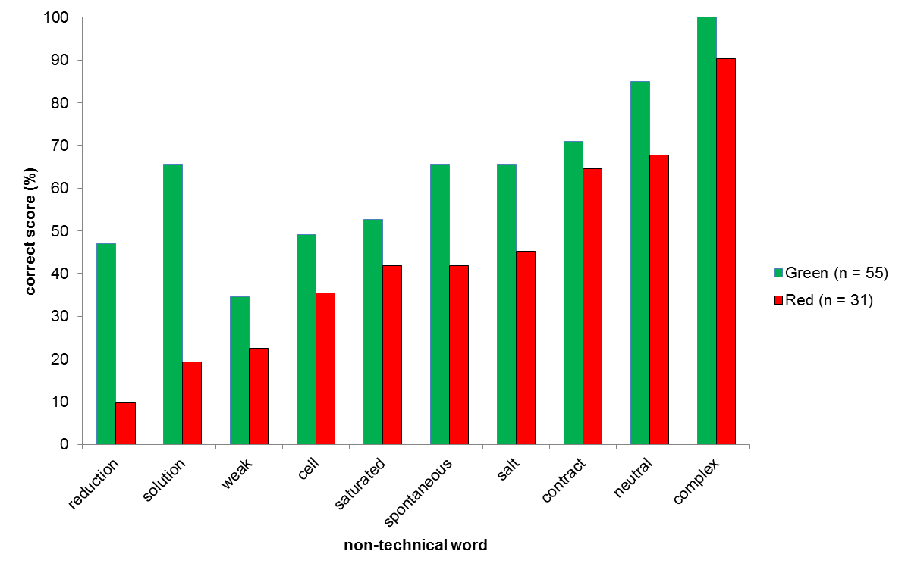
Initial CLDT non-technical section results

Slide 18
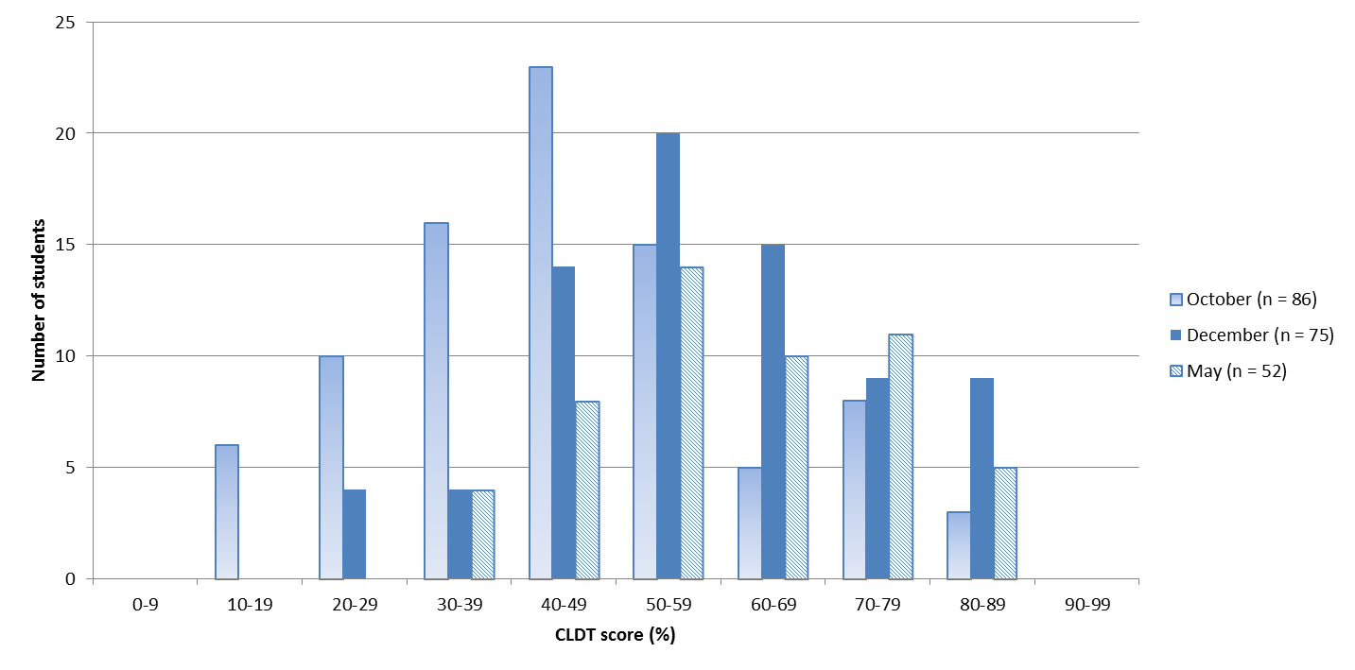
CLDT results across Year 0

Slide 19
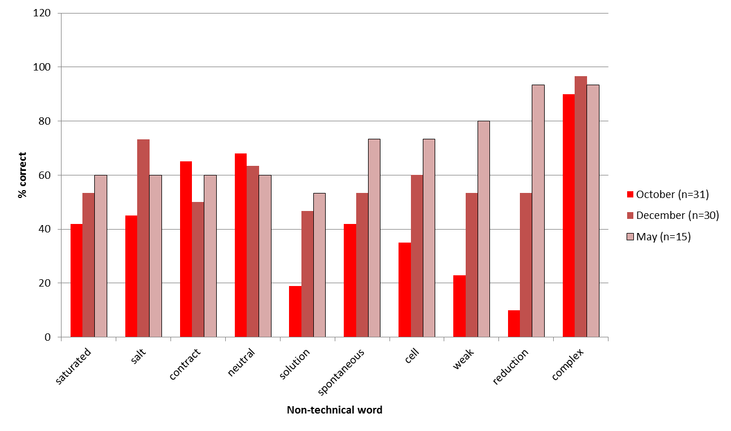
Red sub-group CLDT non-technical section results across Year 0

Slide 20
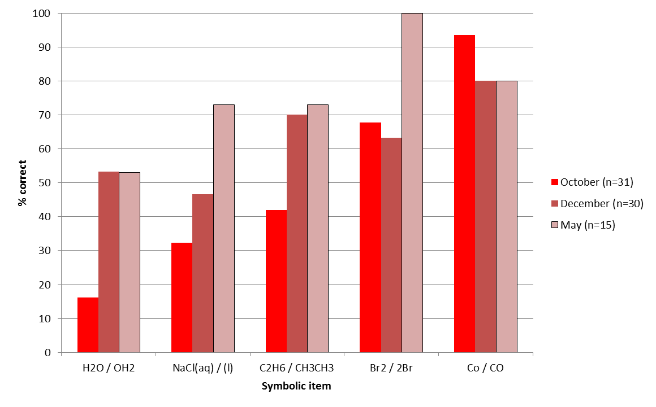
Red sub-group CLDT symbolic section results across Year 0.

Slide 21
r = 0.55
Scatter plot showing January exam scores against October CLDT scores.

Slide 22
r = 0.53
Scatter plot showing May exam scores against October CLDT scores.

Slide 23
Outcome | Home | International
Passed | 10 (53%) | 5 (42%)
Failed | 6 (32%) | 6 (50%)
Withdrew | 3 (15%) | 1 (8%)
Total | 19 | 12
Year 0 final outcomes for home and international students in the Red sub-group.

Slide 24
Linguistic demand in multiple dimensions
Non-literal meaning
Multiple contexts
Sub-microscopic
Similarity

Slide 25
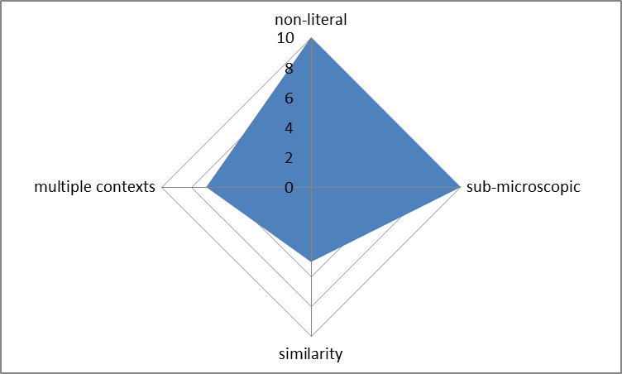
Linguistic demand for “Reduction”

Slide 26
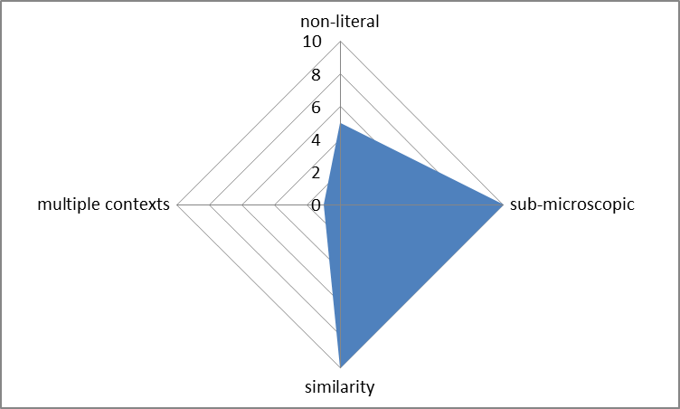
Linguistic demand for “Electronegative”

Slide 27
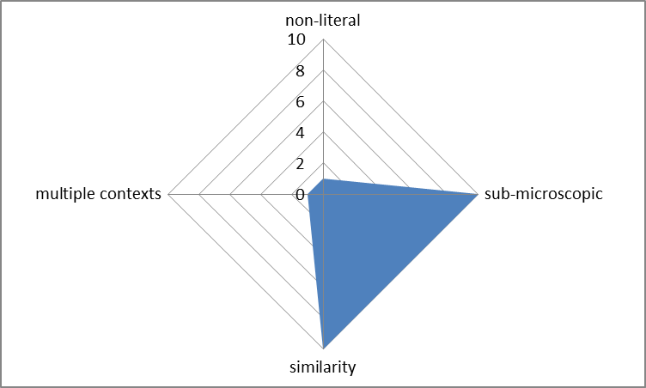
Linguistic demand for “Electrophile”

Slide 28
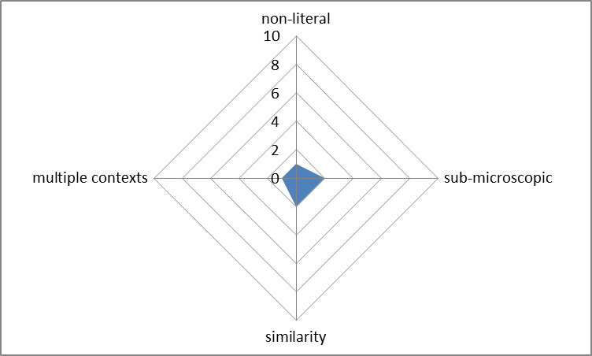
Linguistic demand for “Gas”

Slide 29
Conclusions
- Chemical language understanding as measured by the CLDT correlates with academic success in Year 0 chemistry.
- Students that scored poorly in the initial CLDT were more likely to fail Year 0.
- Some students that scored poorly in the initial CLDT were able to overcome this deficit whilst others were not.
- Considering linguistic demand in multiple dimensions can help explain the difficulties that chemical language presents.

