Slide 1
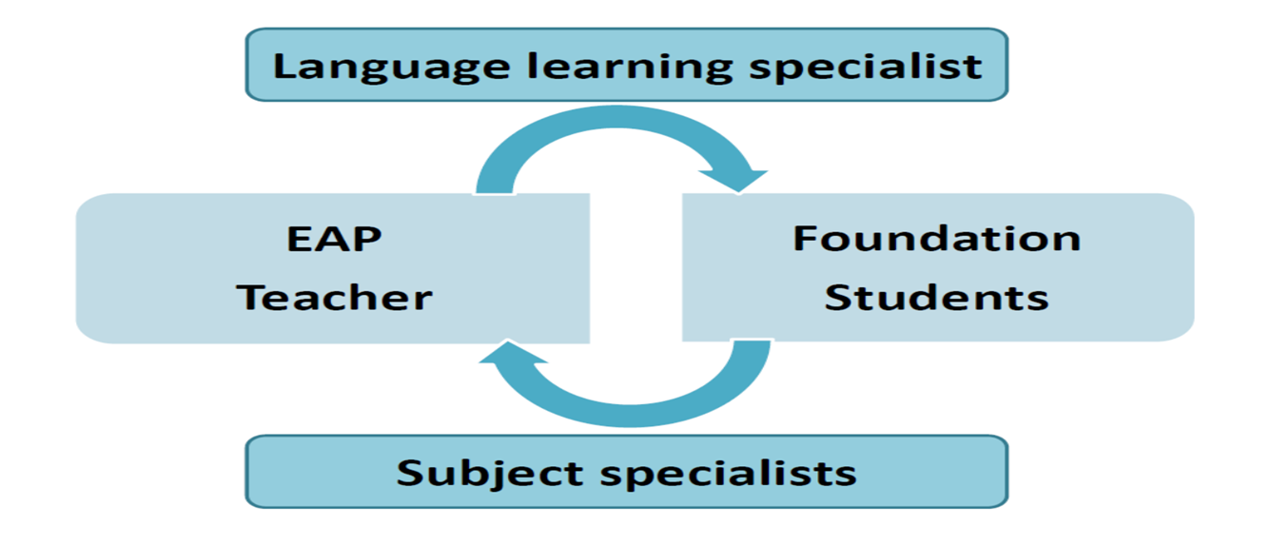
Specialist Knowledge: an Interactive Approach Rina Fokel de Vries & Veronica Raffin EAP Tutors BIA, University of Birmingham
Background
Although most foundation programmes offer pathway-related variety in terms of topic, lexical discipline-specificity is often limited and usually the AWL is taught. Teaching a generic lexis upon which students later build subject-related items may not reflect real-life learning (Hyland, 2002), nor meet actual needs. As Hyland & Tse (2007: 235) state, ‘Teachers should help students develop a … discipline-based lexical repertoire’. That the common core hypothesis (Clapham, 2001) is disputable also shows in the frequent specific meaning and use of words in different academic disciplines (see Fig. 1).
As a language learning specialist, the EAP tutor can guide students towards specialist dictionaries and create awareness of discipline-specific variety in word frequency, word use and meaning. An alternative strategy is letting students use texts from their own subject pathway in the EAP classroom (for an example, see Swales & Feak, 2004), which can be both more motivating and beneficial to them (Jordan, 2012).
Goals
Facilitate discipline-specific learning and promote learner autonomy.
Build a corpus of specialist terminology, specialist meanings, and lexical combinations.
Ease the transition from foundation course to target programme.
Teacher informs students
• Shows the way to discipline-specific corpora and dictionaries. Explains how to create a vocabulary notebook for subject module.
• Provides tools to unpack discipline-specific lexis: morphology and pronunciation of Greek and Latin words (Nagy & Townsend, 2012).
Students adjust learning
• Use discipline-specific corpora and dictionaries. Keep a vocabulary notebook for subject module.
• Use knowledge of morphology and pronunciation to unpack discipline-specific lexis, enhancing word knowledge and word recognition.
Teacher adjusts curriculum
• Differentiates pathways (topics and assessment).
• Varies content of language learning (e.g. humanities: AWL suitable; sciences: nominalisation important).
• Uses students’ texts as input for teaching.
Students inform the teacher
• Bring texts from subject modules to create their own corpus.
• Analyse texts brought in terms of vocabulary or aspects of academic writing.
Fig. 1 – Differences in: (a) amount and nature of specialist terminology; and (b) word meaning in various academic disciplines (Unilearning, 2000)
Sample Texts from Sciences | Sample Texts from Humanities
(a) The number of Dillwynia juniperina seeds with elaiosomes removed per depot was significantly different from the number of seeds without elaiosomes removed per depot (t = 9.64, d.f. = 38, p < 0.05). The mean (± SD) number of seeds with elaiosomes removed was 6.75 (± 2.27), compared to 1.15 (±1.27) for seeds without elaiosomes … In contrast, for Acacia linifolia the number of seeds with elaiosomes removed per depot was not significantly different to the number of seeds without elaiosomes (t = 0.98, d.f. = 37, p > 0.05)… | (a) The adoption of a classical management style can produce managers who are non-reflexive or show tunnel vision when problem solving. One symptom of tunnel vision is selective focussing (Fulop, 1995), where the manager only looks at an issue from his or her own perspective rather than attempting to identify alternative perspectives such as that of subordinate staff. In contrast, more modern management styles aim to use a critical approach to problem solving as well as utilising relational management techniques to create workable employer-employee relations (Fulop, 1995).
(b) - For the memory task, the number of participants from the no breakfast condition who performed poorly was significant. - In terms of eye colour, blue is dominant. | (b) - The issue of land rights is significant for Aboriginal people. - News Limited is the dominant partner in the takeover bid.
References
Clapham, C. (2001). ‘Discipline specificity and EAP.’ In: Flowerdew, J. and Peacock, M. (eds.), Research Perspectives on English for Academic Purposes, 84-100. Cambridge: CUP.
Hyland, K. (2002). ‘Specificity revisited: how far should we go now?’ English for Specific Purposes 21 (2002), 385-395.
Hyland, K. and Tse, P. (2007). ‘Is there an “Academic Vocabulary?”’ Tesol Quarterly, Vol. 41, No. 2, June 2007, 235-253.
Jordan, R. R. (2012). English for Academic Purposes: a guide and resource book for teachers. 12ht edition. Cambridge: CUP.
Nagy, W. and Townsend, D (2012). ‘Words as Tools: Learning Academic Vocabulary as Language Acquisition.’ Reading Research Quarterly, 47(1), 91-108.
Swales, J. and Feak, C. (2004). Academic Writing for Graduate Students. 2nd edition. Ann Arbor: U of Michigan Press.
Unilearning (2000). ‘Developing knowledge and understanding of the specialist language in your discipline.’ Available at: http://unilearning.uow.edu.au/academic/2ci.html. Accessed: 20th May 2016.

