Slide 1
Providing focus, or limiting options? Lexis, disciplines and EAP.
Mike Groves
University of Birmingham

Slide 2
Introduction
From a
-Theoretical
-Institutional
-Global
Perspective.
Does a growing focus on discipline specific lexis lead us to greater opportunity costs at foundation level?

Slide 3
Alternative Title
Going too far with discipline
Does EAP need a safe word?

Slide 4
What this presentation is not...
Critical of subject specificity in general
A call to roll back 20 years of scholarship
A suggestion that foundation courses teach intellectually bland topics and language
Particularly data driven

Slide 5
What makes foundation different?
English plus content
Students’ personal development/maturity

Slide 6
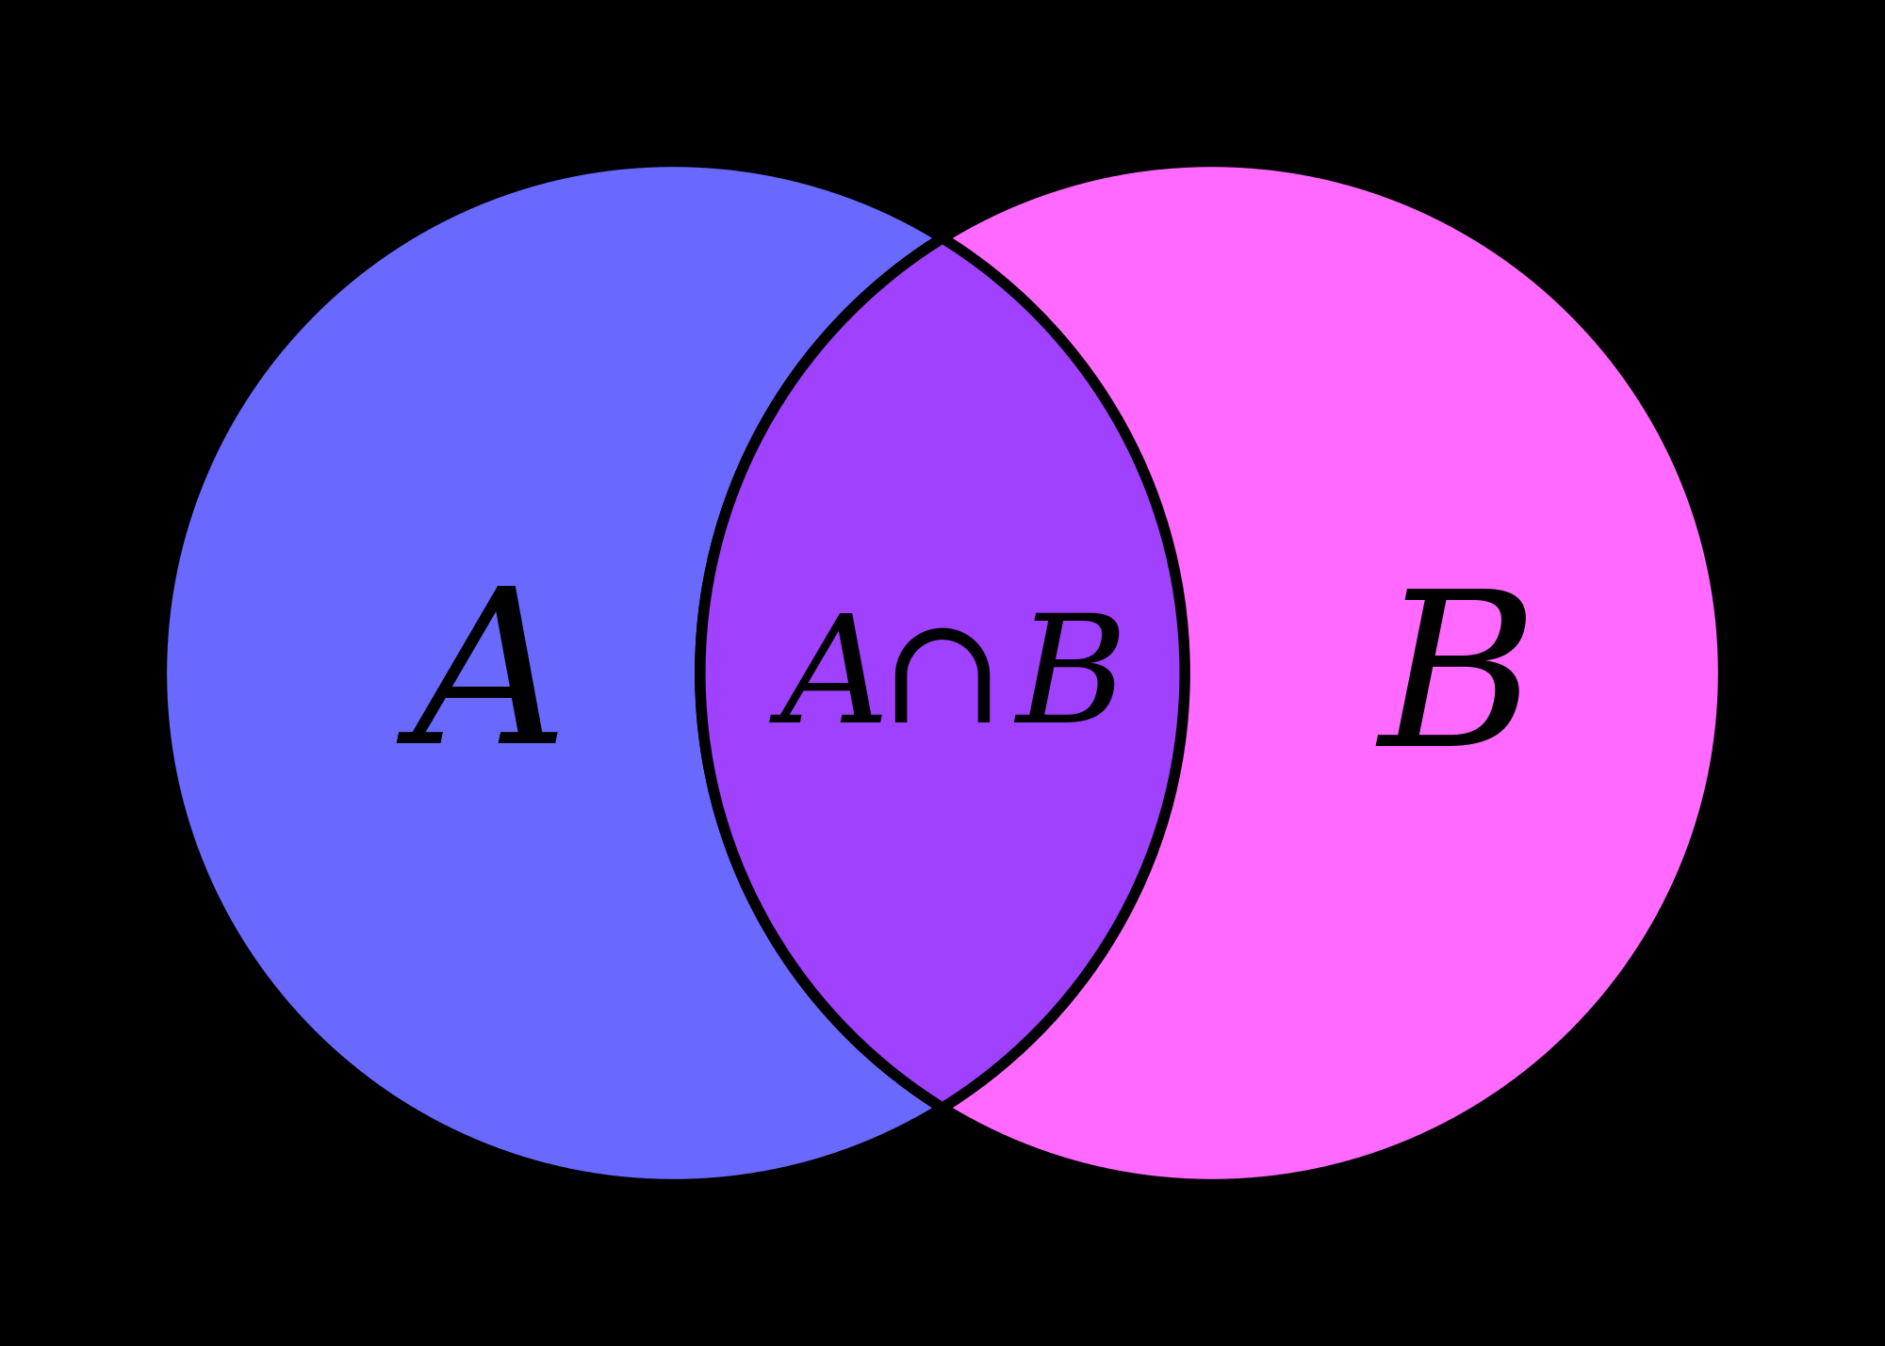
At a theoretical level
https://upload.wikimedia.org/wikipedia/commons/thumb/6/6d/Venn_A_intersect_B.svg/2000px-Venn_A_intersect_B.svg.png

Slide 7
A look at Hyland
Writing as a Social Activity. (Hyland, 2002)
Academic English is not a “unitary mass”, instead a set of “subject specialisms” (Hyland, 2002:p.388)
That “weak students need to control core forms before moving onto specific ….features of language is not supported by research into SLA” (Hyland, 2002 p.388)
“The communicative demands of the modern university, much like the modern workplace involve far more than simply controlling linguistic error or polishing style” Hyland (2007);p.2

Slide 8
But
As Hyland (2007) admits (p.14) there is a key set of linguistic features, which allows us to even use the term ‘Academic discourse”
He then cites the growing body of research into subject specific discourse.
“Placing specificity at the heart of of EAP’s role means that teachers are less likely to focus on decontextualized forms”- p.14

Slide 9
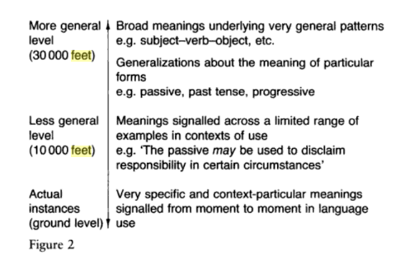
An older metaphor (Batstone 1994, p.12)

Slide 10
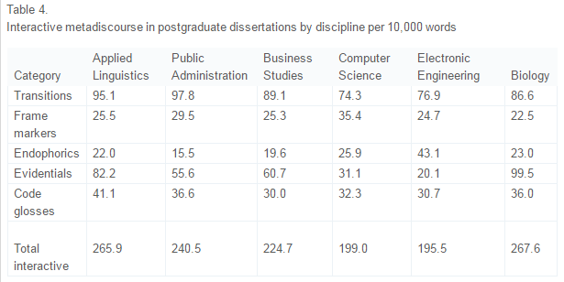
From Hyland and Tse (2004)

Slide 11
From Hyland and Tse (2007)
“Similarly, analyze appears to be used differently across fields. In the social sciences, it tends to occur more regularly as a noun, while in engineering, students are six times more likely to come across the form analytical. There are also semantic differences. The word analysis, for instance, is often associated with particular types of approach, so that it appears in discipline-specific compound nouns such as genre analysis or neutron activation analysis. The verb form also has field-specific meanings. In engineering, it tends to refer to methods of determining the constituent parts or composition of a substance …., and in the social sciences it tends to mean simply considering something carefully”
Hyland and Tse (2007)

Slide 12
Compared to...
In this modern era of technology….
Everybody knows…
Research proves that...
(Anecdotal)

Slide 13
For these students...
Do they need Academic Discourse at 30,000 feet or 10,000 feet?
Is it helpful to discuss the disciplinary specific nuances of hedging? Or should we be introducing and exploring the concept as a whole?
Is it helpful to discuss the nuances of the word “Analyse”, when students struggle to understand the parts of speech of this word.

Slide 14
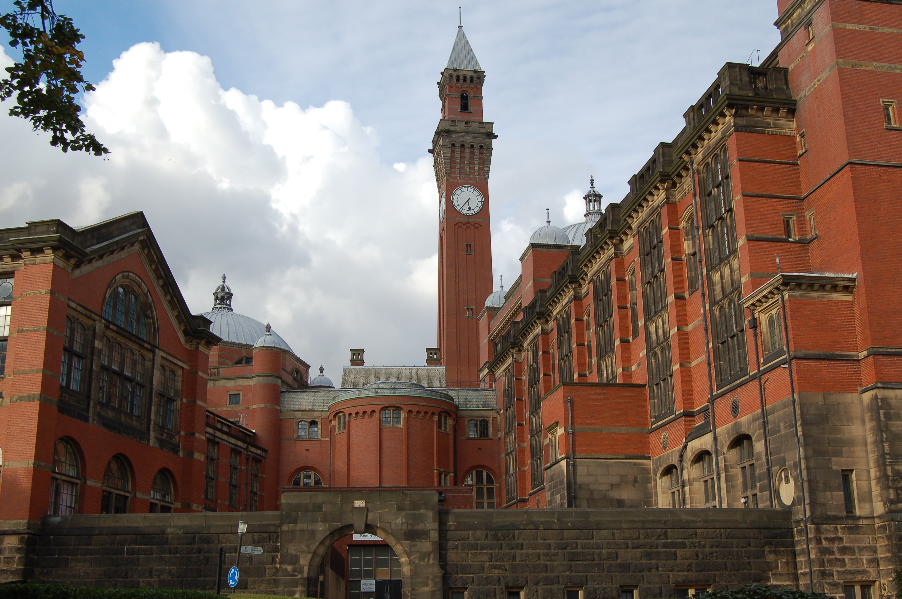
At an institutional level
http://events.cs.bham.ac.uk/turing12/pictures/big/AstonWebb2.JPG

Slide 15
Does a foundation year have an overarching purpose?
Gatekeeping?
Recruitment and retention?
Managing students’ transitions into HE?

Slide 16
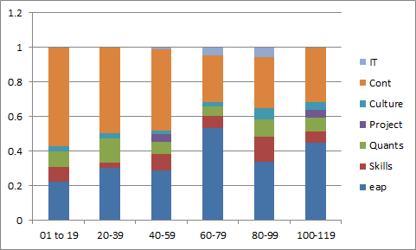
Foundation module structures.
Based on an online survey of foundation for business courses- December 2015

Slide 17
Alongside this…
IELTS Entry Requirements for foundation courses
4.5 | 17
5 | 10
5.5 | 17
6 | 4

Slide 18
A personal brainstorm of what the EAP side of foundation courses needs to achieve.
Time management | Grammatical accuracy | Organisation of text | Listening skills | Notemaking skills | Planning | Review and reflection
Essay planning | Citation and reference skills | Hedging and boosting | Reading skills | Synthesis | Intercultural awareness | Descriptive writing
Analytical writing | Introductions and conclusions | Personal development | Academic integrity | Summary | Understanding nuance | Dealing with institution
Sub technical vocabulary | Understanding difference | Dealing with issues | Constructing argument | Presentation Skills | Fruitful discussion skills | Exam skills

Slide 19
Which raises some questions
Do we have space in our courses to add another aspect?
Are we running the risk of putting our students into intellectual silos?
How do we ensure that our students are not marginalised as they progress through their degrees?
Can we not exploit the fact that students are spending half their academic lives being taught the very subjects that we are preparing them for?

Slide 20
At a global level
https://encrypted-tbn2.gstatic.com/images?q=tbn:ANd9GcRLP0fuMy3qWgit3e5skNOsBylKsX2pLV_2RaeQOYpvrsFWEU0hqQ

Slide 21
On a global level
What is the point of education? What are we doing?
We are working with international students in an internationalised education system (Mighty, 2014)
Are we here to further the career goals of the children of the extant elite?

Slide 22
Two answers
“the strategic role of international academic cooperation in globalizing solidarity among nations and establishing a true global citizenry” (Gacel-Ávila, 2005, p,133)
From the HEA “preparing 21st century graduates to live in and contribute responsibly to a globally interconnected society” (HEA, 2014)
To boil it down…..
“Global citizenship”- (Oxley and Morris, 2013)

Slide 23
So what does “citizenship” mean?

Slide 24
Conception | Key theorists (contemporary proponents) | Focus, key concepts
Cosmopolitan types
Political global citizenship | Kant; Rawls (Held; McGrew; Linklater; Carter; Archibugi; Wendt) | A focus on the relationships of the individual to the state and other polities, particularly in the form of cosmopolitan democracy
Moral global citizenship | Stoics; Kant; Sen; Nussbaum (Osler and Starkey; Veugelers; Cabrera) | A focus on the ethical positioning of individuals and groups to each other, most often featuring ideas of human rights
Economic global citizenship | Hayek; Friedman; Smith; Quesnay; Bowen (Carroll and Shabana; Waddock and Smith; Logsdon and Wood) | A focus on the interplay between power, forms of capital, labour, resources and the human condition, often presented as international development
Cultural global citizenship | J. S. Mill; Nietzsche (übermensch) (He; Brimm; De Ruyter and Spiecker) | A focus on the symbols that unite and divide members of societies, with particular emphasis on globalisation of arts, media, languages, sciences and technologies
Advocacy types
Social global citizenship | Habermas (communicative rationality) (Falk; Cogan and Derricott) | A focus on the interconnections between individuals and groups and their advocacy of the ‘people’s’ voice, often referred to as global civil society
Critical global citizenship | Escobar; Said; Gramsci; Marx; critical pedagogy (for example, Freire) (Andreotti; Tully; Shultz) | A focus on the challenges arising from inequalities and oppression, using critique of social norms to advocate action to improve the lives of dispossessed/subaltern populations, particularly through a post-colonial agenda
Environmental global citizenship | Enviro-scientific research (Dobson; Richardson; Jelin) | A focus on advocating changes in the actions of humans in relation to the natural environment, generally called thesustainable development agenda
Spiritual global citizenship | Danesh; religious texts (Noddings; Golmohamad; Lindner) | A focus on the non-scientific and immeasurable aspects of human relations, advocating commitment to axioms relating to caring, loving, spiritual and emotional connections

Slide 25
Conception | Key theorists (contemporary proponents) | Focus, key concepts
Cosmopolitan types
Political global citizenship | Kant; Rawls (Held; McGrew; Linklater; Carter; Archibugi; Wendt) | A focus on the relationships of the individual to the state and other polities, particularly in the form of cosmopolitan democracy
Moral global citizenship | Stoics; Kant; Sen; Nussbaum (Osler and Starkey; Veugelers; Cabrera) | A focus on the ethical positioning of individuals and groups to each other, most often featuring ideas of human rights
Economic global citizenship | Hayek; Friedman; Smith; Quesnay; Bowen (Carroll and Shabana; Waddock and Smith; Logsdon and Wood) | A focus on the interplay between power, forms of capital, labour, resources and the human condition, often presented as international development
Cultural global citizenship | J. S. Mill; Nietzsche (übermensch) (He; Brimm; De Ruyter and Spiecker) | A focus on the symbols that unite and divide members of societies, with particular emphasis on globalisation of arts, media, languages, sciences and technologies
Advocacy types
Social global citizenship | Habermas (communicative rationality) (Falk; Cogan and Derricott) | A focus on the interconnections between individuals and groups and their advocacy of the ‘people’s’ voice, often referred to as global civil society
Critical global citizenship | Escobar; Said; Gramsci; Marx; critical pedagogy (for example, Freire) (Andreotti; Tully; Shultz) | A focus on the challenges arising from inequalities and oppression, using critique of social norms to advocate action to improve the lives of dispossessed/subaltern populations, particularly through a post-colonial agenda
Environmental global citizenship | Enviro-scientific research (Dobson; Richardson; Jelin) | A focus on advocating changes in the actions of humans in relation to the natural environment, generally called the sustainable development agenda
Spiritual global citizenship | Danesh; religious texts (Noddings; Golmohamad; Lindner) | A focus on the non-scientific and immeasurable aspects of human relations, advocating commitment to axioms relating to caring, loving, spiritual and emotional connections

Slide 26
According to Hadley (2014, p.26)
HE is a balance between two ideals
“The scholarly ideals of Wilhelm von Humbolt, in which scholars link their research interests to instruction…….[students] are steeped in both the academic knowledge and cultural ideals necessary for contributing to the nation state”
“ Providing the knowledge and vocational skills need for economic development”
“The goal has shifted towards producing graduates who have the mental ability to learn quickly and serve the needs of the global market”

Slide 27
Coming back to foundation courses
Students have access to rich, subject specific discourse
Is it our job to teach to teach the students strategies to build their own lexicons
Teaching how to write MLA references to how to identify the features of a referencing system
This goes beyond lexis, including ideas of metadiscourse

Slide 28
Strategies could include.
Using lextutor and the like to analyse their own output
Rigorous (possibly assessed) strategies for recording subject specific vocabulary
Building an understanding of “smaller cultures” within the university (Connor, 2011)
Encouraging students to explore the myriad of tool available to them (word clouds, quizlet) and use them in informed and disciplined ways.

Slide 29
To conclude
By focussing on a subject specific vocabulary, we are running the risk of placing our students into intellectual silos
We should be equipping them with the skills to build their own lexicon, and their own mastery of subject specific styles
The need for further research comparing EGAP and ESAP at foundation level
The transition into higher education should be about opening out, not closing in.

Slide 30
References
Gacel-Ávila, J. (2005) ‘The Internationalisation of Higher Education: A Paradigm for Global Citizenry’ Journal of Studies in International Education 9(2) pp 121-136 DOI: 10.1177/1028315304263795
Bastone, R. (1994) Grammar. Oxford. Oxford University Press
Connor, U (2011) Intercultural Rhetoric in the Writing Classroom Ann Arbor: The University of Michigan Press
Mighty, L (2014) ‘Internationalisation: Differing Interpretations and Associated Student Experience Implications’ International Stduent Expereinece Journal. 2(1)
Hadley, G. (2014) English for Academic Purposes in Neoliberal Universities: A Critical Grounded Theory. London: Springer
Hyland, K (2006). English for academic purposes : an advanced resource book London: Routledge
Hyland, K and Tse, P. (2007) ‘Is there an ‘Academic Vocabulary’ TESOL Quarterly, 41 (2). pp. 235-253. ISSN 0039-8322
Hyland, K. and Tse, P (2004) Metadiscourse in Academic Writing: A Reappraisal Applied Linguistics (2004) 25 (2):156-177
Hyland, K. (2002). ‘Specificity revisited: how far should we go now?’ English for Specific Purposes. 21 (4): 385-395. doi:10.1016/S0889-4906(01)00028-X
Higher Education Academy (2014) ‘Internationalising higher education framework’ [Online] https://www.heacademy.ac.uk/internationalising-higher-education-framework [06 June 2014)

