Slide 1
Write on the edge: using corpus-based teaching activities to support student writing in unfamiliar genres
Megan Bruce and Simon Rees
Durham University Foundation Centre
July 2016
Supported by the HEA, Royal Society of Chemistry and Durham University

Slide 2
Overview
Durham context
Why is corpus-based teaching particularly helpful?
How have we designed our corpus?
Chemistry project
Sport project
What are the next steps for the project?

Slide 3
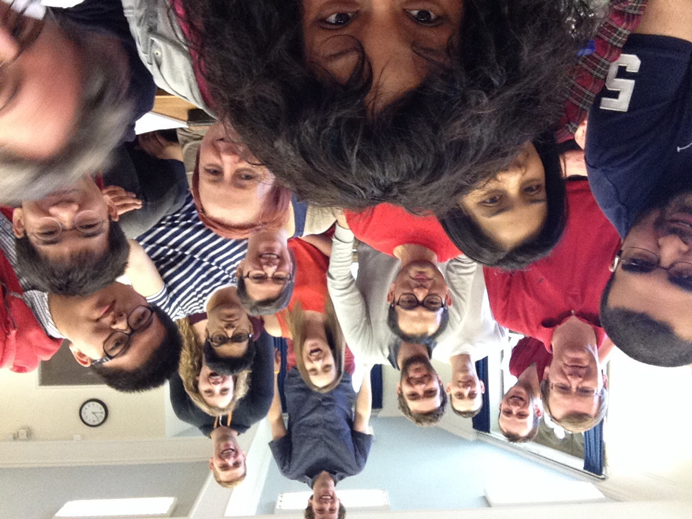
Widening participation and access to Higher Education.
Individuals who would traditionally not have considered studying at University and lack the required formal qualifications.
Over 200 students based at two campuses progressing on to all Durham undergraduate departments.
Around 2/3 local mature students and 1/3 international students.

Slide 4
FOCUS rationale
Students lack awareness of how best to learn new subject-specific vocabulary;
Students have confidence issues related to overt teaching of grammar;
Students needed to develop good self-study skills;
Students wanted self-access materials to use for revision.

Slide 5
The FOCUS project
A corpus of Durham student writings produced by UG/PG students across an increasingly broad range of disciplines e.g. Chemistry, Earth Sciences, Sociology, History, Sport, Criminology, Physics, Business, Theology.
Bespoke concordancer with deliberately simple interface.
It now contains well over 1 million words and figures.
Developing concordancing activities based on these corpora to allow students to discover more about target vocabulary/structures in context.
Supported by HEA, RSC and Durham University funding.

Slide 6
Data Driven Learning
A learning situation where “the language learner is also, essentially, a research worker whose learning needs to be driven by access to linguistic data – hence the term data-driven learning (DDL)”. (Johns 1991:2)
The learner uses data to uncover the rules behind the language while the teacher “provides a context in which the learner can develop strategies for discovery” (ibid).
Helps to develop criticality which is a crucial element of learning skills. Moves away from “single correct answer” towards understanding importance of patterns, alternatives and context. (Gabrielatos 2005)

Slide 7
Corpus-based dissertation support: Chemistry
Enhancing the Student Learning Experience grant to work with 2nd/3rd year Chemistry undergraduates
Final year Chemists have to write extended text for the first time in their UG studies for their dissertation assignment.
2 year project with production of self-study activities

Slide 8
The problem
Chemistry students are unused to producing extended texts
Chemistry staff are unused to explaining to students how to make their writing better
Single intervention workshops run by EAP specialists were not popular with students

Slide 9
The solution
EAP Session developed and run by Chemist and linguist
1st iteration: linguist runs the session and chemist watches
2nd iteration: chemist runs the session and linguist watches
3rd iteration: linguist develops online support materials and chemist runs the live workshops
Successful because linguistic input but delivered by a chemist

Slide 10
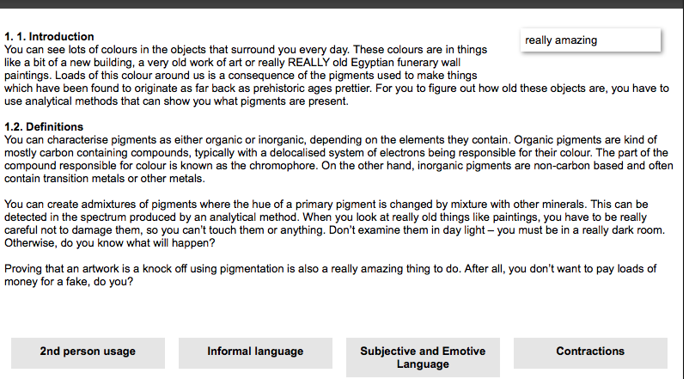
The activities
Online prelab diagnostic quiz and academic voice
Live workshop focusing on:
Reporting verbs
Nominalisation
Connectives
Punctuation

Slide 11
The feedback
“Nominalisation was new to me and a skill/tool I would like to
develop to give me the right tone.’’
‘‘[I would use it] to see if certain words I write are academically
acceptable.’’
‘‘It allows me to compare the language I am using to previous
work that has received a good mark. This is useful.’’
‘‘Useful to check whether [a] chosen word is common in
dissertation[s].’’

Slide 12
Chart showing student responses to the question ‘‘How useful did you find the activities?’’

Slide 13
Would you be likely to access the corpus yourself outside the classroom?

Slide 14
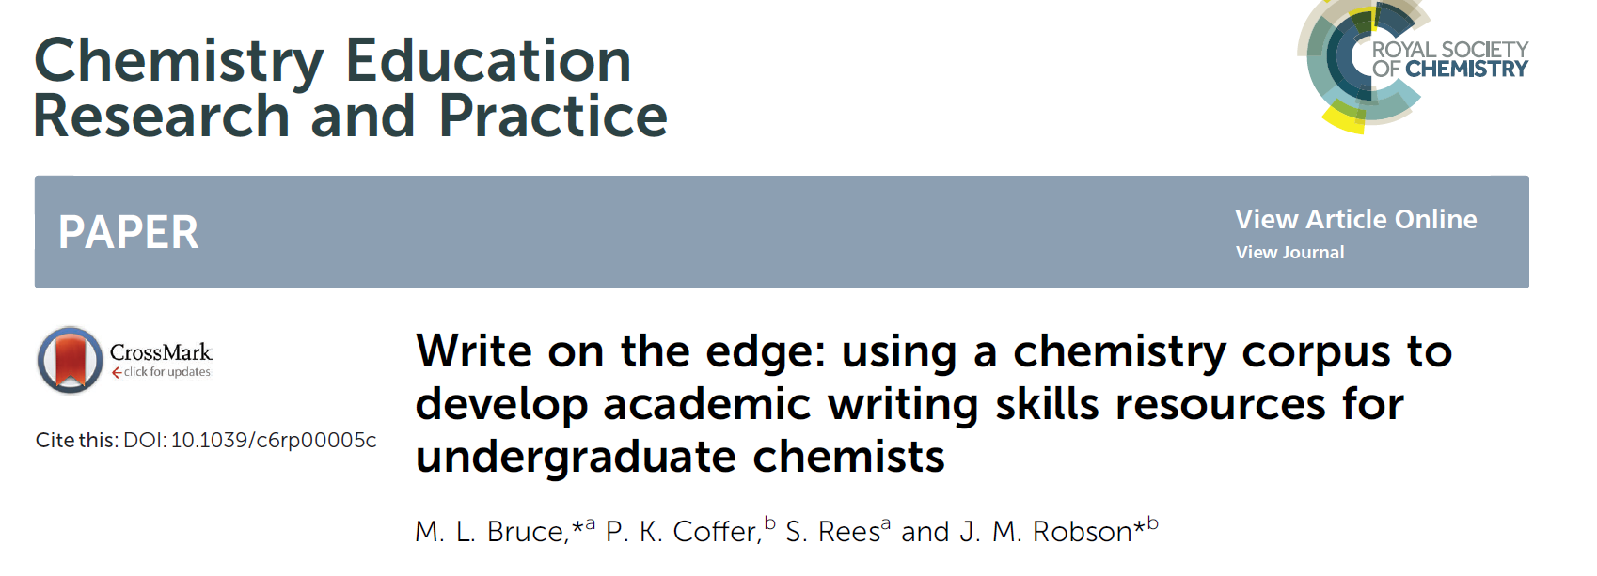

Slide 15
The next stage: Sport lab reports
After the success of the Chemistry project, we obtained a larger grant to roll out our work across more departments
Students studying BA Sport, Exercise and Physical activity need to write a summative lab report in their first year Physiology module.
Students on this programme have not necessarily taken science A-level subjects and thus are inexperienced at writing lab reports.

Slide 16
The problem and context
Students are unsure how to write a lab report due to their lack of experience of this genre.
Key problems are:
Weak hypothesis
Poor referencing
Inability to link literature review and discussion section
Inaccurate terminology
Physiology tutor delivers a 50 minute lecture about lab report structure in November, then students produce a formative in December and a summative in March.
As with Chemistry, staff in Sport can see that the lab reports aren’t correct in terms of language, but are unsure how to help.

Slide 17
The solution
Corpus team attended lab report lecture in November.
Ran focus group in November to assess attitudes to assignment.
Studied formative drafts in January to spot key issues.
Ran a corpus workshop in February before summative deadline.
Studied summative drafts to see what had changed.
Turning activities into online support materials for next year.

Slide 18
The activities
Based on issues identified in the formative lab reports, the workshop that we ran to help students prepare for their summatives focused on the following areas:
Formality
Use of literature
Nominalisation
Scientific terminology

Slide 19
Formality
Students explored formative lab reports for language identified as informal
Corpus searches for these terms identified that they were not present in large numbers in the corpus data
Students brainstormed alternative words/phrases
Corpus searches for these revealed greater frequency
Key areas were highlighted:
Use of 1st person (I/me)
Sensational vocabulary/punctuation (This experiment was amazing!!!)
Use of direct questions (So why did we check their blood pressure?)
Vague language (We used a lot of things for this experiment)
Contractions (isn’t, doesn’t, weren’t)
Informal vocabulary/slang

Slide 20
Use of literature
Formative drafts highlighted that students were not using reporting verbs (e.g. claims, suggests, refutes), but only giving a reference at the end of a sentence: e.g. Random physiology fact (Smith 2015)
Corpus searches for words occurring before “that” created a brainstorm of reporting verbs, and then students completed an exercise exploring the different meanings/uses of the verbs
Students understood the link between using reporting verbs and interacting critically with the literature
Do the summatives show increased usage of reporting verbs?

Slide 21
Nominalisation
Students searched the corpus for various noun and verb forms to ascertain that noun forms are more commonly used in academic writing.
Students completed sentence transformations to illustrate the effect of nominalisation (linked with features of formal writing previously identified).
Rated highly in questionnaire as a useful activity.

Slide 22
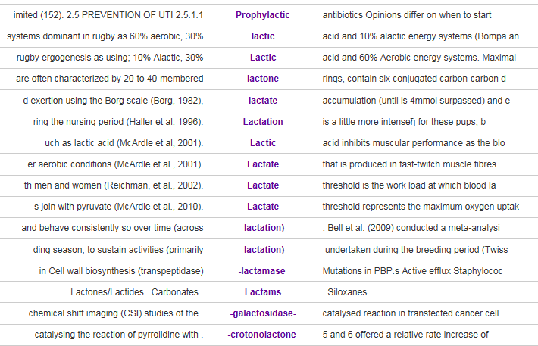
Terminology
Corpus used to improve understanding of key subject specific terminology.
Use and meanings of words explored in context e.g. saturated, contractility.
Common roots of words explored e.g. lactate, lactic acid, alactate

Slide 23
Feedback

Slide 24
Next stages
Continuing to disseminate the project to other departments.
Interest from Education, Psychology and Master of Social Work.
Continuing to add texts to the corpus.
Developing the range of online activities.
.

Slide 25
Acknowledgements
Our thanks to the HEA and Durham University and the Royal Society of Chemistry for financial support and the Foundation Centre, Durham University for enabling us to pursue this project.
We would be interested to hear from colleagues in other institutions that would like to explore the development of activities to support subject specific language understanding with their students.
Contact: Megan Bruce (megan.bruce@durham.ac.uk)
Simon Rees (simon.rees@durham.ac.uk)

