Slide 1
The application of corpora: supporting and informing the pedagogic landscape
Dawn Knight, Cardiff University

Slide 2
Contents
Definitions
Corpus design
Who uses corpora?
Challenges for DDL
The importance of visualisation
Case study: WordWanderer
Case study: CorCenCC
Summary

Slide 3
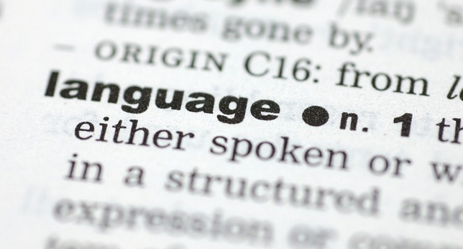
1. Definitions
‘A corpus is a collection of pieces of language text in an electronic form, selected according to external criteria to represent, as far as possible, a language or language variety as a source of data for linguistic research’ (Sinclair, 2005).

Slide 4
1. Definitions
Two common research goals in CL enquiry:
1. To describe the variants and use of a linguistic structure (e.g. modal verbs, that-clause)
2. To describe differences among texts and texts varieties (e.g. registers or dialects)

Slide 5
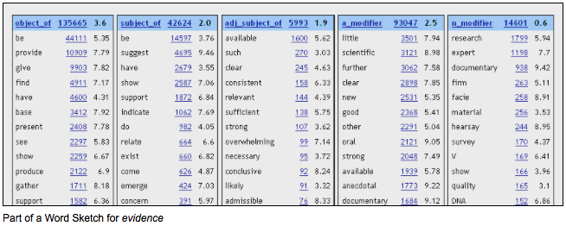
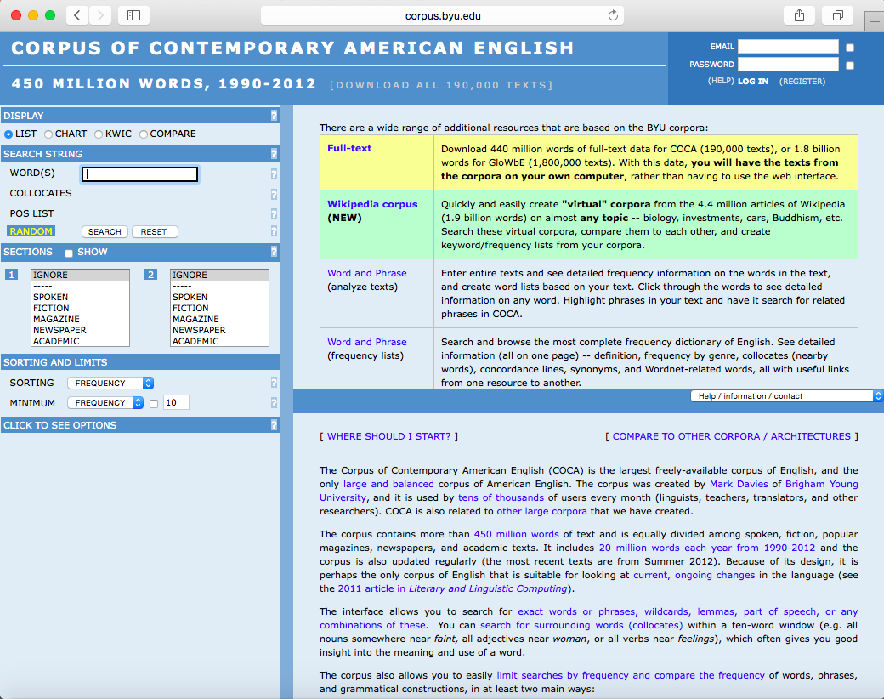
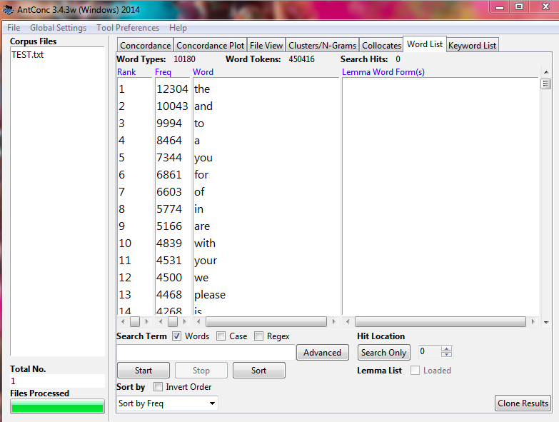
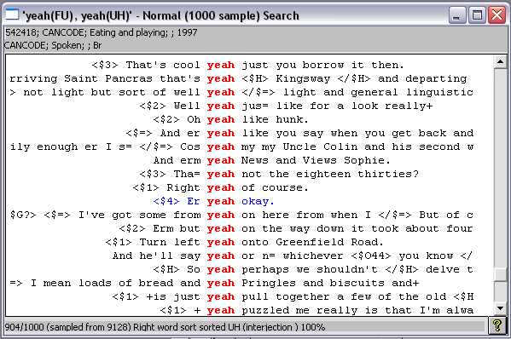
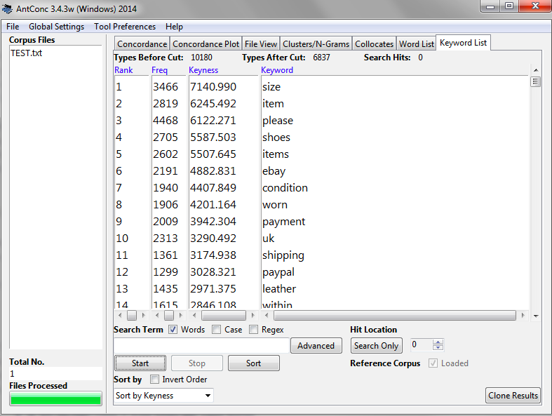
1. Definitions
Methods/tools for analysis
Search and sort tool
Word frequency lists
KWIC (Key Word in Context) concordancers
Collocation tools
Statistical testing facilities
Key word analysers
Word sketches
Tools/methods depend on the questions being asked

Slide 6
2. Corpus design
3 designs for corpora (Biber, 1993: 244) :
Text production - individuals selected from a demographic population and are tracked/language recorded
Text reception - those texts listened to or read (more about exposure)
Texts as products - designed to represent the range of texts rather than the typical patterns of use of various demographic groups

Slide 7
2. Corpus design
General
Comparable
Parallel
Learner
Monitor
Diachronic or historical
Specialised (or specialist/specific)
Design depends on the questions
being asked – balance required
Notes:
EAP

Slide 8
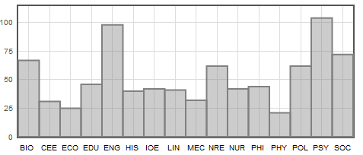
2. Corpus design
MICASE – Michigan Corpus of Academic Spoken English. 152 transcripts, 1,848,364 words (1997-02).

Slide 9
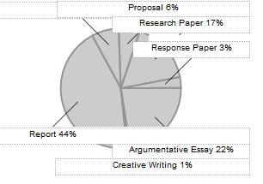
2. Corpus design
Notes:
Design determines what sort of questions that we can ask of a corpus

Slide 10
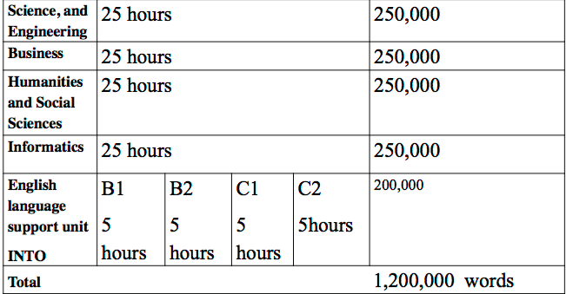
2. Corpus design
NUCASE – Newcastle University Corpus of Academic Spoken English
Specific questions can be answered – how transferable/generalisable are these?

Slide 11
3. Who uses corpora?
Lexicographic, lexical and grammatical studies
Register variation/genre analysis
Dialect distinction/language variety
Contrastive/translation studies
Diachronic study and language change
Semantics
Pragmatics
Sociolinguistics
Discourse analysis
Stylistics
Forensic Linguistics
Language learning and teaching

Slide 12
3. Who uses corpora?
Lexicographic, lexical and grammatical studies
Register variation/genre analysis
Dialect distinction/language variety
Contrastive/translation studies
Diachronic study and language change
Semantics
Pragmatics
Sociolinguistics
Discourse analysis
Stylistics
Forensic Linguistics
Language learning and teaching
The ways in which corpora are used will vary depending on the user group…and the specific questions being asked...

Slide 13
3. Who uses corpora?
Language tester
Lexicographer/ Grammarian
Syllabus
writer
Researcher
CORPUS
Materials writer
Teacher
Learner
Taken from Thompson,
2006
Notes:
For ELT specifically

Slide 14
3. Who uses corpora?
Language tester
Lexicographer/ Grammarian
Syllabus
writer
Researcher
CORPUS
Materials writer
Teacher
Learner
Taken from Thompson,
2006
Notes:
For ELT specifically

Slide 15
3. Who uses corpora?
Language tester
Lexicographer/ Grammarian
Syllabus
writer
Researcher
CORPUS
Materials writer
Teacher
Learner
Taken from Thompson,
2006
Notes:
For ELT specifically

Slide 16
3. Who uses corpora?
Language tester
Lexicographer/ Grammarian
Syllabus
writer
Researcher
CORPUS
Materials writer
Teacher
Learner
Taken from Thompson,
2006
Notes:
For ELT specifically

Slide 17
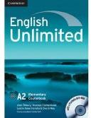
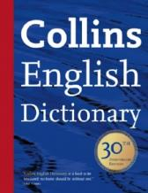
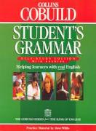
3. Who uses corpora?
Indirect uses of corpora
Input into language and teaching contexts
Selection (from corpora)
Progression (in the course)
Presentation (in materials)
E.g. dictionaries, vocabulary teaching materials, corpus-based grammars

Slide 18
3. Who uses corpora?
Direct uses of corpora
Impacting on the ‘how’ of teaching
More autonomous (DDL)
Involving teachers and students directly
Teaching about
Teaching to exploit (‘every student is a Sherlock Holmes’ – Johns)
Exploiting to teach

Slide 19
4. Challenges of DDL
DDL often involves learners working with a corpus.
DDL is ‘necessarily inductive: learners inspect the evidence and look for patterns in the data from which they can form generalisations’ (Thompson, 2006: 10)
In DDL students may work with a teacher to solve a problem or work directly with corpora to investigate language problems themselves.
Multifunctional – helps to develop self-study skills.

Slide 20
4. Challenges of DDL
Essential to develop students’ understanding of field-specific terminology.
Coxhead’s Academic Word List (AWL, 2000) was an early example of this - consisting of the 550 most frequently occurring word families from academic texts.
Specialist corpora can be used to develop word lists and targeted pedagogic resources.

Slide 21
4. Challenges of DDL
Frequency and implementation of DDL methods – what is the ‘right way’ to do things?
Notes:
Detail and accessibility – removing tags and making things easier

Slide 22
4. Challenges of DDL
Common question in Applied Linguistics…(Fitzpatrick, 2016)
Which method works best, then?
Which is the right theory?
Notes:
How can we teach corpus literacy?

Slide 23
4. Challenges of DDL
We don’t know!
It depends!
None of them!

Slide 24
4. Challenges of DDL
Post-method era: ‘What we have now is not answers or solutions but a rich array of realisations and perspectives’ (Canagarajah 2006)
Compounded by the existence and ubiquity of modern technology…while there is a general understanding that new technologies play an increasingly important role in teaching and learning environments, how to integrate and make the best use of technology to enhance learning, and how to maximise learning opportunities through existing technologies is an ongoing challenge.

Slide 25
4. Challenges of DDL
Frequency and implementation of DDL methods – what is the ‘right way’ to do things?
Accounting for individual diversity…
Providing level-appropriate input [e.g. VocabProfile]
Sustaining motivation to engage
with materials
Promoting self-study and enquiry
Balance detail with accessibility
Notes:
Detail and accessibility – removing tags and making things easier

Slide 26
4. Challenges of DDL
Individual diversity – an alternative approach (e.g. Hall, 2011)
WHO are the learners?
Age, aptitude, personality, gender
HOW do they approach learning?
Motivation, beliefs, learning styles
WHERE are they (from)?
Culture, L1, learning background, social identity

Slide 27
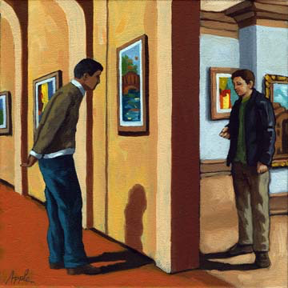
4. Challenges of DDL
Language tester
Lexicographer/ Grammarian
Syllabus
writer
Researcher
CORPUS
Materials writer
Teacher
Learner
Taken from Thompson,
2006
Notes:
Collaboration is key
Impact case study

Slide 28
5. The importance of visualisation
Linking software to methodology. Squaring the circle between users and stakeholders at all levels (collaboration).
Availability and utility of software impacts on users at all levels (in a variety of ways).
Limitations in current visualisations – referencing specific forms of information over others.

Slide 29
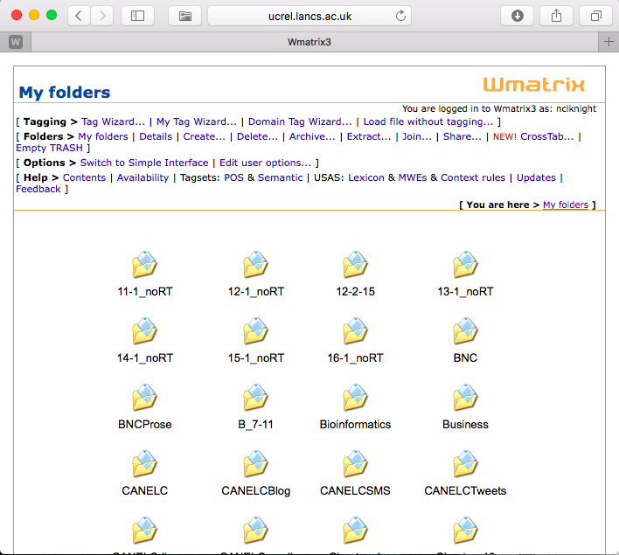
5. The importance of visualisation
Are existing tools:
Engaging?
Intuitive?
Logical?
Functional?
Perhaps we need to reimagine visualations – in consultation with all user groups.
Notes:
They are reliable etc…
We know what to do with them...perhaps we need to flip this

Slide 30
6. Case study: WordWanderer
WordWanderer is a prototype visualization technique that extends tag clouds into a navigational interface for text.
WordWanderer supports the gradual movement between word context views, which represent the words co-occurring in the proximity of the selected word, and word-comparison views, which arrange words based on their association strengths between two selected words.
Pilot study – thanks to Ian Cushing.

Slide 31
www.wordwanderer.org

Slide 32
6. Case study: WordWanderer
Go to http://wordwanderer.org/
Copy and paste the text from The Withered Arm into the software
You will now see the text as a ‘word cloud’. The larger the word, the more frequently it appears.
Try clicking on a word, for example Gertrude. This will bring up a number of things – other words associated with that word (the closer they are to the original, the more commonly they are juxtaposed with it, known as the collocates)
You can draw lines between two words to compare them. For example, try linking Gertrude and arm to see how different words are linked with them.
Press escape to return to the original word cloud

Slide 33
6. Case study: WordWanderer
Look at the ‘homepage’ of the Withered Arm corpus. What immediately strikes you about the most frequently used words?
The most frequently used words normally have a bigger size than the less frequent words. They are bigger because they are more important to the story and they tell us a bit about the word we choose. For example if you click on Gertrude it will give the word arm in big because she has a withered arm and it describes her.

Slide 34
6. Case study: WordWanderer
What kind of collocates does arm bring up? What kinds of words are these, and why do you think Hardy chose to modify arm in these ways?
The word arm brings up collocates such as ‘left’. These words appear because they have appeared in the same sentence as the word arm. I think Hardy chose to modify arm this way because taking back the example left, I think he used it to describe the arm and to say the withered arm is on the left arm of Gertrude.

Slide 35
6. Case study: WordWanderer
Choose 5 or so verb processes that you think indicate a sense of ‘drama’ – for example seized or struck. Explore them in further detail, looking at their collocates and which characters they are associated with.
LINGER: The word linger is used for Gertrude, because in the story Gertrude’s name seems to always come up in every chapter.
PRESSURE: The word pressure is used for Lodge, because he always pressures his wife to be beautiful and to give him a son.
INQUIRED: The word inquired is used for Lodge, because Mrs Lodge always asks questions about how to cure her withered arm.
BREATH: The word breath is used for Rhoda, because Rhoda is a human and in order to live she needs to breath.
OVERLOOKS: The word overlooks is used for Rhoda, because she at the beginning of the book always overlooks the new wife of Farmer Lodge.

Slide 36
6. Case study: WordWanderer
Explore how Hardy uses language to create a ‘text world’. Choose 5 or so nouns that you think are related to location – for example heath. Explore the collocates and see what words are compared with these. What kind of world does Hardy create?
ANGLEBURY: The word Anglebury is used to describe a location because it is a village next to where Rhoda lives.
VILLAGE: The word village describes the location, because the word village itself means a place where people live; he creates an image of whether it is a big or small town.
HEATH: The word heath describes the location, because it creates an image for the writer. Rather than writing a field it givesus the information that the field is wild and not taken carte of.
TOWN: The word town describes the location, because a town is a place and it is used very often, because it would be boring to always use village.

Slide 37
6. Case study: WordWanderer
What did/didn’t you like about using Word Wanderer to explore the text?
We liked WordWander for how precise it was. It also spots the patterns for you.
We really enjoyed using Word Wanderer as it helped us to explore beyond just the meaning of the word, but instead its character. We also found it fascinating looking at one word from four separate dimensions to help us to understand the text in much more detail.
But there could be a better use of colours!!!!!!!
And no words on top of each other!!!
And give definition of the word!!

Slide 38
6. Case study: WordWanderer
Do you think Word Wanderer allows you to explore language in ways that you wouldn’t be able to without the software? How does it do this?
Yes. It does that by clicking on a word it gives you other words and it expands your vocabulary. Without the software we wouldn’t be able to analyse how often each word is used in the story, because the bigger the word the more frequently the word is used.

Slide 39
6. Case study: WordWanderer
Evaluation and further development are required (scope for future collaboration). Some possible developments (from Ian Cushing):
Creating a series of connected lessons which examine different aspects using the tool
Reframe the questions/guidance so there's a bigger emphasis on whole text cohesion and structure, to avoid them looking at the connotations and collocates of individual words. This could be done by comparing two chapters, for example, or by investigating a particular character/event/location across the whole novel. I'll need to teach the whole novel before we do this though, ideally!
I think we are aiming to discover how using corpus linguistics might lead students to ways of thinking / interpretations that they may not have come to otherwise, and how WW specifically can be very easily used as a pedagogical tool
We then need some way of 'measuring' the outcomes - could be a straightforward thematic analysis of their own writing; student interviews/perceptions, etc.
Some channel for sharing all the work we've/they've done!

Slide 40
7. Case study: CorCenCC
User-driven corpus design and construction

Slide 41
7. Case study: CorCenCC
CorCenCC: Corpws Cenedlaethol Cymraeg Cyfoes - The National Corpus of Contemporary Welsh: A community driven approach to linguistic corpus construction
Open-access and freely available 10 million word corpus of Welsh language
Inter-disciplinary – Computer Science, Applied Linguistics and Education

Slide 42
7. Case study: CorCenCC
First large-scale, freely available corpus of Welsh language
First semantic tagger of Welsh, novel part-of-speech tagset
First Welsh corpus to test community crowdsourcing (via an app) for data collection
User-defined corpus, integrating traditional corpus tools with bespoke applications (e.g. the pedagogic toolkit)
Future-proofed: in-built sustainability via an online repository system
Building capacity in applied linguistics
research in Wales
Model of corpus construction for
under-resourced languages
Notes:
Impact will be generated through a user-informed design, so that basic corpus functionalities for the querying of language use can be integrated into a bespoke toolkit for teachers and learners (within this project) and interface specifications for other user groups beyond the project.

Slide 43
7. Case study: CorCenCC
Key work packages:
1: Collect, transcribe and anonymise the data
2: Develop the part-of-speech tag-set/tagger
3: Construct semantic annotation software and tagset
4: Scope/construct the online pedagogic toolkit
5: Construct infrastructure to host CorCenCC and build the corpus
www.lextutor.ca/

Slide 44
7. Case study: CorCenCC
The development of an online pedagogic toolkit will augment the standard corpus querying functionalities. This will work directly with the data to support language teaching and learning, and, specifically, to help improve vocabulary knowledge and reading/writing skills in Welsh.
This toolkit will include a vocabulary profiler (enabling the grading of text produced for, and by, the learner), exercise builder, and interactive language practice, and the repository system will also support the creation and sharing of activities and resources by users.
www.lextutor.ca/

Slide 45
7. Case study: CorCenCC
The pedagogic toolkit:
Support language teaching and learning, and, specifically, help improve vocabulary knowledge and reading/writing skills in Welsh.
Frequency based (pedagogic) word lists
A vocabulary profiler (enabling the grading of text produced for, and by, the learner)
Grammar and semantic tasks
Exercise builder
Interactive language practice
www.lextutor.ca/

Slide 46
7. Case study: CorCenCC
Repository system for the creation and sharing of activities and resources by users.
Aims to support students in learning aspects of grammar and vocabulary from GCSE/Canolradd level through to Hyfedredd/HE level and beyond.
Guidelines for a revised pedagogically-informed approach to inductive learning using corpora (including outline for ‘best-practice’ and how to facilitate ‘learning’ using corpora) will be produced.
Notes:
Say it also has semantic tools
online corpus-based multi-user pedagogic tools
integrated with WP5 tools
KWIC (Key Word in Context) concordancers
collocation tools
search and sort tool
word frequency lists
key word analysers
statistical testing facilities
search for and replay audio files
visualise data
provide
a blueprint for the development of corpus toolkits for other user groups (e.g. translators, publishers, new researchers) beyond the life of this project
based on
theory of DDL
Compleat Lexical Tutor
serve as basis for
tagset information (needs of pedagogic toolkit informs tagset development)
documentation
roadshows/workshops

Slide 47
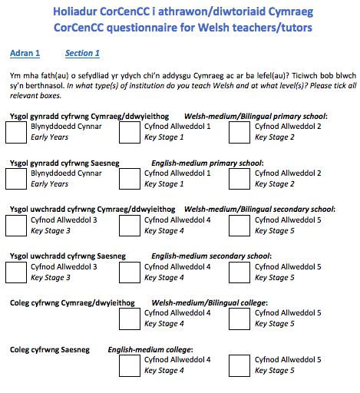

Slide 48
8. Summary
Where next for DDL? How can if the specific task, tools and strategies that we use ‘work’? (more longitudinal studies needed?)
To what extent autonomy needs to be scaffolded? Can we use developments in visualisation to help?
Collaboration is key in methods and tool development – how can we enhance this? How can we best share expertise, resources and good practice? Let’s keep talking…

